Slide 1
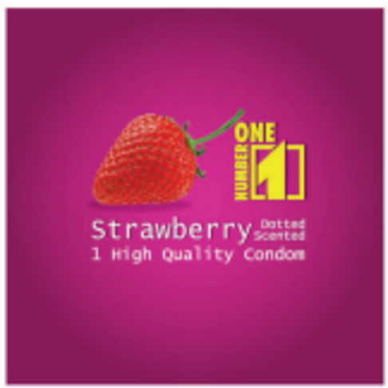
Condom Social Marketing with 8.5 million condoms “Number ONE” brand to be sold
Centre for HIV/AIDS and STI/National AIDS Program

Slide 2
8.5 million # One Condoms to be sold
Procured via UNFPA from pre-qualified source, imported and stored at MPSC warehouse ban Xienda in July 2015.
Contract between PSI and DKSH, and validation of Contract 1 Sept -31 Dec 2015, with 3.2 million # One Condoms.
2 million # One condom already sold – 80,000 USD.
DKSH will send 1.2 million # One condoms back to PSI/CHAS (as per contract clause on expiration of contract).

Slide 3
Two meeting discussed on this issues
First Meeting on 7/01/2016, and
Second Meeting on 14/01/2016.

Slide 4
Issues and Payment for Storage
1.2 million # One Condoms to be returned by DKSH to PSI/CHAS
But MPSC warehouse has no space for storing at the moment.
The private warehouse contracted by DKSH costs US 300/month and about 3-6 months (900-1,800 US).
Request PR/GF to use current revenue from CSM slaes in 2015 for payment of interim storage fees to DKSH, and
New bidding and looking forward a new stocker/distributor soon (intend to be in place by April 2016).

Slide 5
Addition
Stepping up to a sustainable market for male condoms in Lao (TMA)
Need to be hand in hand with strict regulation to ensure commercial brands are of equal quality
ISO4074 standard/WHO Spec
Request CCM/GF to use the revenue from CSM for the testing of condoms for QA/QC,
Work with the FDD and UNFPA
sampling some brands in the market as “Rose, Touch, Sure, etc…” and send to Lab Singapore
Cost estimated about US 5,000.

Slide 6
FPM needs some more details (from PR), in principle accepted the proposed actions as reasonable and supportive to strengthen regulatory capacity
Request Excom to support our request to
Address current situation to get Nr One condom stock moved to market in 2016 with purpose that all stock will be sold by end 2017
Collaborate with FDD and obtain more Quality Assurance from marketed condoms in private sector as steps to TMA
Thanks

