Slide 1
Progress Update on RAI2E Malaria Grant
and
Arrangement for RAI3E Malaria Grant
CCM Vientiane, Lao PDR
9th February 2021

Slide 2
Coverage Indicator 1: LLINs continuous distribution
Target (Jan - Dec 2020) | Result (Jan - Dec 2020) | Achievement %
117,196 | 98,540 | 84%
Coverage Indicator 2: Testing in Public Sector
Target (Jul - Dec 2020) | Result (Jul - Dec 2020) | Achievement %
177,987 | 216,169 | 121%

Slide 3
Coverage Indicator 3: Testing in Community
Target (Jan - Dec 2020) | Result (Jul - Dec 2020) | Achievement %
49,011 | 60,702 | 124%
Coverage Indicator 4: Testing in Private Sector
Target (Jul - Dec 2020) | Result (Jul - Dec 2020) | Achievement %
30,954 | 37,468 | 121%
Notes:
Result against 2017

Slide 4
Coverage Indicator 5: % Treated in public sector
Target (Jul - Dec 2020) | Result (Jul - Dec 2020) | Achievement %
100% | 100% | 100%
Coverage Indicator 6: % Treated in the community
Target (Jul - Dec 2020) | Result (Jul - Dec 2020) | Achievement %
100% | 99% | 99%
Coverage Indicator 7: % Treated in the private sector
Target (Jul - Dec 2020) | Result (Jul - Dec 2020) | Achievement %
100% | 98% | 98%

Slide 5
Coverage Indicator 8: % health facilities with no stock-out
Target (Jul - Dec 2020) | Result (Jul - Dec 2020) | Achievement %
95% | 79% | 83%
Coverage Indicator 9: % cases investigated
Target (Jul - Dec 2020) | Result (Jul - Dec 2020) | Achievement %
95% | 77% | 81%

Slide 6
Coverage Indicator 10: % foci investigated
Target (Jul - Dec 2020) | Result (Jul - Dec 2020) | Achievement %
95% | 45% | 47%
Coverage Indicator 11: % timely reports
Target (Jul - Dec 2020) | Result (Jul - Dec 2020) | Achievement %
95% | 97% | 102%

Slide 7
Programmatic Achivements RAI2E - 2020
Trainings: completed ICCM trainings, surveillance trainings, DHIS2 trainings, drug inspector trainings for all levels of relevant health staff and VMWs; finance trainings of all SRs and all provincial staff;
Meetings: completed biannual bottom-up planning meetings with all provinces and districts, quarterly and biannual review meetings with all SRs, annual review meeting with all SRs and Provinces led by CMPE;
Guidelines and manuals: completed malaria re-stratification 2019andnational strategic plan 2021-2025; , Surveillance guidelines are being drafted;
Pf targeted activities: ACDs, FTAT for forest returnees, high % prescription for PMQ single dose; SMS reporting in hotspots;
Pv targeted activities: trainings and roll out of PMQ 8 weeks for health centers which do not have G6PD RDTs, VMW assisted referral of Pv patients to HCs, PMQ compliance monitoring and reporting by VMWs

Slide 8
Programmatic Achivements RAI2E – 2020 – continued;
Other routine activities: supervision visit by different levels, case investigation and response activities, pharmacies and drug companies inspection;
Covid-19 response Reprogramming: $425,000 from projected RAI2E savings have been reallocated for Covid efforts;
Grant Making for RAI3: Grant Documents for RAI3E 2021 – 2023 approved by Global Fund in Q4 2021;
PSEA Trainings organized by PR UNOPS with all CSO SRs;

Slide 9
Estimated 2020 RAI2E Budget Burn Rate - by Module
Module | 2020 Budget (USD) | 2020 Estimated Expense (USD) | Burn Rate
Case management | 1,467,221 | 1,419,420 | 97%
COVID-19 | 424,982 | 429,057 | 101%
Program management | 978,021 | 945,110 | 96%
RSSH: Health management information systems and M&E | 430,793 | 383,698 | 89%
RSSH: National health strategies | 536,257 | 529,079 | 99%
RSSH: Procurement and supply chain management systems | 154,490 | 142,090 | 92%
Vector control | 72,849 | 71,877 | 99%
TOTAL | $ 4,064,613 | $ 3,920,332 | 96%

Slide 10
Estimated 2020 RAI2E Budget Burn Rate - by Implementer
Module | 2020 Budget (USD) | 2020 Estimated Expense (USD) | Burn Rate
CHIas | 218,261 | 211,671 | 97%
CMPE | 2,127,909 | 2,043,595 | 96%
HPA | 337,959 | 315,075 | 93%
PEDA | 227,527 | 219,700 | 97%
PMU | 406,099 | 404,027 | 99%
WHO | 746,859 | 726,265 | 97%
TOTAL | $ 4,064,613 | $ 3,920,332 | 96%

Slide 11
Closeout of RAI2E – Outstanding Ineligible Amounts
Category | Total Ineligible Amount (a+b) | Amount for Refund as of 20 January, 2021 (a) | Amount to be justified by 19 February, 2021 (b)
Expenditure Verifications of Provincial Offices in 2020 | 74,286,000 LAK | 1,166,000 LAK | 73,120,000 LAK
PR Reviews during 2018 and 2019 | 7,431,000 LAK | 7,431,000 LAK
PR Review of CMPE Vientiane | 850,000 LAK |  | 850,000 LAK
Long Outstanding Advances | 10,550,000 LAK |  | 10,550,000 LAK
Total Ineligible | 93,117,000 LAK | 8,597,000 LAK | 84,520,000 LAK
Notes:
During 2020, PR UNOPS together with PSR DPC/PMU and CMPE conducted 4 visits in 6 high risk Provinces for supportive supervision and expenditures verification. Also, PR UNOPS sampled vouchers from 6 lower risk Provinces for expenditures verifications. A total of 1115 transactions for $337,352 were verified. Potential ineligible at the time of verification: 286M Kip. Preventive correction measures were taken on 212 M kip.

Slide 12
RAI3E Grant Making Process
- Process First Disbursement
- Start Implementation
- Closeout RAI2
Review by LFA and GF
GF board review and Grant signing PR - Global Fund
RAI3 Funding Request
Oct-Nov 2020
Jan 2021
May-Jul 2020
Jan-Mar 2020
Aug-Sep 2020
Nov-Dec 2020
Jan - Feb 2021
Grant Making between PR and SRs
Grant negotiation between GF and PR, SRs
Agreements Signing
PR - MOH and SR’s
We are here

Slide 13
RAI3E Implementation Arrangement

Slide 14
RAI3E Budget - Summary Grant Making
RAI2E GMS
$ 242.4 M
RAI3E GMS
$ 230.6 M
-5%
2018 - 2020
2021 - 2023
RAI3E Laos
$ 14.54 M
+9%
RAI2E Laos
$ 13.32 M

Slide 15
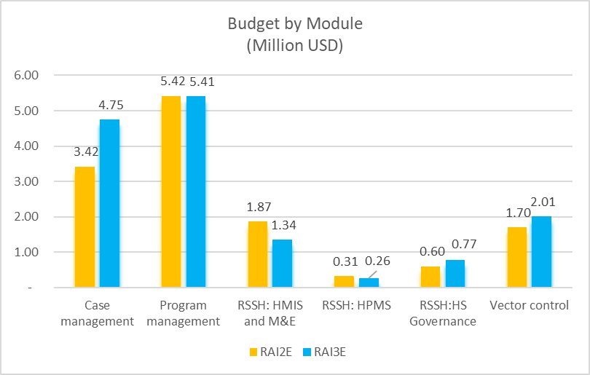
RAI3E Grant Making Process
R RAI3E Laos Budget by Module3E G RAI3E Grant Making Process
rant Making Process
Module | RAI2E Budget ($) | RAI3E Budget ($)
Case Management | 3,422,909 | 4,749,209
Program Management | 5,418,141 | 5,411,893
RSSH: HMIS and M&E | 1,872,287 | 1,344,422
RSSH: HPMS | 314,304 | 255,795
RSSH: HS Governance | 597,688 | 766,010
Vector Control | 1,696,112 | 2,013,752
TOTAL | $ 13,321,441 | $ 14,541,081

Slide 16
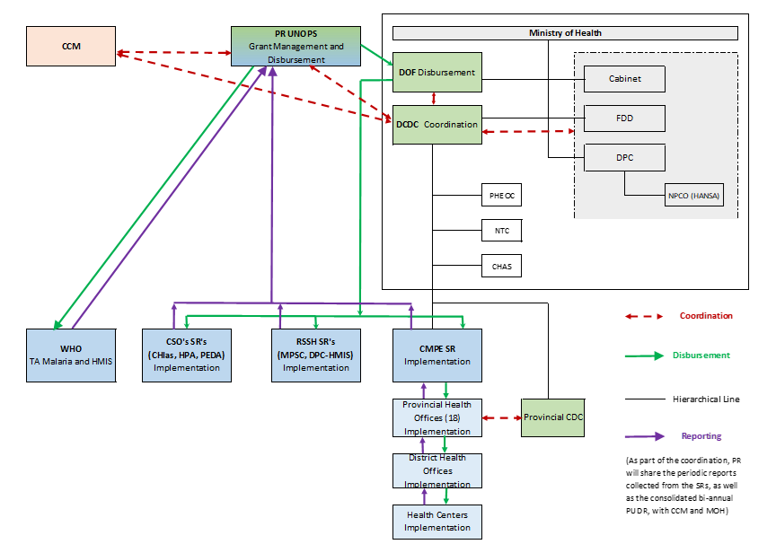
RAI3E Laos Implementation Arrangements

Slide 17
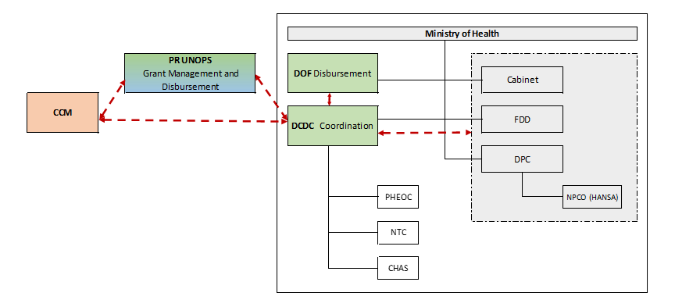
R RAI3E Laos Implementation Arrangements - Coordination
Notes:
The PR UNOPS will work in close collaboration with the MOH (DCDC) for the achievement of the grant objectives
The Ministry of Health and the PR will work closely to:
- Ensure the enhanced coordination and collaborative partnership with various key departments in the MOH, including the PHEOC, DPC (NPCO - HANSA), DOF, FDD, NTC, CHAS, as well as with other Government Agencies (MOF, MOFA, etc);
- Share regularly and timely the performance and the strategic information regarding the RAI3E grant with the MOH and ensure the integration of the grant activities into the standard systems and processes at the MOH and the alignment with other service delivery activities and broader health sector reform;
- Disburse funds from UNOPS to SRs
- Coordinate the in-country PSM work
The focus from the RAI3E grant will be on capacity improvements at the provincial and district level for program management and financial management/ control - this will be achieved through close collaboration between PR UNOPS and MOH.
DCDC will assume the coordination role within the MOH: In the context of the malaria elimination, the DCDC is the best positioned department for the role , being the unit in the MOH managing infectious diseases nationally and at the provinces level.

Slide 18
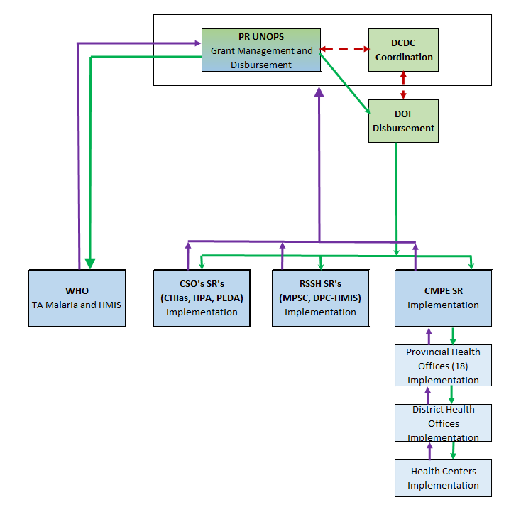
R RAI3E Laos Implementation Arrangements - Fund Flow
Notes:
- For the disbursement role, PR UNOPS will sign a Project Cooperation Agreement (PCA) with the MOH;
- Implementation by the SRs will be directly managed by UNOPS - SR Agreements
- The Grant Funds will be disbursed from PR UNOPS, through MOH bank account, to the subrecipients (SRs: CMPE, HPA, CHIas, PEDA, MPSC, DPC-HMIS
- The funds will be disbursed quarterly, based on quarterly disbursement requests submitted by the SRs to PR UNOPS, and approved by PR UNOPS, together with DCDC
- PR UNOPS will sign Sub Recipient Agreements with the implementing SRs: CMPE, HPA, CHIas, PEDA, MPSC, DPC-HMIS; - The SRs will submit the reports to PR UNOPS with copy to DCDC.

Slide 19
RAI3E Activities

Slide 20
VMWs – different partners
Province | CMPE | CHias | HPA | PEDA | Grand Total
Saravane | 191 | 400 |  |  | 594
Champasack | 314 |  |  | 264 | 578
Savannakhet | 249 |  | 293 |  | 542
Sekong | 76 |  |  | 136 | 212
Attapeu | 40 |  | 107 |  | 147
Phongsaly | 67 |  |  |  | 67
Khammuane | 67 |  |  |  | 67
Luangprabang | 33 |  |  |  | 33
Oudomxay | 3 |  |  |  | 3
Xaysomboun | 3 |  |  |  | 3
Grand Total | 1,043 | 400 | 400 | 400 | 2,246

Slide 21
VMWs related activities/support
Incentive and travel cost
Monthly incentive and monthly travel cost for reporting to HCs
Training of the new VMWs (# 633) in Q1-2021
Training of all VMWs (# 2,250) in Q3-2021 and 2023
Training of 30% of VMWs who are weak performing in 2022
ICCM trainings
Travel cost and food allowance for 1 patient and 1 VMW upon arriving at the HF for G6PD test and/or PMQ for PV cases
PV patients assisted referral
Year 2 - recruitment of new VMWs in villages which become high burden malaria areas as per 2021 revised stratification
VMWs recruitment

Slide 22
Vector control
Entomological monitoring
Monthly visit in hotspot areas – starting from Fe-2021; CMPE + Province + District + HC
LLINs mass distribution
Post-distribution meeting between districts and HCs – in 2022
Pre-distribution meetings for different levels – government co-financing
IEC and community mobilization
IEC for LLINs and radio campaign for mass distributions
Bed net survey
Post distribution – LLINs mass campaigns in 2022

Slide 23
Trainings
ICCM trainings
All provinces, districts, HCs, VMWs
In year 2021 and 2023; 30% of HCs and VMWs will be retrained in 2022
DHIS2 trainings
All provinces and districts
Every year from 2021 - 2023
Surveillance and supervision visit SOP trainings
All provinces, districts, HCs
In year 2021 and 2023

Slide 24
Surveillance and M&E
iDES
Integrated drug efficacy surveillance in selected areas
Elimination targeted areas – 13 central/northern provinces and selected districts in the south (# 19 in 2021)
Foci investigation & response
5 southern provinces
ACD and outbreak response
In the year 2021
Re-stratification

Slide 25
Key meetings
Bottom-up planning meetings
For every 6 months’ work plan
With all provinces and districts
Meeting between HCs and districts
Every month, for all HCs
Supervision visits
By different levels from different partners

Slide 26
Commodities: LLINs (2021-2023)
* LLINs for MMPs, Militaries, Pregnant women

Slide 27
Commodities: RDTs and others (2021-2023)
Other commodities | Support by RAI3E
ACT | For all HFs and VMWs
Artesunate injections | For all hospitals
ASMQ | For all provincial hospitals
G6PD quantitative tests | For all hospitals and strata 3 & 4 HCs
PMQ | For all HFs and VMWs
Paracetamol and ORS | For all VMWs
Microscopy reagents | For all hospitals
Gloves | For all HFs and VMWs
Microscopes | 10 microscopes
Entomological monitoring and insecticide resistance testing | For entomology monitoring

Slide 28
RAI3E – Current Priorities
Agreements Signing:
Project Cooperation Agreement (PCA) between MOH and PR UNOPS was signed on 22 January 2021;
Grant Agreements were signed with CMPE, CHIas,HPA, PEDA;
Grant Agreements with DPC-HMIS and MPSC are in progress (pending bank accounts);
Disbursement:
Following PCA signing, PR UNOPS disbursed the first disbursement to the Bank of Lao – confirmation of transfer shared with DOF on February 5;
RAI3 will use the Bank of Lao bank account of MOH (RAI2 used BCEL bank account) – this is a new disbursement process. “The Global Fund will be monitoring the timeliness of the disbursements under this new fund flow with Bank of Laos and should we identify delays that hinder implementation of the programs, we will contact you to revise the structure”
PR UNOPS is working closely with DOF to process the first transfer in no longer than 10 days from Bank of Lao to the Sub Recipients;

Slide 29
Thank You!

