Slide 1
National TB Center (NTC)
CCM meeting, 26th March 2024

Slide 2
Contents
1) HANSA-2 proposed NTC workplan 2024-2026
2) HANSA-2 TB Budget 2024 - 2026
2.1 HANSA-2 TB Budget 2024 – 2026 (TB Allocation Budget)
2.2 HANSA-2 TB Budget 2024 – 2026 (GF Input Based)
3) HANSA-2 Co - Financing Budget 2024 - 2026
4) Gaps and challenges with solutions

Slide 3
HANSA 2 ( PBC 7 )
PBC 7 : Increase TB prevention and care coverage and reaching the unreached to End TB PBC Condition 1: Number of notified TB cases of all forms (New and Relapse) PBC Condition 2: Number of household contact children under 5-year-old received Tuberculosis Preventive Treatment

Slide 4
PBC Condition 1: Number of notified TB cases of all forms (new and relapse)

Slide 5
PBC Condition 2
All eligible (number to be defined at end of Y2)
Children under 5-year-old

Slide 6
HANSA2 targets PBC 7 End TB targets by province
 | PBC 7.1 (TB notification) |  |  | PBC 7.2 (TPT)
 | Target Y1 | Target Y2 | Target Y3 | Target Y1 | Target Y2 | Target Y3
Province | 2024 | 2025 | 2026 | 2024 | 2025 | 2026
01 Vientiane Capital | 1,159 | 1,162 | 1,155 | 190 | 230 | 399
02 Phongsaly | 224 | 225 | 223 | 37 | 44 | 77
03 Luangnamtha | 239 | 239 | 238 | 39 | 47 | 82
04 Oudomxay | 412 | 413 | 410 | 68 | 82 | 142
05 Bokeo | 244 | 244 | 243 | 40 | 48 | 84
06 Luangprabang | 542 | 544 | 540 | 89 | 108 | 187
07 Huaphan | 359 | 361 | 358 | 59 | 71 | 124
08 Xayabouly | 512 | 503 | 499 | 84 | 99 | 172
09 Xiengkhouang | 318 | 313 | 310 | 52 | 62 | 107
10 Vientiane Province | 559 | 549 | 544 | 92 | 109 | 188
11 Bolikhamxay | 387 | 380 | 377 | 63 | 75 | 130
12 Khammouan | 526 | 517 | 513 | 86 | 102 | 177
13 Savannakhet | 1,305 | 1,282 | 1,272 | 214 | 254 | 440
14 Saravan | 544 | 535 | 530 | 89 | 106 | 183
15 Sekong | 160 | 158 | 156 | 26 | 31 | 54
16 Champasak | 911 | 895 | 887 | 149 | 177 | 307
17 Attapeu | 198 | 195 | 193 | 33 | 39 | 67
18 Xaisomboun | 138 | 136 | 134 | 23 | 27 | 46
Total | 8,737 | 8,650 | 8,582 | 1434 | 1711 | 2968

Slide 7
Priority activities to increase TB prevention and care coverage and reaching the unreached to End TB
(i) supporting integration of TB activities at PHC level (building capacity for provision of patient-centered, integrated TB, TB/HIV services at provincial, district, HC, VHV, VHW, Village levels);
(ii) training pediatricians and OPD/IPD physicians on lung health and TB, including clinical diagnosis in adults and children;
(iii) household contact TB screening and referral;
(iv) treating all TB cases and providing TPT (at least) to children under 5 after excluding active TB;
(v) active case finding to reach the unreached in remote areas and in prisons;
(vi) increasing MDR/RR-TB treatment coverage; (vii) TB/HIV collaborative activities;
(viii) community TB care delivery;
(ix) strengthening laboratory systems, including specimen transportation, expanding molecular testing capacity and other main laboratory functions;
(x) monitoring, reporting, and data use for action with TB Tracker

Slide 8
2.1 HANSA-2 TB Budget 2024-2026 (TB Allocation Budget)

Slide 9
2.1.1 HANSA-2 TB Budget 2024 (TB Allocation Budget)

Slide 10
2.2 HANSA-2 TB Budget 2024-2026 (GF Input Based)

Slide 11
3) HANSA-2 Co-Financing Budget 2024 – 2026

Slide 12
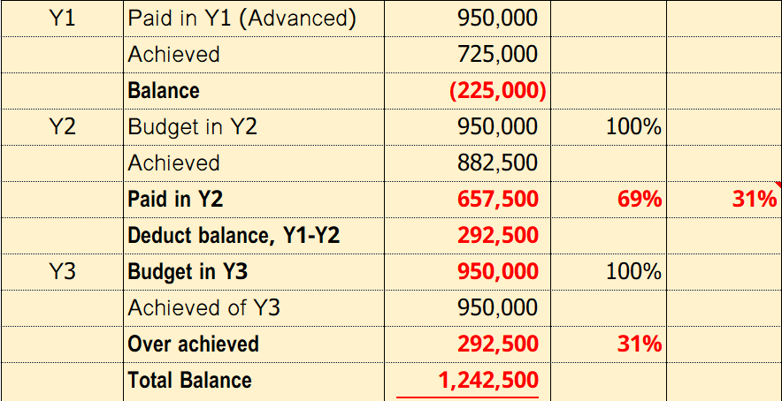
Timeline of Budget HANSA1 to HANSA2
Year3, Jun 2022 – May 2023, Reimbursement fund amount: 1.242.500$
It is on processing for fund transfer to each level by MOF.
HANSA2 Year1: 1.024.289$
HANSA1 Period
Different amount
HANSA1 Y3 and HANSA2 Y1: $218.211
Year0, Jan – Dec 2020, Reimbursement Fund on 23 Apr 2021
Year1, Jan - May 2021, Reimbursement Fund on 08 Apr 2022
Year2, Jun 2021 - May 2022, Reimbursement Fund on 13 Jun 2023

Slide 13
Gaps/Challenges
Challenges
Funding delay: each level could not conduct PBC7 Y1 work plan activities so that targets could not be achieved, if reimbursement from HANSA1 Year3 is not disbursed to each level on time; Budget of HANSA1 Y3 950.000US$ plus over achieved 292.500US$ = 1.242.500US$ is expected to be allocated, considering cumulative achievement of HANSA1 Y1-Y3 target, missing amount: 218.211US$; Concept of integration may not be clear and need more understandable as practices Need more capacity building for local health provider (District and HCs level) Limited capacity for Xpert Maintenance Delay to data entry and Data quality improvement
Solution
Need more clear timeline of disbursement budget (1.024.289US$) to each level (DPF), so each level could start to conduct activities as HANSA2PBC Y1 work plan; NTC is ready to provide and submit additional work plan of this balance amount: 218.211US$; All programs, PBCs and None PBCs should create specific SOPs Funding support would be available NCLE and NTC is finding the options for maintenance DHIS2-TB Tracker need more real time data entry from district level

Slide 14
ຂອບໃຈ

