Slide 1
Progress Update HIV - PBC preparation under HANSA II (2024 – 2026) (PBC-6)
1st Plenary CCM Meeting on 26 March 2024
Center for HIV/AIDS and STI (CHAS)
Ministry of Health

Slide 2
Outline
Update HIV cascade
Progress Update on HIV - PBC 6 preparation under HANSA II
Annual Operational Plan for 2024
Challenges and Areas to improve

Slide 3
HIV/AIDS strategy to ending AIDS 2030
NSP Goal
End the transmission and limit the impact of HIV and AIDS in Lao PDR by 2030
1. Strengthen an enabling environment for an effective HIV/AIDS response
3. Increase access to quality treatment and care services
Objective
2. Improve access to quality prevention services
Law, policy and advocacy
Human resources
Sustainability & fundraising
Management & planning
Strategic information
Stigma & discrimination
International & cross-border
Intervention
Female sex workers
Men who have sex with men
Transgender women
People who use & inject drugs
Mobile people & migrants
Pregnant women
Prisoners
Victims of human trafficking
Condoms
Sexually-transmitted infections
Blood safety
Online & social media
Pre-exposure prophylaxis
HIV testing
Treatment
HIV/TB
Home & community care & support

Slide 4
The national HIV cascade was updated based on new estimates from AEM for 2023. The 2022 PLHIV estimates were retrospectively updated from 15,681 to 17,983 (14% change) in the 2022 version of the AEM
Data source: Estimated PLHIV from updated AEM Feb 2023, 95 figures from DHIS2 - MOH updated as of November 2023 and report at 2023-Q4

Slide 5
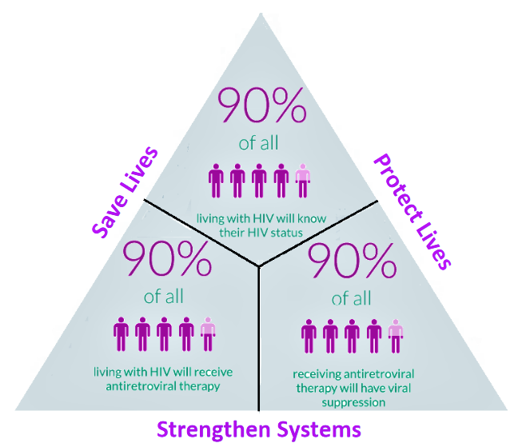
HIV cascade in 2023
Fast Track Strategy
95%
95%
95%
The national HIV cascade was updated based on new estimates from AEM for 2023. The 2022 PLHIV estimates were retrospectively updated from 15,681 to 17,983 (14% change) in the 2022 version of the AEM
Data source: Estimated PLHIV from updated AEM Feb 2023, 95 figures from DHIS2 - MOH updated as of November 2023 and report at 2023-Q4

Slide 6
Global Fund allocation budget for 2024-2026 (GF notification letter dated 20 December 2022)
 | Budget allocation (US$) | Implementation Period
National HIV program | 7,449,033 | 1 Jan 2024 to 31 Dec 2026
National TB program | 8,088,355 | 1 Jan 2024 to 31 Dec 2026
Total | 15,537,388
ການໄດ້ຮັບທຶນເພີ້ມຕື່ມຈາກກອງທຶນໂລກ ສຳລັບການສ້າງຄວາມເຂັ້ມແຂງໃຫ້ແກ່ລະບົບຫ້ອງວິເຄາະ (LSS): ສປປ ລາວ ແມ່ນຈັດຢູ່ໃນບັນດາປະເທດ ທີ່ມີເງື່ອນໄຂ ທີ່ໄດ້ຮັບທຶນເພີ້ມຕື່ມອີກ ຈາກຈຳນວນທີ່ໄດ້ຈັດສັນໃຫ້ແລ້ວ ຮ້ອງວ່າ “Matching Funds” ເປັນຈຳນວນເງິນ ➔ US$2,000,000 ເພື່ອສ້າງຄວາມເຂັ້ມແຂງ ໃຫ້ແກ່ລະບົບຫ້ອງວິເຄາະ ແບບເຊື່ອມສານ (Laboratory Systems Strengthening).

Slide 7
HIV Procurement Plan
Component | Cost Input | Y1 (2024) | Y2 (2025) | Y3 (2026) | Total 3 years
HIV | 4.1 Antiretroviral medicines | 473,944.10 | 444,269.40 | 521,531.80 | 1,439,745.30
 | 5.13 Molecular testing reagents, test kits and consumables | 305,301.00 | 296,659.00 | 200,405.00 | 802,365.00
 | 5.2 Condoms - Male | 37,647.00 | 16,242.50 | 18,467.50 | 72,357.00
 | 5.4 Rapid Diagnostic Tests | 202,851.80 | 220,263.50 | 208,254.50 | 631,369.80
 | 5.8 Other consumables | 9,400.00 | 4,400.00 | 5,600.00 | 19,400.00
 | 7.1 Procurement agent and handling fees | 15,547.07 | 14,304.07 | 15,273.99 | 45,125.12
 | 7.2 Freight and insurance costs | 189,152.32 | 180,914.66 | 180,109.49 | 550,176.46
 | 7.5 Quality assurance and quality control costs (QA/QC) | 2,352.35 | 1,032.13 | 1,203.38 | 4,587.85
Total ($US) |  | 1,236,195.64 | 1,178,085.25 | 1,150,845.65 | 3,565,126.53

Slide 8
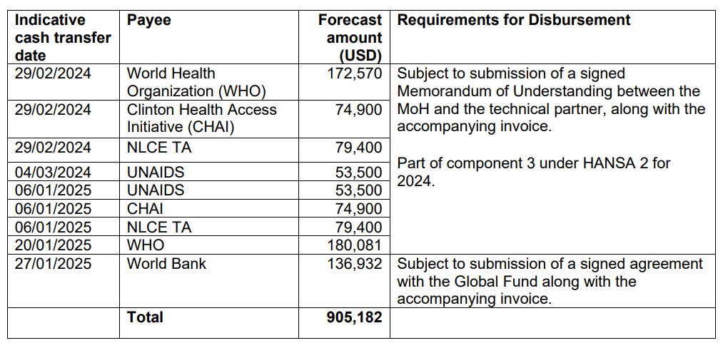
HANSA2 - Project Preparation, (Cont1)
The disbursement schedule to technical and development partners for technical assistance is planned as follows:

Slide 9
Improving quality and access to essential health services through integrated PHC service delivery
Strengthening PHC system
PHC Service Delivery
People Centered PHC Services
Improving quality of primary health care using QPS as management tools
Ensuring access to PHC services by the poor
Supply of essential drugs and supplies at Health Center
Implementation of Integrated Social and Behavioral Change Communication
Delivery of Quality Essential Health Services Package
Aligned with:
Essential Health Service Package 2018/20
Policy on PHC 2019
Model Healthy Village 2018
Integrated Community Health 2021
Deployment of trained clinical health worker at Health Center
Integrated outreach services (EPI, FP, ANC, PNC, GMP, HIV, TB) in rural and remote villages
Financial management for Health Center (planning, reporting, and evaluation)
Immunization focusing on lowest performing districts and deliveries with SBA
Data for Planning and Management
Notified TB cases of all forms
Financing PHC using NHI system
Performance payment linked to verified QPS score by 3 party
Direct facility transfer to Health Centers using NHI
Health security and pandemic preparedness
HIV testing among key populations (FSW &MSM) and HIV treatment
Governance and accountability: Local health governance: (i) Province and District Integrated Planning and Budgeting; (ii) management of health program (i.e. improvement of HC using QPS)
Community engagement: village-level participatory planning for health services, management of community-based services

Slide 10
HANSA2 Project Components
Component 1: Financing for PHC services using NHI payments
Component 2: Integrated PHC Service Delivery
Component 3: Adaptive Learning and Project Management
Component 4: Contingent Emergency Response

Slide 11
Component 2: Integrated PHC Service Delivery
PHC Service Delivery
Delivering Integrated PHC Services: aims to increase access to quality PHC services through a people-centered approach, with a focus on closing gender and equity gaps
Integrated PHC service package need to be defined: (1) what services to integrate for whom, (2) where integrated services to take place (health facilities, outreach, community), (3) who deliver them (by health workers, volunteers) and (4) how they are financed (program budgets, NHI/QPS funds)
It is necessary to ensure a focus on establishing linkages across, community, integrated outreach and health facilities with a functional referral system back to the health-facility level.
Indicative PBC conditions, eligible expenditures, implementing agencies (central and subnational), and mainstreaming GESI dimension in PBCs need to further discussed and agreed on by implementing entities (departments, centers, programs, CSO, PHOs, DHOs and HCs)
Free MCH => Ensuring access to PHC services by the poor
Implementation of Integrated Social and Behavioral Change Communication
Integrated outreach services (EPI, FP, ANC, PNC, GMP, HIV, TB) in rural and remote villages
Immunization focusing on lowest performing districts and deliveries with SBA
Notified TB cases of all forms
HIV testing among key populations (FSW &MSM) and HIV treatment

Slide 12
Component 2: Integrated PHC Service Delivery
Strengthening PHC system
Strengthening PHC System is to ensure delivery of quality PHC services through a people-centered approach at frontline service delivery level.
Key interventions under HANSA will be continued under HANSA2 but with a greater focus on integrated planning, budgeting, HRH deployment, monitoring and quality supervision to be accountable for supply-side readiness for health facilities to deliver quality PHC services
Indicative PBC conditions, eligible expenditures, implementing agencies (central and subnational), and mainstreaming GESI dimension in PBCs need to further discussed and agreed on by implementing entities (departments, centers, programs, PHOs, DHOs and HCs)
Improving quality of primary health care using QPS as management tools
Supply of essential drugs and supplies at Health Center
Deployment of trained clinical health worker at Health Center
Financial management for Health Center (planning, reporting, and evaluation)
Data for Planning and Management
Health security and pandemic preparedness

Slide 13
PBC 6 Overall objective
This PBC aims to increase access to quality of people-centred based approach for HIV services for all the people living with HIV, key populations through adoption and expansion of innovative and differentiated service delivery (DSD) models including HIV testing, PrEP and ART with strong involvement and participation of the affected communities and key populations.

Slide 14
PBC 6: Key populations and people living with HIV/AIDS access to HIV services
PBC No. | Detail | Y 1 (2024) | Y 2 (2025) | Y 3 (2026)
PBC 6.1 (ສືບຕໍ່) | Percentage of female sex workers (FSW) in the 5 target sites that have received an HIV test during the reporting period and know their results | 93% | 94% | 95%
PBC 6.2 (ສືບຕໍ່) | Percentage of men who have sex with men/transgender (MSM/TG) in the 5 target sites that have received an HIV test during the reporting period and know their results | 57% | 70% | 84%
PBC 6.3 (ສືບຕໍ່) | Percentage of people living with HIV (PLHIV) on ART among all estimated PLHIV at the end of the reporting period | 64% | 66% | 69%
PBC 6.4 (ໃໝ່) | Percentage of people living with HIV (PLHIV) on ART with a viral load test result at least once during the reporting period | 89% | 95% | 98%
PBC 6.5 (ໃໝ່) | Number of men who have sex with men (MSM)/transgender (TG) who received any PrEP product at least once during the reporting period. | 1100 | 1300 | 1500
Implementing Agency: Center for HIV/AIDS and STI ໂດຍມີ ຄູ່ຮ່ວມງານ ຄື CHias, APL+, and PEDA
Total PBC value: 2,870,632US$

Slide 15
Additional Indicators need to be reported.
Percentage of FSW who have HIV infected refer to treatment on ARV in past 12 month Percentage of MSM/TG who have HIV infected refer to treatment on ARV in past 12 month Percentage of PLHIV received Multi-Month Dispensing “MMD” Percentage of HIV- infected enrolled on ART have TB screening Percentage of HIV-infected people enrolled in ART who received TPT/IPT for TB prevention Percentage of pregnant women who have HIV-infected people refer to ARV treatment Percentage of enfant who birth born from positive mother have HIV test after 2 month of birth. (EID in 4-6 Weeks)

Slide 16
#. PBC 6.1 Percentage of female sex workers (FSW) in the 5 target sites that have received an HIV test during the reporting period and know their results
Province | Tested for HIV (FSW) |  |  |  |  | HIV Testing Coverage (FSW)
 | Y0 2023 | Y1 2024 | Y2 2025 | Y3 2026 | Y4 2027 | Y0 2023 | Y1 2024 | Y2 2025 | Y3 2026 | Y4 2027
Vientiane Capital City | 3,664 | 3758 | 3852 | 3942 | 3991 | 92% | 93% | 94% | 95% | 95%
Vientiane Province | 1,526 | 1565 | 1604 | 1642 | 1662 | 92% | 93% | 94% | 95% | 95%
Khammouan | 1,267 | 1304 | 1336 | 1368 | 1385 | 92% | 93% | 94% | 95% | 95%
Savannakhet | 1,542 | 1582 | 1621 | 1659 | 1680 | 92% | 93% | 94% | 95% | 95%
Champasack | 1,235 | 1266 | 1298 | 1328 | 1345 | 92% | 93% | 94% | 95% | 95%
HANSA PBC Target | 9,235 | 9,476 | 9,711 | 9,939 | 10,062 | 92% | 93% | 94% | 95% | 95%
Numerator = Number of FSW in the targeted areas who have been tested for HIV during the reporting period and who know their results
Denominator = Estimated number of FSW in the targeted areas
Org. | Y1 | Y2 | Y3 | Total | % Cover
CSO | 4,136 | 4,238 | 4,338 | 12,712 | 44%
PCCA | 5,341 | 5,473 | 5,601 | 16,415 | 56%
Total | 9,476 | 9,711 | 9,939 | 29,126 | 100%

Slide 17
#. PBC 6.2 Percentage of men who have sex with men/transgender (MSM/TG) in the 5 target sites that have received an HIV test during the reporting period and know their results
Province | Tested for HIV (MSM+TG) |  |  |  |  | HIV Testing Coverage (MSM+TG)
 | Y0 2023 | Y1 2024 | Y2 2025 | Y3 2026 | Y4 2027 | Y0 2023 | Y1 2024 | Y2 2025 | Y3 2026 | Y4 2027
Luangprabang | 988 | 1190 | 1481 | 1800 | 2060 | 48% | 57% | 70% | 84% | 95%
Xayabouli | 611 | 736 | 916 | 1113 | 1274 | 48% | 57% | 70% | 84% | 95%
Vientiane Province | 1,134 | 1366 | 1701 | 2067 | 2366 | 48% | 57% | 70% | 84% | 95%
Bolikhamsay | 350 | 422 | 525 | 638 | 731 | 48% | 57% | 70% | 84% | 95%
Khammouan | 599 | 721 | 898 | 1091 | 1249 | 48% | 57% | 70% | 84% | 95%
HANSA PBC Target | 3,681 | 4,435 | 5,521 | 6,708 | 7,679 | 48% | 57% | 70% | 84% | 95%
Numerator = Number of MSM/TG in the targeted areas who have been tested for HIV during the reporting period and who know their results
Denominator = Estimated number of MSM/TG in the targeted areas
Org. | Y1 | Y2 | Y3 | Total | % Cover
CSO | 4,013 | 4,996 | 6,069 | 15,078 | 90%
PCCA | 422 | 525 | 638 | 1,586 | 10%
Total | 4,435 | 5,521 | 6,708 | 16,664 | 100%

Slide 18
#. PBC 6.3 Percentage of people living with HIV (PLHIV) on ART among all estimated PLHIV at the end of the reporting period (Nationwide)
Province | Total (cumulative) number of PLHIV on ART |  |  |  |  | % of PLHIV on ART of all estimated PLHIV
 | Y0 2023 | Y1 2024 | Y2 2025 | Y3 2026 | Y4 2027 | Y0 2023 | Y1 2024 | Y2 2025 | Y3 2026 | Y4 2027
HANSA PBC Target | 11,025 | 11,979 | 12,934 | 13,967 | 14,977 | 61% | 64% | 66% | 69% | 71%
Numerator = Number of people on ART at the end of the reporting period
Denominator = Estimated number of people living with HIV in Lao PDR

Slide 19
#. PBC 6.4 Percentage of people living with HIV (PLHIV) on ART with a viral load test result at least once during the reporting period (Nationwide)
Province | Total Net Tested for VL |  |  |  |  | % VL Test for all PLHIV on ART
 | Y0 2023 | Y1 2024 | Y2 2025 | Y3 2026 | Y4 2027 | Y0 2023 | Y1 2024 | Y2 2025 | Y3 2026 | Y4 2027
HANSA PBC Target | 9,213 | 10,610 | 12,232 | 13,627 | 14,612 | 84% | 89% | 95% | 98% | 98%
Numerator = Number of people on ART with a viral load test result at least once during the reporting period
Denominator = Number of people on ART who are eligible for HIV viral load testing (more than 6 months of ART initiation), excluding LTFU and death during the reporting period

Slide 20
#. PBC 6.5 Number of men who have sex with men (MSM)/transgender (TG) who received any PrEP product at least once during the reporting period (Nationwide)
 | Y1 2024 | Y2 2025 | Y3 2026
HANSA PBC Target | 1,100 | 1,300 | 1,500
Numerator = Number of who have sex with men (MSM)/transgender (TG) prescribed or dispensed any form of PrEP at least once during the reporting period
Denominator = NA

Slide 21
PBC 6 Value
PBC 6 | PBC Value Y1 (US$) | PBC Value Y2 (US$) | PBC Value Y3 (US$) | Total 3 Years (US$)
PBC 6.1: % FSW tested in targeted sites | 186,240 | 175,440 | 175,440 | 537,120
PBC 6.2: % MSM/TG tested in targeted sites | 171,617 | 172,537 | 172,974 | 517,127
PBC 6.3: % PLHIV on ART nationwide | 525,938 | 511,966 | 524,654 | 1,562,558
PBC 6.4: % VLT nationwide | 29,676 | 29,900 | 29,900 | 89,476
PBC 6.5: No. PrEP for MSM/TG Nationwide | 44,350 | 60,000 | 60,001 | 164,351
Total | 957,821 | 949,843 | 962,968 | 2,870,632

Slide 22
Funding Allocation for PBC 6
HIV Component budget summary for 3 years (2024-2026)
Resp. Unit | Budget | Budget | Budget | Total for 3yrs
 | Y1 (2024) | Y2 (2025) | Y3 (2026)
CHAS | 407,346 (43%) | 383,256 (40%) | 375,988 (39%) | 1,166,590
PHO | 315,878 (33%) | 333,690 (35%) | 353,084 (37%) | 1,002,652
PEDA | 68,860 (7%) | 68,860 (7%) | 68,860 (7%) | 206,580
Chias | 119,317 (12%) | 120,317 (13%) | 121,317 (13%) | 360,950
APL plus | 46,420 (5%) | 43,720 (5%) | 43,720 (5%) | 133,860
Total: | 957,821 | 949,843 | 962,968 | 2,870,632

Slide 23
Specific objective PBC 6.1
PBC 6.1: % of FSW in the 5 target sites that have received an HIV test during the reporting period and know their results: VTE cap, VTE Pro, KM, SVK, CPS.
Objective:
To increase the HIV testing coverage among FSW by updating and implementing the differentiated HIV service delivery and strengthening linkage to HIV prevention, treatment and care.
Main Activities:
1. Implement community-based testing for FSW through outreach activity, mobile testing and peer led intervention with adopting of index testing and HIV self-testing.
2. Conduct community awareness raising for HIV prevention and S&D reduction in community, incorporating with CLM: Public awareness on HIV prevention including S&D reduction at community level and printing IEC material
3. Strengthen on strategic information system (M&E capacity building and coordination, RDQA), including HIV sentinel surveillance for KPs: Training on data management for PCCA, health providers and community partners for HIV prevention and HTS such as VCT, STI, PrEP, Index testing.

Slide 24
Annual Operational Plan 2024
Activity Code | Activity Description | Budget (US$) | Implementing Agency | Implementation Month
 |  |  |  | Jan | Feb | Mar | Apr | May | Jun | Jul | Aug | Sep | Oct | Nov | Dec
PBC 6.1 Increase the HIV testing coverage among FSW
PBC 6.1.1 | Update the mapping of locations and sub -populations of FSW and HIV prevalence to inform program planning for 5 target provinces | 10,800 | CHAS |  |  |  | X | X
PBC 6.1.2 | TOT for PCCA, health providers and community workers on HIV testing services through CBT, HIVST with adapting Index testing and promote PrEP services for KPs | 9,380 | CHAS |  |  |  |  | X
PBC 6.1.7 | Workshop to update on HIV services (IQVIA manual) and S&D reduction package among KPs for CSO staff | 8,160 | CHAS |  |  |  |  |  | X
PBC 6.1.16 | Printing IEC materials for HIV knowledge and prevention among KPs | 5,000 | CHAS |  |  |  |  |  | X
 | Sub total | 33,340

Slide 25
Annual Operational Plan 2024
Activity Code | Activity Description | Budget (US$) | Implementing Agency | Implementation Month
 |  |  |  | Jan | Feb | Mar | Apr | May | Jun | Jul | Aug | Sep | Oct | Nov | Dec
PBC 6.1 Increase the HIV testing coverage among FSW
PBC 6.1.8 | Refresh training on HIV services for PEs/community workers to update HIV prevention and testing strategy among FSW | 2,702 | PEDA |  |  |  |  | x
PBC 6.1.9 | Mobile outreach activity, Peer-led interventions for HIV testing among FSW in community and hot spot of high burden areas. Once in a quarter in 3 target provinces (VTP,KM,CPS) | 20,955 | PEDA |  |  | x |  |  | x |  |  | x |  |  | x
PBC 6.1.10 | PE monthly salary to conduct community based testing (CBT) for FSW target. Totally 9PEs contracted for 3 target provinces | 15,789 | PEDA | x | x | x | x | x | x | x | x | x | x | x | x
PBC 6.1.11 | Performance based incentive for FSW outreach who deliver FSW HIV positive to treatment site (Cost assumption of 10$/person). Target: 40 FSW HIV infected in each year | 400 | PEDA | x | x | x | x | x | x | x | x | x | x | x | x
PBC 6.1.12 | Site supervision for CSO staff - to supervise on quality of outreach interventions, peer-led interventions including attending meetings and/or trainings. 2 central staff*2 times per year*3 provinces | 8,041 | PEDA |  |  |  |  |  | x |  |  |  |  |  | x
PBC 6.1.13 | Project management cost (Salary for PEDA staff and office running cost) | 20,975 | PEDA | x | x | x | x | x | x | x | x | x | x | x | x
 | Sub total | 68,860

Slide 26
Annual Operational Plan 2024
Activity Code | Activity Description | Budget (US$) | Implementing Agency | Implementation Month
 |  |  |  | Jan | Feb | Mar | Apr | May | Jun | Jul | Aug | Sep | Oct | Nov | Dec
PBC 6.1 Increase the HIV testing coverage among FSW
PBC 6.1.3 | Outreach activity/Peer-led testing/Mobile testing for FSW in community and hot spot of high burden areas in 2 target provinces (VTC&SVK) | 13,440 | PHO | x | x | x | x | x | x | x | x | x | x | x | x
PBC 6.1.4 | Salary for PEs to provide HIV services in 2 target provinces. Assumption is 15 PEs contracted for VTC+SVK | 36,000 | PHO | x | x | x | x | x | x | x | x | x | x | x | x
PBC 6.1.5 | Performance based incentive for FSW outreach who deliver FSW HIV positive to treatment site. Cost assumption is 10$/person @ 60 FSW HIV + | 600 | PHO | x | x | x | x | x | x | x | x | x | x | x | x
PBC 6.1.6 | Site supervision for PHO/DHO staff - to supervise on quality of FSW outreach interventions, peer-led interventions. Assumption 500$/quarter@2provinces (VTC+SVK)@4 times/year | 4,000 | PHO |  |  | x |  |  | x |  |  | x |  |  | x
PBC 6.1.15 | Public awareness on HIV knowledge and prevention among KPs including S&D reduction in community. | 30,000 | PHO |  |  |  |  | x |  |  | x |  |  | x
 | Sub total | 84,040

Slide 27
Specific objective PBC 6.2
PBC 6.2: % MSM/TG in the 5 target sites that have received an HIV test during the reporting period and know their results: LPB, XYBL, BLKX, KM, VTE pro.
Objective:
To increase the HIV testing coverage among MSM/TG by updating and implementing the differentiated HIV service delivery and strengthening linkage to HIV prevention, treatment and care; and monitor the trend of HIV prevalence among key populations (MSM/TG)
Main Activities:
Implement community-based testing for MSM/TG through outreach activity, mobile testing and peer led intervention with adopting of index testing and HIV self-testing.
Establish community-based clinic as one-stop-shop at community level to provide HIV services including HIVST, ARV point of care, PrEP and condom&lubricants for prevention in priority locations.
Virtual intervention/Online reach and link to test ‘testVTE & MatesDer’, focus on MSM/TG and young population
community awareness raising for HIV prevention and S&D reduction in community, incorporating with CLM: Public awareness on HIV prevention including S&D reduction at community level
Strengthen on strategic information system (M&E capacity building and coordination, RDQA), including HIV sentinel surveillance for KPs: Conduct HIV sentinel surveillance among MSM/TG

Slide 28
Annual Operational Plan 2024
Activity Code | Activity Description | Budget (US$) | Implementing Agency | Implementation Month
 |  |  |  | Jan | Feb | Mar | Apr | May | Jun | Jul | Aug | Sep | Oct | Nov | Dec
PBC 6.2 Increase the HIV testing coverage among MSM/TG
PBC 6.2.1 | Update the mapping of locations and sub -populations of MSM/TG and HIV prevalence to inform program planning for 5 target provinces | 10,800 | CHAS |  |  |  | x | x
PBC 6.2.2 | Outreach activity/Peer-Led testing/Mobile testing for HIV among MSM/TG in community and hot spot of high burden areas in BLX province | 3,840 | PHO |  |  | x |  |  | x |  |  | x |  |  | x
PBC 6.2.3 | Salary for PEs to conduct HIV services (CBT,HIVST) in community and hot spot in high burden areas. Assumption is 200$/month/PE @ 4PEs contracted for BLX province | 9,600 | PHO | x | x | x | x | x | x | x | x | x | x | x | x
PBC 6.2.4 | Performance based incentive for MSM outreach who refer MSM HIV positive to treatment site (Cost assumption is 10$/person@ 46 MSM/TG HIV+). | 460 | PHO | x | x | x | x | x | x | x | x | x | x | x | x
PBC 6.2.5 | Site mentoring and coaching for PHO/DHO staff - to mentor on quality of HIV testing services and outreach activity, CBT, HIVST including DQA at district level. | 21,000 | PHO |  |  | x |  |  | x |  |  | x |  |  | x
PBC 6.2.14 | Project coordination and management cost for PHO | 21,600 | PHO | x | x | x | x | x | x | x | x | x | x | x | x
 | Sub total | 67,300

Slide 29
Annual Operational Plan 2024
Activity Code | Activity Description | Budget (US$) | Implementing Agency | Implementation Month
 |  |  |  | Jan | Feb | Mar | Apr | May | Jun | Jul | Aug | Sep | Oct | Nov | Dec
PBC 6.2 Increase the HIV testing coverage among MSM/TG
PBC 6.2.6 | Refresh training on HIV services for community workers to update HIV prevention and testing strategy among MSM/TG – 3 days training with total 30 participants | 7,344 | CHias |  |  |  |  | x
PBC 6.2.7 | Outreach activity/Peer-Led testing/Mobile testing for HIV among MSM/TG in community and hot spot of high burden areas. Cost assumption is 6$@70 clients/month in 4 target provinces. | 20,160 | CHias | x | x | x | x | x | x | x | x | x | x | x | x
PBC 6.2.8 | Salary for PEs to conduct HIV services in community and hot spot in high burden areas. Assumption is 200$/month/PE @ 16 COSs contracted for 4 target provinces | 38,400 | CHias | x | x | x | x | x | x | x | x | x | x | x | x
PBC 6.2.9 | Performance based incentive for MSM outreach who refer MSM HIV positive to treatment site (Cost assumption of 10$/person). Target: 400 in 2024, 500 in 2025, 600 in 2026. | 4,000 | CHias | x | x | x | x | x | x | x | x | x | x | x | x
PBC 6.2.10 | Site supervision for CSO staff - to mentor and supervise on quality of outreach services including CBT, HIVST and DQA at site level. | 10,000 | CHias |  |  | x |  |  | x |  |  | x |  |  | x
PBC 6.2.11 | Project management cost (Salary for CHias staff and office running cost) | 24,413 | CHias | x | x | x | x | x | x | x | x | x | x | x | x
 | Sub total | 104,317

Slide 30
Specific objective PBC 6.3
PBC 6.3: % of PLHIV on ART among all estimated PLHIV at the end of the reporting period
Objective: To improve ART coverage and retention on HIV treatment and care through implementation differentiated ART services delivery, expansion ART/POC sites in all provinces with capacity building for healthcare worker and CSOs.
Main Activities:
Expanding ART/POC sites in priority area. Target 4 POC sites in each year
Establish and improve referral system - linking newly diagnosed HIV from HIVST, KPLHV from community to ART or POC ART sites with CSO’s worker accompaniment
Build capacity for health care workers to enhance early/rapid ARV treatment with patient centred approach and AHD, co-morbidity management, including S&D reduction in all ARV and POC sites.
Promote DSD for HIV services at ART/POC sites to improve access to treatment, including ARV delivery for KPs through community based clinic – incoporating with QPS
Strengthen on SI (M&E capacity building and coordination, RDQA)
Community awareness raising for HIV prevention and S&D reduction in community– incorporating with CLM
Program management – hiring PE/case manager and running cost for ARV and POC sites

Slide 31
Annual Operational Plan 2024
Activity Code | Activity Description | Budget (US$) | Implementing Agency | Implementation Month
 |  |  |  | Jan | Feb | Mar | Apr | May | Jun | Jul | Aug | Sep | Oct | Nov | Dec
PBC 6.3 Improve ART coverage and retention on HIV treatment and care
PBC 6.3.1 | Expanding ART/POC sites in priority area. Target new 4 POC sites | 20,180 | CHAS |  |  |  |  | x | x
PBC 6.3.2 | Workshop to update and improve referral system through coordination and linking newly HIV from community to ART/POC sites with CSOs, TB and MCH centers | 10,400 | CHAS |  |  |  |  |  | x
PBC 6.3.3 | Clinical training to update and improve early/rapid ARV treatment and AHD, co-morbidity case management for health care providers from ART and POC sites. (1 training workshop for ARV sites and one for POC sites) | 19,500 | CHAS |  |  |  |  |  |  |  |  | x | x
PBC 6.3.4 | Support S&D routine monitoring and workshops to improve quality of services for PLHIV/KPLHIV in HFs, and support S&D reduction in educational and workplace setting. | 12,000 | CHAS |  |  |  |  |  |  | x
PBC 6.3.5 | Workshop to refresh on ARV tracker/DHIS2 data reporting, data analysis, data utilization and RDQA for SI team | 16,500 | CHAS |  |  |  |  |  |  |  |  | x | x
PBC 6.3.6 | On site coaching for HIV care and treatment services including DQA and DHIS2-ARV tracker in selected ART and POC sites | 28,450 | CHAS |  |  |  |  | x |  |  | x |  |  | x
PBC 6.3.7 | Program review for HIV outcomes under HANSA including HSS for KPs outcomes | 77,000 | CHAS |  |  |  |  |  |  |  |  |  | x | x | x
PBC 6.3.12 | Program management | 144,400 |  | x | x | x | x | x | x | x | x | x | x | x | x
 | Sub total | 328,430

Slide 32
Annual Operational Plan 2024
Activity Code | Activity Description | Budget (US$) | Implementing Agency | Implementation Month
 |  |  |  | Jan | Feb | Mar | Apr | May | Jun | Jul | Aug | Sep | Oct | Nov | Dec
PBC 6.3 Improve ART coverage and retention on HIV treatment and care
PBC 6.3.8 | Support Lab testing fees for HIV new diagnosed KPs to initiate ART and poor PLHIV to support ARV treatment monitoring and retention | 29,048 | PHO |  |  |  |  |  |  |  | x | x | x | x | x
PBC 6.3.9 | Salary for 40 Peer supports working at ART and POC sites – to enhance adherence counselling, psycho-social and mental health support for PLHIV at HF and community – incorporation with APL+ | 96,000 | PHO | x | x | x | x | x | x | x | x | x | x | x | x
PBC 6.3.11 | Project coordination and management costs for ARV and POC sites | 40,200 | PHO (ARV&POC sites) | x | x | x | x | x | x | x | x | x | x | x | x
 | Sub total | 165,248

Slide 33
Annual Operational Plan 2024
Activity Code | Activity Description | Budget (US$) | Implementing Agency | Implementation Month
 |  |  |  | Jan | Feb | Mar | Apr | May | Jun | Jul | Aug | Sep | Oct | Nov | Dec
PBC 6.3 Improve ART coverage and retention on HIV treatment and care
PBC 6.3.12 | Refresh training workshop on S&D reduction, gender, laws and social security in community | 3,500 | APL+ |  |  |  |  |  |  |  | x | x | x | x | x
PBC 6.3.13 | Conduct Community led monitoring (CLM) - implemented by APL+ (8 Provinces) | 8,000 | APL+ |  |  |  |  | x | x | x | x | x | x | x | x
PBC 6.3.14 | Site monitoring and supervision to support Peers at community level | 6,000 | APL+ |  |  |  |  |  | x |  |  |  |  |  | x
 | Project coordination and management costs for APL+ | 13,020 | APL+ | x | x | x | x | x | x | x | x | x | x | x | x
 | Sub total | 30,520

Slide 34
Specific objective PBC 6.4
PBC 6.4: % of PLHIV on ART with a viral load test result at least once during the reporting period
Objective:
To improve access to HIV viral load testing and follow up across the country.
Main Activities:
Promote POC VL testing at district level and intensify quality of VL monitoring with case management and data reporting, using IT to facilitate VL lab services.
Support PLHIV engagement in HIV care and treatment through tele health counselling, psycho-social and mental health support
Reinforce U=U awareness among PLHIV/KPLHIV, reduce S&D in community
Lesson learned workshop to review program updates and improve HIV testing and treatment services

Slide 35
Annual Operational Plan 2024
Activity Code | Activity Description | Budget (US$) | Implementing Agency | Implementation Month
 |  |  |  | Jan | Feb | Mar | Apr | May | Jun | Jul | Aug | Sep | Oct | Nov | Dec
PBC 6.4 Improve access to HIV viral load testing
PBC 6.4.1 | Home visits to follow up LTFU cases and support psycho-social and mental health for PLHIV and affected families, reinforce VL testing, support those who have experienced of stigma, discrimination, and violence victims | 9,600 | APL+ |  |  |  |  |  |  |  | x | x | x | x | x
PBC 6.4.2 | Develop VDO clips to reinforce VLS, reduces stigma, U=U and address gender base violence among PLHIV communities. | 2,700 | APL+ |  |  |  |  | x | x | x | x | x | x | x | x
PBC 6.4.3 | Awareness campaign to provide HIV/AIDS information, stigma and discrimination reduction and reinforce U=U with VL suppression outcomes for health through online and offline intervention | 3,600 | APL+ |  |  |  |  | x | x | x | x | x | x | x | x
PBC 6.4.4 | Support phone credit for tele-health services to enhance VL testing, prevent LTFU through peer support on mental health counseling. | 5,000 | CHAS |  |  |  | x | x | x | x | x | x | x | x
PBC 6.4.5 | Workshop to review and share lesson learned on quality of VL decentralization (POC VL&EID testing) and data reporting, including EQA | 8776 | CHAS |  |  |  |  |  |  |  |  |  | x
 | Sub total | 29,676

Slide 36
Specific objective PBC 6.5
PBC 6.5: Number of MSM/TG who received any PrEP product at least once during the reporting period.
Objective:
To scale up PrEP service and uptake.
Activities
Roll out and simply PrEP services for MSM/TG
Develop and implement differentiated PrEP services in community

Slide 37
Annual Operational Plan 2024
Activity Code | Activity Description | Budget (US$) | Implementing Agency | Implementation Month
 |  |  |  | Jan | Feb | Mar | Apr | May | Jun | Jul | Aug | Sep | Oct | Nov | Dec
PBC 6.5 scale up PrEP service and uptake
PBC 6.5.1 | Organize community based event to discuss the knowledge and interest of PrEP/HIV testing and care treatment among MSM/TG in the community in 4 target provinces both offline and online | 5,000 | CHias |  |  |  |  | x | x | x | x | x | x | x | x
PBC 6.5.2 | Support community-based clinic establishment at community level to provide HIV services including HIVST, ARV point of care, PrEP services and condom for prevention in priority locations. | 10,000 | CHias |  |  |  | x | x | x | x | x | x | x | x | x
PBC 6.5.3 | Training on data management for PCCA, health care providers and CSOs for PrEP and Index testing | 13,000 | CHAS |  |  |  |  |  | x
PBC 6.5.4 | HIV campaign to promote PrEP service, stigma and discrimination reduction and reinforce U=U objectives | 8,000 | CHAS |  |  |  |  |  | x |  |  | x |  |  | x
 | Sub total | 44,350

Slide 38
Key documents requirement | Progress
CSOs contract (PEDA, CHIas, APL+) is conplete | Signed
POM (Project Operation Manual) is complete and shared to NPCO | Complete
Master Plan (2024-2026), AOP_2024 (Annual Operation Plan 2024), PMF (Project Performance Monitoring Framework) | Complete
Procurement and Monitoring plan (HPMT) | Complete
TOR TAs (International TA from UNAIDS and CHAI) | Complete

Slide 39
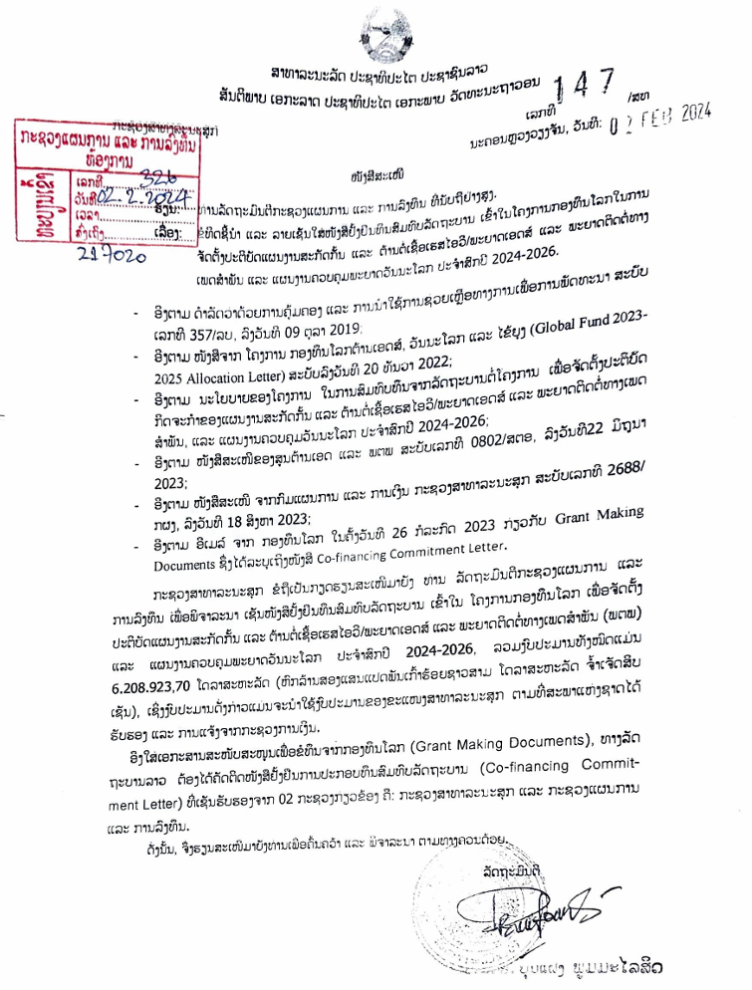
Draft GC7 co-financing commitments (2024-2026)
 | 2024-2026 commitments (USD) |  |  |  | Additional amount (Difference in totals) (USD)
 | Y1 | Y2 | Y3 | Total
 | Budget | Budget | Budget
HIV | 1,064,902.84 | 917,915.64 | 1,124,661.50 | 3,107,479.98 | 1,345,699.28
TB | 1,005,200.81 | 1,201,777.40 | 894,465.51 | 3,101,443.72 | 2,128,961.19
Totals | 2,070,103.65 | 2,119,693.04 | 2,019,127.01 | 6,208,923.70 | 3,474,660.47
Program | Intervention/Activity | Total domestic financing commitment for 2024-2026 (USD)
HIV | 1) Antiretroviral medicines | 390,588.68
 | 2) HIV Rapid Diagnostic Tests | 157,502.12
 | 3) HIV Viral Load and EID cartridge | 239,773.88
 | 4) Opportunistic infections and STI medicines | 590,425.10
 | 5) CD4 analyzers/ accessories and lab reagents | 216,523.56
 | 6) Lab consumables | 73,435.59
 | 7) Expanding new POC sites in provincial and district level | 88,118.00
 | 8) Capacity building on program management and strengthening on strategic Information | 481,129.00
 | 9) HIV Prevention Program (for KPs, OVP, AGYW, GP) | 165,671.00
 | 10) Differentiated HIV testing and treatment | 443,590.00
 | 11) TB/HIV collaboration | 80,000
 | 12) PMCT program | 105,223.05
 | 13) S&D survey | 75,500

Slide 40
Lao government co-financing commitments for 2021-2023

Slide 41
Challenges
Areas to improve
Delay on funding for PBC implementation, meanwhile MOU HANSA II project already started on 1/1/2024;
Delay procurement will make potential commodity shortage for HIV services
Integrated service delivery at PHC is challenging for HIV program
Expanding POC testing for HIV VL-GXP and EID-GXP at district level
KP/PLHIV stigma and discrimination is barrier to access health services
CLM implementation under HANSA II with CSO engagement towards to build sustainability
Government co-financing for 2024-2026 for HIV program is challenging – Still waiting for MPI signing-off
Propose DPF for possibility to advance budget, so each PBC will be able to implement activities as HANSA 2 PBC Y1 work plan
Monitor closely with NPCO/Procurement unit to clarify and place the order ASAP
Integrated PHC service delivery package need to be defined and ensuring on establishing linkages across, community, integrated outreach and health facilities
CHAS will list the HFs to distribute GXP machine and discuss with NCLE and NTC
S&D reduction package for KPs is now finalizing and CHAS will
CHAS allocated budget for CLM implementation to initiate and moving forward with CSO engagement for sustainability

Slide 43
ສິ່ງທ້າທາຍ
ອີງໃສ່ສັນຍາຂອງການຈັດຕັ້ງປະຕິບັດໂຄງການ HANSA II ແມ່ນເລີ່ມຕົ້ນ 1/1/2024 ແຕ່ປະຈຸບັນ ພວກເຮົາຍັງບໍ່ໄດ້ຮັບງົບປະມານ ແລະ ບໍ່ທັນເລີ່ມປະຕິບັດໄດ້
ການຈັດຕັ້ງປະຕິບັດກິດຈະກຳແບບເຊື່ອມສານ ຍັງເປັນສິ່ງທ້າທາຍ, ເຄື່ອງມືຕ່າງໆ ຍັງບໍ່ທັນໄດ້ປັບປຸງ
ການເຂົ້າເຖິງກຸ່ມ ສບກ ທີ່ເປັນກຸ່ມເຄື່ອນຍ້າຍ ແລະ ແອບແຝງ (ສາວມືຖື)
ການເຂົ້າເຖິງກຸ່ມ ຊພຊ ໂດຍສະເພາະ ກະເທີຍ ໄວໜຸ່ມ
ການແກ້ໄຂບັນຫາຈຳແນກ - ລັງກຽດ ຕ້ອງການການມີສ່ວນຮ່ວມຈາກຫລາຍພາກສ່ວນ
ການຂະຫຍາຍຕາໜ່າງກວດ HIV VL ແລະ EID ດ້ວຍເຄື່ອງ GXP ຢູ່ຂັ້ນເມືອງ
ງົບປະມານສົມທົບຂອງລັດຖະບານ ສຳລັບປີ 2024 – 2026 ຍັງເປັນສິ່ງທ້າທາຍ

Slide 44
ສິ່ງທ້າທາຍ
Increasing new HIV diagnosed (17% increased in 2023 compare to 2022 data) particularly among young MSM and TG group
GF/HANSA efforts may not be enough to create visible impact on first 95
ການຄົ້ນຫາຜູ້ຕິດເຊື້ອ ໃນປີ 2023 ໄດ້ 84% ຊຶ່ງຍັງບໍ່ສາມາດບັນລຸເປົ້າໝາຍໄດ້ ເນື່ອງຈາກງົບປະມານແມ່ນອີງໃສ່ໂຄງການຊ່ວຍເຫລືອເປັນຫລັກ ຊຶ່ງການຈັດຕັ້ງປະຕິບັດຍັງບໍ່ທັນກວມເອົາໄດ້ທຸກໆແຂວງ;
ຕາໜ່າງການບໍລິການກວດເລືອດຊອກຫາການຕິດເຊື້ອ HIV ຍັງບໍ່ສາມາດຂະຫຍາຍລົງຮອດທຸກສຸກສາລາ, ລວມທັງສະຖານທີ່ປິ່ນປົວດ້ວຍຢາຕ້ານຕໍ່ເຊື້ອເຮສໄອວີ (ARV) ກໍ່ຍັງມີຈຳກັດແຕ່ຢູ່ໂຮງໝໍສູນກາງ, ໂຮງໝໍແຂວງ ແລະ ເມືອງ 2 ແຫ່ງ;
ການໂຄສະນາກ່ຽວກັບຄວາມຮູ້ ແລະ ວິທີປ້ອງກັນ HIV ຍັງບໍ່ກວ້າງຂວາງ. ຈາກຜົນການສຳຫຼວດ LSIS 3 ພົບວ່າຄວາມຮູ້ກ່ຽວກັບ HIV ໃນກຸ່ມຊາວໜຸ່ມ (15-24ປີ) ຍັງຕ່ຳ (ຜູ້ຍິງ 20,1%, ຜູ້ຊາຍ 23,1%)

Slide 45
ບັນຫາ ແລະ ສີ່ງທ້າທາຍ (ຕໍ່)
ຄົນເຈັບເຂົ້າມາຮັບການປິ່ນປົວຊ້າ ແລະ ຍັງມີຈຳນວນຂາດການຕິດຕາມໃນການປິ່ນປົວ;
ບັນຫາການຈຳແນກ-ລັງກຽດຜູ້ຕິດເຊື້ອ ຍັງມີຢູ່ໃນສະຖານບໍລິການສາທາລະນະສຸກ, ຊຸມຊົນ, ສັງຄົມ ແລະ ກຸ່ມຜູ້ຕິດເຊື້ອເອງ;
ການສະໜອງນ້ຳຢາກວດເລືອດຊອກຫາການຕິດເຊື້ອເຮສໄອວີ ສຳລັບແມ່ຍິງຖືພາ, ຢາປິ່ນປົວພະຍາດແຊກຊ້ອນ ບາງລາຍການແມ່ນບໍ່ພຽງພໍ
ການມີສ່ວນຮ່ວມຂອງສັງຄົມ, ຊຸມຊົນ ແລະ ເອກະຊົນ ຍັງມີໜ້ອຍ;
ງົບປະມານໃນການຈັດຕັ້ງປະຕິບັດວຽກງານຕ້ານເອດ ຍັງບໍ່ພຽງພໍ, ແລະ ທຶນຊ່ວຍເຫຼືອຈາກສາກົນ ນັບມື້ນັບຫຼຸດລົງ, ຄວາມຍືນຍົງທາງດ້ານງົບປະມານ.
ສະນັ້ນ ການທີ່ຈະບັນລຸເປົ້າໝາຍ 95-95-95 ໃນປີ 2025 ຍັງມີຫຼາຍສິ່ງທ້າທາຍ

