Slide 1
CCM Meeting
18 JUNE 2021

Slide 2
Agenda
Overview of C19RM funding opportunity, application process, and progress to date
Documents needed for submission
Clarification on PR and SRs funding flow
Next steps

Slide 3
Budget request overview
Implementer | Approved Funding | C19RM Above Base Allocation | Total | %
Ministry of Health of the Lao People's Democratic Republic | 143,127 | 91,601 | 234,728 | 2.71%
Lao Red Cross | 145,990 | 94,489 | 240,479 | 2.77%
Lao Women Union | 119,912 | 123,404 | 243,315 | 2.81%
MoH FDD | 204,600 | 233,350 | 437,950 | 5.05%
CHIAS/APL+/PEDA/HPP | 335,720 | 290,272 | 625,992 | 7.22%
MoH NCLE | 462,607 | 540,800 | 1,003,407 | 11.57%
MoH CMPE | 621,746 | 585,172 | 1,206,919 | 13.92%
MoH DHR | 720,875 | 675,663 | 1,396,538 | 16.11%
MoH NTC | 779,037 | 623,296 | 1,402,333 | 16.17%
MoH CHAS/ HIV activities | 800,440 | 1,078,138 | 1,878,578 | 21.67%
Grand Total | 4,334,054 | 4,336,185 | 8,670,239 | 100.00%
Ceiling | 4,336,143 | 4,336,143 | 8,672,286
Variance | 2,089 | 42 | 2,047

Slide 4
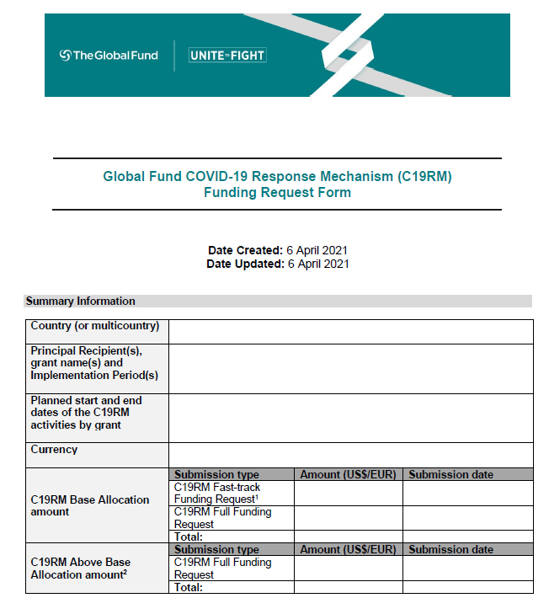
C19rm Funding Request form | Overview
There is only ONE form for C19RM funding.
Section 1 is the C19RM Fast-Track Funding Request.
Section 2 is the C19RM Full Funding Request.

Slide 5
C19rm Funding Request form | Overview
Summary Information
Section 1:
Fast-Track Submission
Section 2:
Full Submission
Country
(or multicountry)
1.1: Funding Priorities
2.1: Context
Principal Recipient
1.2: Program Implementation
Arrangements
2.2: Implementation of
2020 C19RM Award
Existing Grant &
IP information
1.3: Supporting Documents
2.3: Funding Request
& Prioritization
Start Date
2.4: Implementation Arrangements
C19RM Allocation
Funding Request Amount
2.5: Funding Landscape
C19RM PAAR Amount
2.6: Supporting Documents
Notes:
Section 1 not applicable if there is no Fast Track application

Slide 6
2.3 Funding request & prioritization
Section 2: C19RM Full Funding Request
Applicants should become familiar with COVID-19 Modular Framework and the C19RM Technical Information Note, prior to filling in this section.
Important annexes for this section include:
C19RM Budget template
C19RM Funding Landscape Table.
Where relevant, applicants should describe the disruption of HIV, TB and/or malaria services (particularly for key and vulnerable populations) and if the program(s) already included funding for adaptations to the COVID-19 context.

Slide 7
2.3 Funding request & prioritization
Section 2: C19RM Full Funding Request
Each table corresponds to on eligible investment area:
a. COVID-19 Control and containment interventions
b. COVID-19-related risk mitigation measures
for programs to fight HIV/AIDS, TB, and malaria
c. Expanded reinforcement of key aspects of
health systems and community-led response systems

Slide 8
Health and community System Strengthening
Human Resources for Health includes:
Support for health care workers, community health workers;
Staff involved in surveillance, contact tracing, referrals, infection prevention control, case management, vaccination and others.
Safeguarding front-line health workers with PPE, IPC programs and others;
Enhance effectiveness of health worker performance through web-enable training and supervision platforms;
Staff hired for C19RM funding expected to be temporary;
Surge capacity to complement existing staff capacity;
Appropriate funding should be allocated to knowledge transfer.

Slide 9
Health and community system strengthening
RSSH interventions critical to respond to COVID-19 and
to strengthen underlying health systems.
Applicants are strongly encouraged to prioritize activities in this section for support.
Interventions that allow COVID-19 responses to be embedded into health systems to enable a more sustainable response.
Where health systems investments contribute to future pandemic preparedness, CCMs will be requested to ensure:
Involvement of relevant actors, such as national International Health Regulation (IHR) focal points and epidemic preparedness coordinating bodies;
Alignment with relevant technical frameworks including International Health Regulations (IHR), the Global Health Security Agenda/Joint External Evaluations, WHO Benchmarks for IHR Capacities, and, where available, National Action Plans for Health Security (NAPHS).

Slide 10
Finance CONSIDERATIONS | KEY MESSAGES
C19RM Funding Requests must be captured in the C19RM Budget (which has one COVID-19 module with 18 interventions and 9 new cost inputs).
C19RM Budget
Fast-Track Funding Request
C19RM Full Funding Request
on a grant-by-grant basis.
Includes:
PPE,
Diagnostics,
Therapeutics, and
Costs relating to the effective deployment of such health products, including technical assistance.
on a grant-by-grant basis.
Includes:
C19RM Base Allocation (net off any funding awarded through the C19RM Fast-track process)
C19RM Above Base Allocation Request
Any estimated available uncommitted funds and financial obligations (such as orders pending delivery) as of 30 June 2021 from the C19RM 2020 Award (where relevant).

Slide 11
Pillar 10
Systems Support Contributing to Vaccine Delivery Services (What does C19RM Cover?)
1
Plans to address COVID-19 testing, treatment and vaccine hesitancy in communities.
The Global Fund does NOT intend to use C19RM to fund vaccine procurement & deployment.
Six targeted activities are considered “in scope” within C19RM.
2
Apply Infection Prevention and Control (IPC) measures and provide COVID-19 response-related training of community HCWs that also support vaccine delivery.
3
Activities to identify and reach those excluded or not covered by the public health system: detainees, migrants and refugees, and stigmatized populations, with COVID-19-related services, that may support vaccination services.
4
Conduct COVID-19 vaccine table-top (simulation) exercises to test on-going country readiness.
5
Adapt and apply existing surveillance and monitoring frameworks to address vaccination coverage, acceptability and adverse events reporting.
6
Adapt and apply existing Health Management Information Systems to monitor progress and coverage among different at-risk and marginalized groups in order to facilitate vaccine delivery and timely reporting.

Slide 12
Documents needed for C19RM FR submission
☐ | C19RM Funding Request Form
☐ | C19RM Consolidated Budget (including C19RM Above Base Allocation Request)
☐ | Quantification or needs assessment for COVID-19 health products (including contribution and projected pipeline from domestic and other sources of funding) (any format suitable to the applicant)
☐ | COVID-19 National Testing Strategy, where available
☐ | C19RM Health Product Management Template (HPMT) per grant
☐ | C19RM Funding Landscape Table
☐ | CCM Endorsement of the C19RM Full Funding Request
☐ | Endorsement by the national COVID-19 response coordinating body of the COVID-19 control and containment interventions of the C19RM Full Funding Request (where relevant)
☐ | National Strategic Preparedness and Response Plan for COVID-19 and budget (ideally for 2021)
☐ | HIV, TB and malaria program mitigation plans (where relevant)
☐ | List of Civil Society suggestions for inclusion in the C19RM Full Funding Request

Slide 13
Clarification on PR and SRs funding flow

Slide 14
Next steps
18-Jun-21 | CCM Meeting to review the draft of C19RM2 full funding request | CCM, OC, RMC
21-Jun-21 | Submission of the final draft to CCM by noon time | writing team
21-Jun-21 | Submission of C19RM2 full funding request to the GF | Writing team, CCM

