Slide 1
GF/Catalytic Funding-Multicountry Grant to support SKPA, USD $12.5 m 2019-2021
GF’s Multicountry grant to support the Sustainable Scale-up of HIV Services for Key Populations in South East Asia (SKPA)

Slide 2
Which countries?
Those with smaller allocations which as a result need reinforced financing to achieve systemic changes:
Bhutan
Lao PDR
Malaysia
Mongolia
Papua New Guinea
Philippines
Sri Lanka
Timor-Leste
To support the scale-up of service delivery to 90% coverage of key populations, to secure zero new transmission by 2030
Notes:
Number 8, define the ideal implementer for the purpose of the discussion.
Statement of work and TORs are the same
These are them minimum in terms of structure
The idea is to minimize to as much as possible the management costs of managing mini grants. So athe funds are being directed to the most needed areas, and not loose the funds through admin costs.

Slide 3
Objectives of multi-country grant
Secure strategic information to inform program design
Scale-up outreach to key populations aiming for 90% coverage and retention in the treatment cascade
Strengthen community responses & systems for scale-up of services
Address barriers to accessing services incl. human rights & gender-related
Secure long-term sustainability of service delivery through
Focusing domestic financing to have impact
Increasing domestic investments
Exploring innovative & more effective & efficient approaches for service delivery
Stimulating increase in financing from alternate sources
Support national HIV programs and complement national grants, to secure zero new transmission by 2030
Notes:
Number 8, define the ideal implementer for the purpose of the discussion.
Statement of work and TORs are the same
These are them minimum in terms of structure
The idea is to minimize to as much as possible the management costs of managing mini grants. So athe funds are being directed to the most needed areas, and not loose the funds through admin costs.

Slide 4
Lao PDR’s Objectives
Promote and expand access to community-based testing, self-testing and PrEP
Increase domestic financing to support transition and sustainability
Peer-led demand creation and service re-orientation to increase treatment uptake and reduce loss to follow-up
Develop strategic information for PWID, TG and low-risk women to inform planning

Slide 5
Activities implemented by CHIAS
1. Community Base Monitoring (CBM) consultation training in Khammoune Province
2. Community Base Monitoring (CBM) consultation training in Vientiane Capital
3. Stigma & Discrimination training for health care workers and Peer supporters
4. Demand Creation detail activity work plan and budget with APCOM
5. MSM/TG focus group discussion (FGD) on community demands
6. PrEP and tests (Oral Quick)-HIVST to cover 216 MSM/TG.
7. PWID Rapid Assessment 2021 with budget $85,000/afao and 117,000 euro/French 5% Initiative.

Slide 6
Sub-recipients 1) Centre for HIV/AIDS & STI (CHAS) Ministry of Health 2) Community Health & Inclusion Association (CHIAs)
Agreement signed by
AFAO & PMU/DPC-MOH

Slide 7
Fund Flow - afao to PMU Budget and expenditures
Y1 (2019) – Planned budget $194,257 and utilized $23,266
Y2 (2020) – Planned budget $ 617,628 and utilized $ 172,184
Y3 (2021) Reprogramming?

Slide 8
SKPA Phase 2?
AFAO has consulted with country and CCM through Zoom.

Slide 9
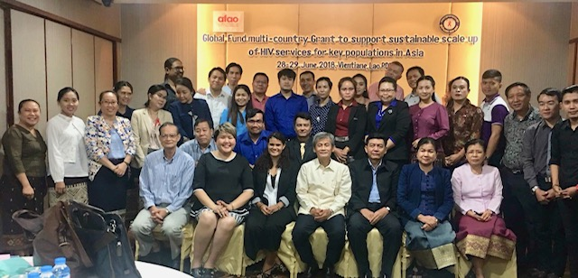
Lao PDR
Presentation on Priorities, Identified Strategies and Activities
Regional Dialogue Workshop
16-18 July 2018
Bangkok, Thailand

Slide 10
Thank you

