Slide 1
Progress report on DLI-K (HIV)
Health and Nutrition Service Access (HANSA)
(Center for HIV/AIDS and STI)

Slide 2
Outline
Areas of implementation for Key Pop and ART sites
Indicators for FSW and MSM in year Y2 period on June2021- May2022
Progress report DLIK
Co financing in Y2
C19RM
Challenges and Mitigation

Slide 3
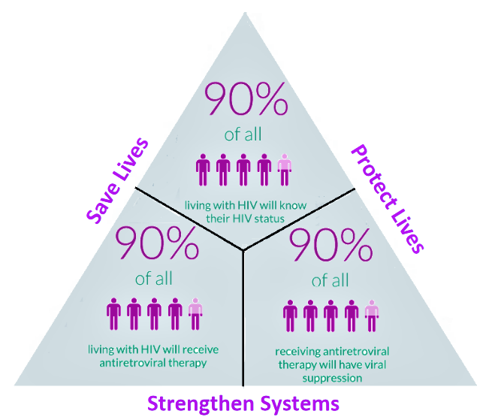
HIV/AIDS strategy to ending AIDS 2030
95%
95%
95%

Slide 4
1. Period of implementation on DLI K
YEAR | Period
Y 1 | 01/01/2021 ເຖິງ 31/05/2021 (5 months)
Y 2 | 01/06/2021 ເຖິງ 31/05/2022 (12 months)
Y 3 | 01/06/2022 ເຖິງ 31/05/2023 (12 months)
Y4 | 01/06/2023 ເຖິງ 31/05/2024 (12 months)
2. Implementers DLI-K : CHAS, PCCAs, CHIAs and PEDA
Notes:
FSW: Consider 2 more provinces for FSW intervention such as LNT and XK
MSM

Slide 5
3. Areas of implementation for reach the key population (FSW and MSM)
Provinces | Implementers
1. Vientiane Capital | PCCAs
2. Vientiane | PEDA
3. Khammaune | PEDA
4. Savanaket | PCCAs
5. Champasack | PEDA
FSW
ແຂວງ | Implementers
1. Louanprabang | CHias
2. Xayabury | CHias
3. Vientiane Province | CHias
4. Borikhamxay | PCCAs
5. Khammouane | CHias
MSM
Notes:
FSW: Consider 2 more provinces for FSW intervention such as LNT and XK
MSM

Slide 6
4. Health facilities provide services on ARV drugs for PLHIV
Provinces | Health Facilities (ART and POC sites)
1. Vientiane Capital | Sethathirath Hospital ARV Mahosoth Hospital ARV Frienfship Hospital ARV
2. Khamouane | Khamouane Provincial Hospital ARV
3. Savanaket | Savanaket Provincial Hospital ARV Songkhone District Hospital POC
4. Champasack | Champasack Provincial Hospital ARV
5. Saravanh | Saravanh Provincial Hospital POC
6. Louangprabang | Louangprabang Provincial Hospital ARV
7. Oudumxay | Oudumxay Provincial Hospital POC
8. LouangNumtha | LouangNumtha Provincial Hospital ARV
9. Borkeo | Borkeo Provincial Hospital ARV Tonpeung District Hospital ARV
10. Huaphanh | Huaphanh Provincial Hospital ARV
11. Vientiane Provincial | 15. Vientiane Provincial Hospital POC ➔ 9/2021
12. Xayabury | 16. Xayabury Provincial Hospital POC ➔ 8/2021
13. Borikhamxay | 17. Borikhamxay Provincial Hospital POC ➔ ທ້າຍປີ 2021
14. Xiengkoung | 18. Xiengkoung Provincial Hospital POC ➔ ທ້າຍປີ 2021
ARV & POC
14 ແຂວງ
11 ARV
7 POC
Notes:
FSW: Consider 2 more provinces for FSW intervention such as LNT and XK
MSM

Slide 7
Indicator DLI K - (a1) Percentage of FSW received an HIV test in the past twelve (12) months and know their results
Indicators of DLI-K
Percentage of FSW that have received an HIV test in the past twelve (12) months and know their results | Percentage Increase (FSW)
 | Y0 | Y1 | Y2 | Y3 | Y4
 | 0% | 2% | 2% | 2% | 2%
Indicator DLI-K (a2): Percentage of MSM received an HIV test in the past twelve (12) months and know their results
Percentage of MSM received an HIV test in the past twelve (12) months and know their results | Percentage Increase (MSM + TG)
 | Y0 | Y1 | Y2 | Y3 | Y4
 | 0% | 5% | 6% | 8% | 10%
Indicator DLI-K (b): Number of HIV positive cases currently on treatment
Number of HIV positive cases currently on treatment | Percentage Increase (on ART)
 | Y0 | Y1 | Y2 | Y3 | Y4
 | 0% | 1.7% | 4% | 5% | 5%

Slide 8
DLIK-A: Percentage and Number of FSW who received an HIV test in the past twelve (12) months and know their results
Y2 Increasing 2% of FSW received an HIV test in the past twelve (12) months and know their results
Are of implementation | Baseline Y1 (06/2020-05/2021) |  |  | Target Y2 (06/2021-05/2022)
 | Estimate number FSW of 2021 * | Number of FSW received HIV test | % of FSW revived HIV test | +2% | Estimate number of FSW 2022 * | Number of FSW have HIV test
Vientiane Capital | 3,412 | 3,399 | 99.6% | 101.6% | 3,465 | 3,521
Vientiane Province | 1,563 | 1,077 | 68.9% | 70.9% | 1,587 | 1,125
Khammouane Province | 1,299 | 1,218 | 93.8% | 95.8% | 1,319 | 1,263
Savannaket Province | 1,580 | 1,311 | 83% | 85% | 1,605 | 1,363
Champasack Provincee | 1,265 | 1,022 | 80.8% | 82.8% | 1,285 | 1,064
Target FSW Y2 | 9,119 | 8,027 | 88% | 90% | 9,260 | 8,336

Slide 9
DLIK-B: Percentage and Number of MSM who received an HIV test in the past twelve (12) months and know their results
Y2 Increasing 6% of MSM who received an HIV test in the past twelve (12) months and know their results
Are of implementation | Baseline Y1 (06/2020-05/2021) |  |  | Target Y2 (06/2021-05/2022)
 | Estimate number of MSM 2021 * | Number of MSM received HIV test | % of MSM revived HIV test | +6% | Estimate number of MSM 2022 * | Number of MSM have HIV test
Luangprabang province | 1,659 | 57 | 3% | 9% | 1,689 | 159
Xayabury Province | 1,119 | 57 | 5% | 11% | 1,139 | 126
Vientaine Province | 1,905 | 1,067 | 56% | 62% | 1,940 | 1,203
Borykhamxay Province | 694 | 14 | 2% | 8% | 706 | 57
Khammouane Province | 1,077 | 577 | 54% | 60% | 1,097 | 653
Target MSM | 6,454 | 1,772 | 27% | 33% | 6,570 | 2,198

Slide 10
Target Y2: DLIK-(C) Increase 4% of Number HIV positive cases currently on treatment
No. | Name of Health Facilities (ART and POC sites) | Y1 (end of may.21) | Target Y2 (+4%) (end of may.22)
1 | Savannakhet | 1,367 | 1,422
2 | Setthathilath HP | 2,736 | 2,845
3 | Mahosot HP | 1,420 | 1,477
4 | Louangphrabang | 596 | 620
5 | Champasack | 946 | 984
6 | Bokeo | 156 | 162
7 | Louangnamtha | 158 | 164
8 | Khammouane | 443 | 461
9 | Tonpheung Dist. Hospital | 51 | 53
10 | Houaphan | 80 | 83
11 | Friendship HP | 460 | 478
12 | Saravanh | 0 | 0
13 | Oudomxay | 20 | 21
14 | Songkhone Dist. Hospital | 0 | 0
15 | Sayaboury | 0 | 0
16 | Vientiane Province | 0 | 0
17 | Bolikhamxay | 0 | 0
18 | Xiengkuang | 0 | 0
Total |  | 8,433 | 8,770
337 (+4%)

Slide 11
Progress report on DLI K Y2

Slide 12
Progress-DLI K Y2:
DLIK-A: Increasing 2% of FSW received an HIV test in the past twelve (12) months and know their results
No. | Provinces | Denominator | Baseline | 2021 |  |  |  |  |  |  | 2022 |  |  |  |  | Total |  | Target: +2% | Progress
 |  |  |  | Jun | Jul | Aug | Sep | Oct * | Nov | Dec | Jan | Feb | Mar | Apr | May | Sum | %
1 | Vientiane Capital | 3,465 | 99.6% | 178 | 408 | 239 | 33 | 38 |  |  |  |  |  |  |  | 896 | 26% | 101.6% | 25%
2 | Vientiane Province | 1,587 | 68.9% | 90 | 88 | 69 | 58 | 35 |  |  |  |  |  |  |  | 340 | 21% | 70.9% | 30%
3 | Khammouan | 1,319 | 93.8% | 30 | 41 | 89 | 0 | 139 |  |  |  |  |  |  |  | 299 | 23% | 95.8% | 24%
4 | Savannakhet | 1,605 | 83% | 80 | 117 | 0 | 0 | 0 |  |  |  |  |  |  |  | 197 | 12% | 85% | 14%
5 | Champasak | 1,285 | 80.8% | 65 | 9 | 81 | 69 | 5 |  |  |  |  |  |  |  | 229 | 18% | 82.8% | 22%
Total |  | 9,260 | 88% | 443 | 663 | 478 | 160 | 217 |  |  |  |  |  |  |  | 1,961 | 21% | 90% | 24%
Y1 target : + 2%= 3741 (98%) /2208 (60%)
Y2= 8,336

Slide 13
Progress-DLI K Y2:
DLIK-B: Increasing 6% of MSM who received an HIV test in the past twelve (12) months and know their results
No. | Provinces | Denominator | Baseline | 2021 |  |  |  |  |  |  | 2022 |  |  |  |  | Total |  | Target: +6% | Progress
 |  |  |  | Jun | Jul | Aug | Sep | Oct * | Nov | Dec | Jan | Feb | Mar | Apr | May | Tested | %
1 | Louangphabang | 1,689 | 3% | 34 | 33 | 34 | 82 | 2 |  |  |  |  |  |  |  | 185 | 11% | 9% | 116%
2 | Xainyabouli | 1,139 | 5% | 23 | 22 | 22 | 79 | 33 |  |  |  |  |  |  |  | 179 | 16% | 11% | 142%
3 | Vientiane Province | 1,940 | 56% | 80 | 142 | 103 | 52 | 99 |  |  |  |  |  |  |  | 476 | 25% | 62% | 40%
4 | Bolikhamxai | 706 | 2% | 5 | 3 | 16 | 11 | 0 |  |  |  |  |  |  |  | 35 | 5% | 8% | 62%
5 | Khammouan | 1,097 | 54% | 44 | 74 | 94 | 19 | 32 |  |  |  |  |  |  |  | 263 | 24% | 60% | 40%
Total |  | 6,570 | 27% | 186 | 274 | 269 | 243 | 166 |  |  |  |  |  |  |  | 1,138 | 17% | 33% | 52%
Y1 target : +5% = 871 (32% )/ 882= (101%)
Y2=2,198

Slide 14
Progress-DLI K Y2: DLIK-(C) increase + 4% of Number HIV positive cases currently on treatment
No. | ARV/POC Site | Baseline* | Target: 4% | 2021 |  |  |  |  |  |  | 2022 |  |  |  |  | Total | Progress
 |  |  |  | Jun | Jul | Aug | Sep | Oct | Nov | Dec | Jan | Feb | Mar | Apr | May
1 | 01 PH Savannakhet | 1,367 | 1,422 |  |  |  | 1,323 |  |  |  |  |  |  |  |  | 1,323 | 100.5%
2 | 02 CH Setthathirath | 2,736 | 2,845 |  |  |  | 2,884 |  |  |  |  |  |  |  |  | 2,884
3 | 03 CH Mahosod | 1,420 | 1,477 |  |  |  | 1,414 |  |  |  |  |  |  |  |  | 1,414
4 | 04 PH Luangprabang | 596 | 620 |  |  |  | 606 |  |  |  |  |  |  |  |  | 606
5 | 05 PH Champasak | 946 | 984 |  |  |  | 930 |  |  |  |  |  |  |  |  | 930
6 | 07 PH Bokeo | 156 | 162 |  |  |  | 171 |  |  |  |  |  |  |  |  | 171
7 | 08 PH Luangnamtha | 158 | 164 |  |  |  | 166 |  |  |  |  |  |  |  |  | 166
8 | 09 PH Khammuane | 443 | 461 |  |  |  | 484 |  |  |  |  |  |  |  |  | 484
9 | 10 DH Tonpheung | 51 | 53 |  |  |  | 53 |  |  |  |  |  |  |  |  | 53
10 | 11 PH Huaphanh | 80 | 83 |  |  |  | 93 |  |  |  |  |  |  |  |  | 93
11 | 12 CH Mittaphab | 460 | 478 |  |  |  | 570 |  |  |  |  |  |  |  |  | 570
12 | 13 PH Saravanh | 0 | 0 |  |  |  | 22 |  |  |  |  |  |  |  |  | 22
13 | 14 PH Oudomexai | 20 | 21 |  |  |  | 54 |  |  |  |  |  |  |  |  | 54
14 | 15 DH songkhone | 0 | 0 |  |  |  | 44 |  |  |  |  |  |  |  |  | 44
15 | 16 PH Xainyabouli | 0 | 0 |  |  |  | 0 |  |  |  |  |  |  |  |  | 0
16 | 17 PH Vientiane | 0 | 0 |  |  |  | 0 |  |  |  |  |  |  |  |  | 0
17 | 18 PH Borlikhhamxai | 0 | 0 |  |  |  | 0 |  |  |  |  |  |  |  |  | 0
18 | 19 PH Xiangkhouang | 0 | 0 |  |  |  | 0 |  |  |  |  |  |  |  |  | 0
Total |  | 8,433 | 8,770 |  |  |  | 8,814 |  |  |  |  |  |  |  |  | 8,814 | 100.5%
Y1 target : + 1.7%= 7,744 / 8433 = (109%)

Slide 15
Budget for DLI-K and Co-financing in Y2

Slide 16
Celling Budget of DLI-K in Year 0 and Year1 for CHAS CSO

Slide 17
Y 2021 Co- financing
182,655 $

Slide 18
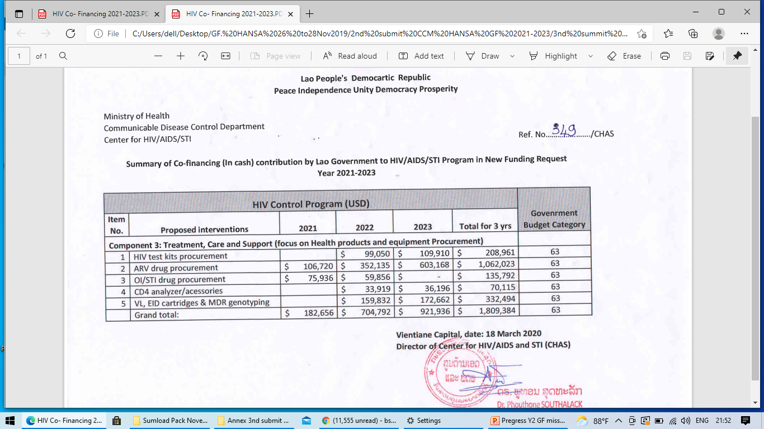
Y2022 Co- financing
Co- financing Y1 in letter was progess
Co-financing Y2
= 704,792 $
This amount was focus on Health product and equipment procurement
submitted on March 2021

Slide 19
Progress updated on Y2 co-financing
MOH approved on 1st November 2021.
list of health products (ARV, OI, Lab equipment and reagent were submitted to DPC.

Slide 20
Challenges

Slide 21
Challenges
Corona virus 19(COVID-1) pandemic since 1 April 2020 the country was lock down, it have impacted to PLHIV patience and it hard to reach the target group (Key population FSW and MSM) .
Entertainments, bar beers, resorts, Massage shops, guesthouses, schools those places were closed up service.
Transportation and travelling were restricted:
PLHIV could not come to pick up ARV at the health facilities(ART).
Vulnerable people could not come to service for HIV testing and treatment.
Patients are reluctant to come for health service at Health facilities.
Increasing of PLHIV lost of follow up.

Slide 22
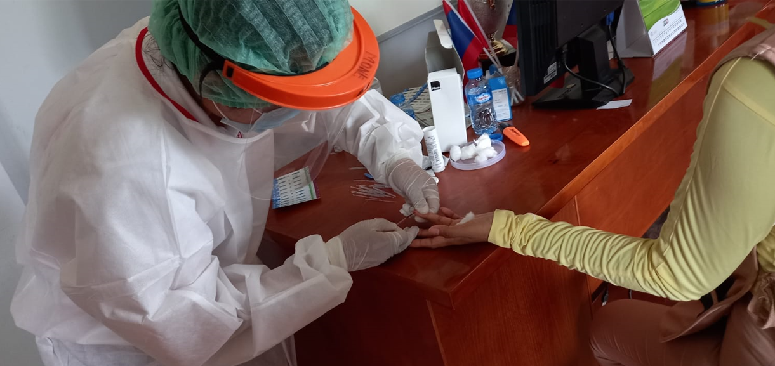
Spa & Beauty Massage
HIV test for FSW in field during covid19 situation
Rental room

Slide 23
Challenges(continue..)
Request from 23 point to DPC on Mach 2021 and 17 point July 2021 until now it will continued to fix on DHIS2 system
DHIS2 needs to continue improved the system such as :
Adherence calculate it not match with ARV drug on hand’s PLHIV.
PLHIV Next appoint date did not save in system..
Daily ARV regiment dose missed on Event report page…………..
DHIS2 system have not opened box yet to accept the result of VL result from Gen X-pert…………

Slide 24
Major risks to HIV Grant: FSW
Risks | Mitigation Measures | Risk management actions during COVID-19
1. Hidden high-risk populations FSW not being reached for VCT and services (Covid19 pandemic) (June-Oct/2021) | Developing mechanism to reach the hidden of FSW. Using social media to promote and link with network to access key population and HIV testing | Strengthening the closed coordination, collaboration and plan due to Covid-19 situation among CHAS, PCCAs/DCCAs, PE and CSOs to fit the real time situation. Continuing the implementation of activities on raising awareness and providing mobile HIV testing services at the sites and hotspots. Increasing the frequency to reach FWS in collaboration with the national and local TASK Force Committee against Covid-19 to find the way how to access to key population. 4. Recommending and providing the team at the implemented sites on the national guidelines of the prevention and control Covid-19. All should be healthy and safe. 5. Closely monitoring activities and ensuring data entry through DHIS2 system.

Slide 25
Major risks to HIV Grant: MSM
Risks | Mitigation Measures | Risk management actions_ Covid19 Pandemic
2. Hidden high-risk populations MSM not being reached for VCT and services (Covid19 pandemic) (June-Oct/2021) | Continuing to strengthen strategy for reaching MSM and providing health services. Improving Index testing activities Using social media and linking with network to promote and access the HIV testing | Consultation with partners at Provincial level and PCCAs for the guidance and set up plan to reach MSM target Using Social media or online network (WhatsApp, Facebook, MSM application group) to promote and access HIV testing and PrEP for key population such MSM. 3. Training-Retraining Peers and field teams on the Implementation of index testing and PrEP. 4. Improving coordination and collaboration between outreach activity teams and health care providers at health facilities on HIV testing and referral to ART sites. 5.Using safety IPC equipment during implemented activities such as PPE, mask, alcohol, gloves, self-face cap….for Peers. 6. Closely monitoring activities and ensuring data entry through DHIS2 system.

Slide 26
Major risks to HIV Grant: PLHIV
Risks | Mitigation Measures | Risk management actions_ Covid19 Pandemic
Disruption to ARV pick up and Care seeking ​due to COVID Lockdown | Communication and peer-support for drug delivery to ensure continuity of HIV treatment MMD Strategy Telehealth Provider Fast Track ARV pick up at ART sites Scaling up Point of Care (POC) sites | During COVID-19 outbreak, PLHIV were affected by travel restriction and had disruption in continuity of treatment. Peer support provides home delivery of MMD ARV refill during COVID lockdown Telehealth provider done by health care workers and Peers at ART sites is very crucial to follow up patient’s health and adherence. Using technology on mobile phone to have a video call for checking ARV drug and psycho-support during COVID lockdown. Fast track ARV pick up is more implemented during COVID-19 pandemic at ART sites according to the guidance and SOP Scaling up POC sites at provincial and district level will make PLHIV more accessible to HIV treatment, reduce transportation cost for ARV refill at ART sites and reduce LTFU cases particularly during COVID lockdown

Slide 27
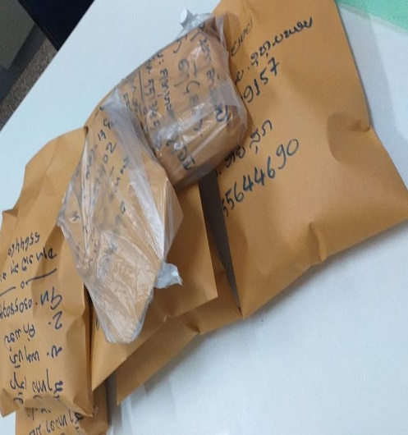
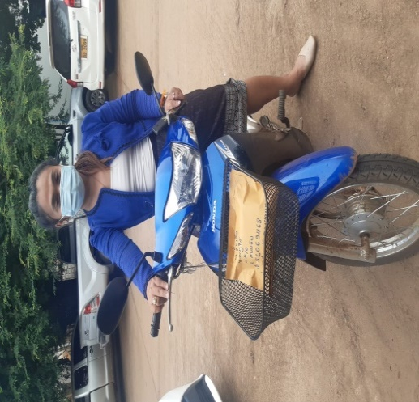
(Mitigation Plan)
SOP on community based ART Delivery model in Lao PDR
ARV
Scenario | Strategies
PLHIV living near ART sites | Fast track ART pick-up at ART sites
PLHIV living in the urban area | Home-based ART delivery by peers and health care workers
PLHIV living in the rural area | Community ART group delivery by peers Family group ART delivery
PLHIV living in other countries e.g., Thailand | ART refill by post

Slide 28
Number of PLHIV received ARV delivery in 2021
ART sites | Q2 (Apr-Jun) | Q3 (Jul-Sep) | Q4 (only October)
SVK | 89 | 279 | 30
STR | 295 | 297 | 150
MHS | 237 | 98 | 90
LPB | 158 | 217 | 102
CPS | 138 | 104 | 40
BK | 39 | 102 | 59
LNT | 76 | 0 | 0
KM | 251 | 331 | 99
TP | 71 | 59 | 20
HP | 75 | 52 | 19
FSH | 130 | 92 | 0
Total | 1559 | 1631 | 609

Slide 29
MMD in Q3/2021
966
0-12 weeks
6183
13-16 weeks
1263
17-20 weeks
289
21-24 weeks
113
>24 weeks
0-12 weeks
13-16 weeks
17-20 weeks
21- 24 weeks
>24 weeks
17-20 weeks
14.32%
0-12 weeks
10.9%
0-12 weeks
13-16 weeks
17-20 weeks
21-24 weeks
>24 weeks
13-16 weeks
70.14%
Bokeo
Salavan
Setthathi…
Mahosot
Friendship
Tonpheung
Oudomxai
Champasak
Khammuane
Houaphanh
Savannakhet
Luang Prabang
Luang Namtha
** Assumption from ARV dispensing and number of patient on ARV regimen data in Q3

Slide 30
HIV+, Register, retention ARV and lost of follow up since 2003- June 2021

Slide 31
Mitigating actions
Capacity building of Health care provider
Meeting with site to review implementation status with 11 ARV sites
Refresher training including case conference and QI workshop for Health care provider and CSOs
Develop and implement QI plan to improve index partner HTC service
Monitoring and coaching on site for care and treatment service
Support ARV sites conduct monthly meeting
Establishing selected new POC for stable PLHIV
Develop of quality improvement coaching manual
Training on utilization QI coaching manual for Health staff fro ARV
QI and index testing sharing lesson learned for ART and POC
Training S&D for health care staff in 11 ARV sites and 6 POC
Establishing HIV-1 Recent infection surveillance among persons newly diagnosed with HIV
National consultation workshop to finalize protocol of HIV-1 recency testing service
Capacity building 11 ARV sites and 1 POC to implement
Workshop for HIV recency data collection and reporting system ( VCT log book Lab log book, DHIS2 )
Strengthen laboratory Capacity and quality system
Strengthen National HIV serology EQA program t monitor laboratory performance and the quality of HIV testing
Consultation meeting to discuss and planning EQA
On site supervision and evaluation to observe the testing process
Strengthening HIV strategic information (SI)
Consultation meeting on sharing lesson learn to harmonize HIV/AIDS data from HIV CAM plus and DHIS2 software
Workshop on population estimation by used AEM software
Meeting on data quality check and data used for provincial and ART level in DHIS2 software
Consultation on monitoring and evaluation to support strategic information at CHAS
Supervision and monitoring data quality check in SVK and CPS provinces

Slide 32
Progress report on HIV-COVID-19 (2020-2021)
(Center for HIV/AIDS and STI)

Slide 33
Activities and Budget COVID-19 (2020): 919.527,22 USD
Detail activities:
IPC= Infection Prevention Control
EBS=Education Based Service
Training in IPC and EBS at Health center ( Dispensary )
Training on HIV patient management during Covid-19
Community based ARV dispensing for PLHIV during covid-19 outbreak
IEC material development of radio massages
Supervision District raising awareness for 4 diseases
HIV DHIS2 data management for ART and POC sites, coaching for Health staff, coaching for CSO staff
Printing pamphlets work with village chiefs to disseminate
Airtime to hospitals and Health center workers
Phone credit for routine report of EBS from Health center-village to District Health service and Provincial CDC
Procure Lab equipment ( SafeSeal Microcentrifuge tube, Filter pipette tips, RNA mini kit, HIV viral load testing using Gene X pert, CD4 testing machine and other consumables: Mask, Gel…
done
Implementer :
CHAS
NTB
CMPE
NCLE
CHAS: 152,000 USD
Those HIV activities is will be report in this PUDR 2021

Slide 34
C-19 RM (COVID-19 Response Mechanism Project)
Implementation Period 3 years : 1 January 2021 - 31 December 2023
Activities and Budget: 597.283 USD
Main Focus of C19RM Funding: Mitigation of Covid19 risks for the HIV programs

Slide 35
C19 RM Y1
= 134, 640 $
Detail activities 2021

Slide 36
Progress update C-19 RM funding (2021)
The Signed contract between DPC/NPOC/PR and CHAS to Implementation Project: 1st October 2021
Completed open bank account for COVID-19 funding 2021.
Recruited Project coordinator and Finance officer .
Remark: CHAS does not have any procurement of health product in this grand

Slide 37
Areas for further enhancement of partnerships
WHO : Technical assistance, guideline development, National data base (DHIS2), POC, PrEP, PMCT.
UNAIDS: HIV/AIDS National Strategic Action Plan Review and Development, Key Pop demographics survey
(IBBS),Technical assistance, M&E.
AHF : Support gap on some Peer at ARV site, community based testing, some test kit ad condom, Food
and some transportation.
Aids Care China: ARV care and treatment for foreigner , HCV – HBC treatment.
PEPFAR/USAID/FHI: Index & Self testing, Community Linkage and retention, adherence, KP (MSM, TG),
Training and supervision (CQI & Clinical Treatment Services), M&E, program management, PrEP , Quality
improvement, Strategic information, HTC, External quality assessment (EQA), index
testing, Recency testing.
GFATM/CHIA : HIV testing/Laboratory/community services, TB/HIV, KP, PP, Commodity & supply, ARV for
PrEP, PSCM/ Forecasting & Warehousing and Inventory (through CHAI), non-
professional HCWs, Above site Programs, Care and treatment, Prevention, OVC programs by CHIAS.
Government : Co-financing all health services including support partners fighting HIV/AIDS in country…

Slide 38
TB/HIV Collaboration
CHAS to share areas of collaboration with TB program: supervision, monitoring, testing and treatment, etc….
Assign TB/HIV focal point
Conduct quarterly meeting
Develop TB/HIV co-infection Policy and guideline
Share responsibility for indicator
Joint Monitoring and supervision
Support IPT and CPT for patient HIV infection
Viral load testing by using Gene X pert machine

Slide 39
Thank you for your attention
Q&A

