Slide 1
ລາຍງານຄວາມຄືບໜ້າ ໃນການສະເໜີຂໍທຶນຊ່ວຍເຫຼືອຈາກກອງທຶນໂລກ ປີ 2024 – 2026 HANSA II (PBC-6)
ດຣ ບົວທອງ ສີມະໂນວົງ, ຮອງຫົວໜ້າສູນຕ້ານເອດ ແລະ ພຕພ
ຄັ້ງວັນທີ 19 ມີນາ 2024

Slide 2
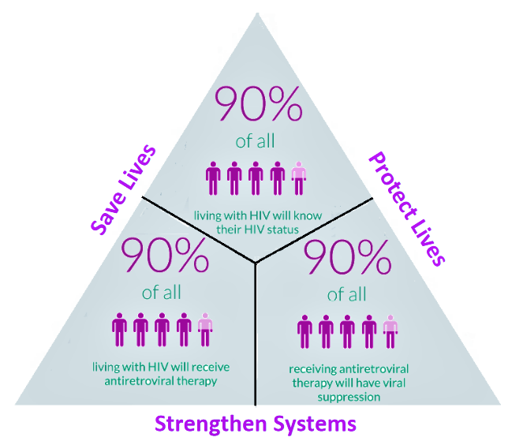
HIV/AIDS strategy to ending AIDS 2030
95%
NSP Goal
End the transmission and limit the impact of HIV and AIDS in Lao PDR by 2030
95%
95%
1. Strengthen an enabling environment for an effective HIV/AIDS response
3. Increase access to quality treatment and care services
Objective
2. Improve access to quality prevention services
Law, policy and advocacy
Human resources
Sustainability & fundraising
Management & planning
Strategic information
Stigma & discrimination
International & cross-border
Intervention
Female sex workers
Men who have sex with men
Transgender women
People who use & inject drugs
Mobile people & migrants
Pregnant women
Prisoners
Victims of human trafficking
Condoms
Sexually-transmitted infections
Blood safety
Online & social media
Pre-exposure prophylaxis
HIV testing
Treatment
HIV/TB
Home & community care & support
Mobile people & migrants

Slide 3
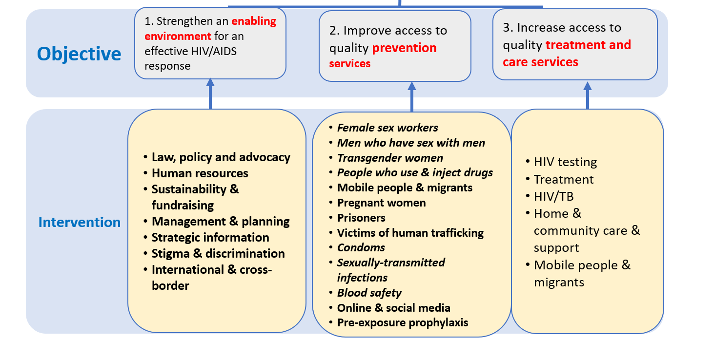
NSP Component 2
NSP Component 3
1st epidemic is among labour migrants 1990;
2nd epidemic is among most-at-risk populations since 2000;
HIV prevalence of 0.39% (AEM 2023) among the 15-49 year olds.
Men who have sex with Men : 5%
- Female sex worker : 1 %
PWUD/PWID : 0,6%

Slide 4
The national HIV cascade was updated based on new estimates from AEM for 2023. The 2022 PLHIV estimates were retrospectively updated from 15,681 to 17,983 (14% change) in the 2022 version of the AEM
Data source: Estimated PLHIV from updated AEM Feb 2023, 95 figures from DHIS2 - MOH updated as of November 2023 and report at 2023-Q4

Slide 5
#. ການຈັດສັນທຶນຊ່ວຍເຫຼືອຈາກກອງທຶນໂລກ (ອີງໃສ່ ຈົດໝາຍຈາກກອງທຶນໂລກ ລົງວັນທີ 20 ທັນວາ 2022)
ອົງປະກອນ ແຜນງານ | ການຈັດສັນງົບປະມານ (US$) | ໄລຍະໃນການນຳໃຊ້ທຶນ
ແຜນງານຕ້ານເອດ | 7,449,033 | 1 ມັງກອນ 2024 to 31ທັນວາ 2026
ແຜນງານຄວບຄຸມວັນນະໂລກ | 8,088,355 | 1 ມັງກອນ 2024 to 31ທັນວາ 2026
ລວມ | 15,537,388
ໂອກາດໃນການໄດ້ທຶນເພີ້ມຕື່ມຈາກ ຈຳນວນທຶນ ທີ່ໄດ້ ຈັດສັນໃຫ້ແລ້ວ: ສປປ ລາວ ແມ່ນຈັດຢູ່ໃນບັນດາ ປະເທດ ທີ່ມີເງື່ອນໄຂ ທີ່ຈະໄດ້ຮັບທຶນເພີ້ມຕື່ມອີກ ຈາກຈຳນວນທີ່ໄດ້ຈັດສັນໃຫ້ແລ້ວ ຮ້ອງວ່າ Matching Funds: ເປັນຈຳນວນເງິນ ➔ US$2,000,000 ສຳລັບ ສ້າງຄວາມເຂັ້ມແຂງ ໃຫ້ແກ່ ລະບົບ ຫ້ອງວິເຄາະ ແບບເສື່ອມສານ (Laboratory systems strengthening).

Slide 6
PBC 6 Overall objective
This PBC aims to increase access to quality of people-centred based approach for HIV services for all the people living with HIV, key populations through adoption and expansion of innovative and differentiated service delivery (DSD) models including HIV testing, PrEP and ART with strong involvement and participation of the affected communities and key populations.

Slide 7
PBC 6: Key populations and people living with HIV/AIDS access to HIV services
PBC No. | Detail | Y 1 (2024) | Y 2 (2025) | Y 3 (2026)
PBC 6.1 (ສືບຕໍ່) | Percentage of female sex workers (FSW) in the 5 target sites that have received an HIV test during the reporting period and know their results | 93% | 94% | 95%
PBC 6.2 (ສືບຕໍ່) | Percentage of men who have sex with men/transgender (MSM/TG) in the 5 target sites that have received an HIV test during the reporting period and know their results | 57% | 70% | 84%
PBC 6.3 (ສືບຕໍ່) | Percentage of people living with HIV (PLHIV) on ART among all estimated PLHIV at the end of the reporting period | 64% | 66% | 69%
PBC 6.4 (ໃໝ່) | Percentage of people living with HIV (PLHIV) on ART with a viral load test result at least once during the reporting period | 89% | 95% | 98%
PBC 6.5 (ໃໝ່) | Number of men who have sex with men (MSM)/transgender (TG) who received any PrEP product at least once during the reporting period. | 1100 | 1300 | 1500
Implementing Agency: Center for HIV/AIDS and STI ໂດຍມີ ຄູ່ຮ່ວມງານ ຄື CHIas, APL+, and PEDA
Total PBC value: 2,870,632US$

Slide 8
ຂໍ້ມູນທີ່ຕ້ອງໄດ້ລາຍງານ ເພີ້ມ ໃນແຜນງານຕ້ານເອດ (PF)
ກ. % ຂອງ ສບກ ທີ່ຕິດເຊື້ອ (HIV+) ທີ່ໄດ້ຖືກສົ່ງຕໍ່ໄປຮັບປິ່ນປົວ ໃນໄລຍະ 12 ເດືອນທີ່ຜ່ານມາ ຂ. % ຂອງ ຊພຊ/ກທ ທີ່ຕິດເຊື້ອ (HIV+) ທີ່ໄດ້ຖືກສົ່ງຕໍ່ໄປຮັບປິ່ນປົວ ໃນໄລຍະ 12 ເດືອນທີ່ຜ່ານມາ ຄ. % ຂອງ ຄົນທີ່ຕິດເຊື້ອ HIV (PLHIV) ທີ່ໄດ້ຮັບຢາຕ້ານເຊື້ອເຮສໄອວີ ສຳລັບຫຼາຍເດືອນ (multi-month dispensing “MMD”) ງ. % ຂອງຄົນທີ່ຕິດເຊື້ອ HIV ໃໝ່ ທີ່ໄດ້ເລີ້ມກິນຢາຕ້ານເຊື້ອ HIV ທີ່ໄດ້ຖືກກັ່ນຕອງຫາການຕິດເຊື້ອວັນນະໂລກ (TB Screening). ຈ. % ຂອງຜູ້ຕິດເຊື້ອ HIV ທີ່ລົງທະບຽນທີ່ໄດ້ຮັບ TPT/IPT ສຳລັບການປ້ອງກັນ ພະຍາດວັນນະໂລກ ສ. % ຂອງແມ່ຍິງຖືພາ ທີ່ຕິດເຊື້ອ HIV (PMTCT) ທີ່ໄດ້ຖືກສົ່ງຕໍ່ໄປຮັບການປິ່ນປົວ ຊ. % ຂອງເດັກນ້ອຍ ທີ່ໄດ້ຖືກສຳພັດກັບເຊຶ້ອ HIV ທີ່ໄດ້ຮັບການກວດຊອກຫາການຕິດເຊື້ອ HIV ພາຍໃນສອງ ເດືອນ ຫຼັງຈາກເກີດ (EID ໃນ4-6 Weeks)

Slide 9
#. PBC 6.1 Percentage of female sex workers (FSW) in the 5 target sites that have received an HIV test during the reporting period and know their results
Province | Tested for HIV (FSW) |  |  |  |  | HIV Testing Coverage (FSW)
 | Y0 2023 | Y1 2024 | Y2 2025 | Y3 2026 | Y4 2027 | Y0 2023 | Y1 2024 | Y2 2025 | Y3 2026 | Y4 2027
Vientiane Capital City | 3,664 | 3758 | 3852 | 3942 | 3991 | 92% | 93% | 94% | 95% | 95%
Vientiane Province | 1,526 | 1565 | 1604 | 1642 | 1662 | 92% | 93% | 94% | 95% | 95%
Khammouan | 1,267 | 1304 | 1336 | 1368 | 1385 | 92% | 93% | 94% | 95% | 95%
Savannakhet | 1,542 | 1582 | 1621 | 1659 | 1680 | 92% | 93% | 94% | 95% | 95%
Champasack | 1,235 | 1266 | 1298 | 1328 | 1345 | 92% | 93% | 94% | 95% | 95%
HANSA PBC Target | 9,235 | 9,476 | 9,711 | 9,939 | 10,062 | 92% | 93% | 94% | 95% | 95%
Numerator = Number of FSW in the targeted areas who have been tested for HIV during the reporting period and who know their results
Denominator = Estimated number of FSW in the targeted areas
Org. | Y1 | Y2 | Y3 | Total | % Cover
CSO | 4,136 | 4,238 | 4,338 | 12,712 | 44%
PCCA | 5,341 | 5,473 | 5,601 | 16,415 | 56%
Total | 9,476 | 9,711 | 9,939 | 29,126 | 100%

Slide 10
#. PBC 6.2 Percentage of men who have sex with men/transgender (MSM/TG) in the 5 target sites that have received an HIV test during the reporting period and know their results
Province | Tested for HIV (MSM+TG) |  |  |  |  | HIV Testing Coverage (MSM+TG)
 | Y0 2023 | Y1 2024 | Y2 2025 | Y3 2026 | Y4 2027 | Y0 2023 | Y1 2024 | Y2 2025 | Y3 2026 | Y4 2027
Luangprabang | 988 | 1190 | 1481 | 1800 | 2060 | 48% | 57% | 70% | 84% | 95%
Xayabouli | 611 | 736 | 916 | 1113 | 1274 | 48% | 57% | 70% | 84% | 95%
Vientiane Province | 1,134 | 1366 | 1701 | 2067 | 2366 | 48% | 57% | 70% | 84% | 95%
Bolikhamsay | 350 | 422 | 525 | 638 | 731 | 48% | 57% | 70% | 84% | 95%
Khammouan | 599 | 721 | 898 | 1091 | 1249 | 48% | 57% | 70% | 84% | 95%
HANSA PBC Target | 3,681 | 4,435 | 5,521 | 6,708 | 7,679 | 48% | 57% | 70% | 84% | 95%
Numerator = Number of MSM/TG in the targeted areas who have been tested for HIV during the reporting period and who know their results
Denominator = Estimated number of MSM/TG in the targeted areas
Org. | Y1 | Y2 | Y3 | Total | % Cover
CSO | 4,013 | 4,996 | 6,069 | 15,078 | 90%
PCCA | 422 | 525 | 638 | 1,586 | 10%
Total | 4,435 | 5,521 | 6,708 | 16,664 | 100%

Slide 11
#. PBC 6.3 Percentage of people living with HIV (PLHIV) on ART among all estimated PLHIV at the end of the reporting period (Nationwide)
Province | Total (cumulative) number of PLHIV on ART |  |  |  |  | % of PLHIV on ART of all estimated PLHIV
 | Y0 2023 | Y1 2024 | Y2 2025 | Y3 2026 | Y4 2027 | Y0 2023 | Y1 2024 | Y2 2025 | Y3 2026 | Y4 2027
HANSA PBC Target | 11,025 | 11,979 | 12,934 | 13,967 | 14,977 | 61% | 64% | 66% | 69% | 71%
Numerator = Number of people on ART at the end of the reporting period
Denominator = Estimated number of people living with HIV in Lao PDR

Slide 12
#. PBC 6.4 Percentage of people living with HIV (PLHIV) on ART with a viral load test result at least once during the reporting period (Nationwide)
Province | Total Net Tested for VL |  |  |  |  | % VL Test for all PLHIV on ART
 | Y0 2023 | Y1 2024 | Y2 2025 | Y3 2026 | Y4 2027 | Y0 2023 | Y1 2024 | Y2 2025 | Y3 2026 | Y4 2027
HANSA PBC Target | 9,213 | 10,610 | 12,232 | 13,627 | 14,612 | 84% | 89% | 95% | 98% | 98%
Numerator = Number of people on ART with a viral load test result at least once during the reporting period
Denominator = Number of people on ART who are eligible for HIV viral load testing (more than 6 months of ART initiation), excluding LTFU and death during the reporting period

Slide 13
#. PBC 6.5 Number of men who have sex with men (MSM)/transgender (TG) who received any PrEP product at least once during the reporting period (Nationwide)
 | Y1 2024 | Y2 2025 | Y3 2026
HANSA PBC Target | 1,100 | 1,300 | 1,500
Numerator = Number of who have sex with men (MSM)/transgender (TG) prescribed or dispensed any form of PrEP at least once during the reporting period
Denominator = NA

Slide 14
#. PBC 6 Value
PBC 6 | PBC Value Y1 US$ | PBC Value Y2 US$ | PBC Value Y3 US$ | Total 3 Y US$
PBC 6.1: % FSW tested in targeted sites | 186,240 | 175,440 | 175,440 | 537,120
PBC 6.2: % MSM/TG tested in targeted sites | 171,617 | 172,537 | 172,974 | 517,127
PBC 6.3: % PLHIV on ART nationwide | 525,938 | 511,966 | 524,654 | 1,562,558
PBC 6.4: % VLT nationwide | 29,676 | 29,900 | 29,900 | 89,476
PBC 6.5: No. PrEP for MSM/TG Nationwide | 44,350 | 60,000 | 60,001 | 164,351
Total | 957,821 | 949,843 | 962,968 | 2,870,632

Slide 15
#. Partner Allocate fund
HIV Component budget summary for 3yrs (2024-2026)
Resp. Unit | Budget | Budget | Budget | Total for 3yrs
 | Y1 (2024) | Y2 (2025) | Y3 (2026)
CHAS | 407,346 (43%) | 383,256 (40%) | 375,988 (39%) | 1,166,590
PHO | 315,878 (33%) | 333,690 (35%) | 353,084 (37%) | 1,002,652
PEDA | 68,860 (7%) | 68,860 (7%) | 68,860 (7%) | 206,580
Chias | 119,317 (12%) | 120,317 (13%) | 121,317 (13%) | 360,950
APL plus | 46,420 (5%) | 43,720 (5%) | 43,720 (5%) | 133,860
Total: | 957,821 | 949,843 | 962,968 | 2,870,632

Slide 16
Specific objective PBC 6.1
PBC 6.1: % of FSW in the 5 target sites that have received an HIV test during the reporting period and know their results: VTE cap, VTE Pro, KM, SVK, CPS.
Objective:
To increase the HIV testing coverage among FSW by updating and implementing the differentiated HIV service delivery and strengthening linkage to HIV prevention, treatment and care.
Main Activities:
1. Implement community-based testing for FSW through outreach activity, mobile testing and peer led intervention with adopting of index testing and HIV self-testing.
2. Conduct community awareness raising for HIV prevention and S&D reduction in community, incorporating with CLM: Public awareness on HIV prevention including S&D reduction at community level and printing IEC material
3. Strengthen on strategic information system (M&E capacity building and coordination, RDQA), including HIV sentinel surveillance for KPs: Training on data management for PCCA, health providers and community partners for HIV prevention and HTS such as VCT, STI, PrEP, Index testing.

Slide 17
Specific objective PBC 6.2
PBC 6.2: % MSM/TG in the 5 target sites that have received an HIV test during the reporting period and know their results: LPB, XYBL, BLKX, KM, VTE pro.
Objective:
To increase the HIV testing coverage among MSM/TG by updating and implementing the differentiated HIV service delivery and strengthening linkage to HIV prevention, treatment and care; and monitor the trend of HIV prevalence among key populations (MSM/TG)
Main Activities:
Implement community-based testing for MSM/TG through outreach activity, mobile testing and peer led intervention with adopting of index testing and HIV self-testing.
Establish community-based clinic as one-stop-shop at community level to provide HIV services including HIVST, ARV point of care, PrEP and condom&lubricants for prevention in priority locations.
Virtual intervention/Online reach and link to test ‘testVTE & MatesDer’, focus on MSM/TG and young population
community awareness raising for HIV prevention and S&D reduction in community, incorporating with CLM: Public awareness on HIV prevention including S&D reduction at community level
Strengthen on strategic information system (M&E capacity building and coordination, RDQA), including HIV sentinel surveillance for KPs: Conduct HIV sentinel surveillance among MSM/TG

Slide 18
Specific objective PBC 6.3
PBC 6.3: % of PLHIV on ART among all estimated PLHIV at the end of the reporting period
Objective: To improve ART coverage and retention on HIV treatment and care through implementation differentiated ART services delivery, expansion ART/POC sites in all provinces with capacity building for healthcare worker and CSOs.
Main Activities:
Expanding ART/POC sites in priority area. Target 4 POC sites in each year
Establish and improve referral system - linking newly diagnosed HIV from HIVST, KPLHV from community to ART or POC ART sites with CSO’s worker accompaniment
Build capacity for health care workers to enhance early/rapid ARV treatment with patient centred approach and AHD, co-morbidity management, including S&D reduction in all ARV and POC sites.
Promote DSD for HIV services at ART/POC sites to improve access to treatment, including ARV delivery for KPs through community based clinic – incoporating with QPS
Strengthen on SI (M&E capacity building and coordination, RDQA)
Community awareness raising for HIV prevention and S&D reduction in community– incorporating with CLM
Program management – hiring contracted staff and running cost

Slide 19
Specific objective PBC 6.4
PBC 6.4: % of PLHIV on ART with a viral load test result at least once during the reporting period
Objective:
To improve access to HIV viral load testing and follow up across the country.
Main Activities:
Promote POC VL testing at district level and intensify quality of VL monitoring with case management and data reporting, using IT to facilitate VL lab services.
Support PLHIV engagement in HIV care and treatment through tele health counselling, psycho-social and mental health support
Reinforce U=U awareness among PLHIV/KPLHIV, reduce S&D in community
Lesson learned workshop to review program updates and improve HIV testing and treatment services

Slide 20
Specific objective PBC 6.5
PBC 6.5: Number of MSM/TG who received any PrEP product at least once during the reporting period.
Objective:
To scale up PrEP service and uptake.
Activities
Roll out and simply PrEP services for MSM/TG
Develop and implement differentiated PrEP services in community

Slide 21
Key interventions | Implementors
Update the mapping of locations and sub-populations of FSW & MSM/TG update size estimation and HIV prevalence, and inform program planning | CHAS/PHO
Update DSD strategy and guidelines for HIV prevention package, specifying comprehensive and minimum packages of HIV services for KPs | CHAS/CSOs
Conduct training for health provider and community workers in DSD for KPs and their sexual partners and clients | CHAS/CSOs
Develop virtual intervention strategy in line with Digital for health strategy to improve access on HIV services among KPs and other OVP, including innovative strategy for HIV prevention, PrEP, PEP, STI/hepatitis testing, condoms and lubricant promotion | CHAS/CSOs
Increase HIV case finding: in health care setting and community through CBT, outreach activity using rapid screening test kit, HIVST and index testing. | PHO/CSOs
Update PrEP guideline to simplify PrEP service delivery and roll out PrEP for KPs in nationwide | CHAS/CSOs
Establish community-based clinic as one-stop-shop at community level to provide HIV services including HIVST, ARV point of care, PrEP and condom for prevention in priority locations. | PHO/CSOs

Slide 22
Key interventions | Implementors
Expanding ART/POC sites in priority area. Target 4 ART/POC sites in each year | CHAS/PHO
Capacity building for HCWs and lay providers to improve early/rapid ARV treatment with patient-centered approach and AHD, HIV/TB and other co-morbidity management at all ARV and POC sites. | CHAS
Support integrating of routine HIV services for pregnant women at HCs in high burden areas, and ensure linkage HIV+ mothers to access care and treatment and EID for exposed infants | CHAS/PHO/DHO
Improve Quality of HIV services based on QPS conditions and 5 Good and 1 Satisfaction, MOH policy (Improve referral system; training/workshop on HTS, PMCT, EID; On site supervision…) | CHAS/PHO
Conducting and mentoring on S&D reduction activities in healthcare facilities and community in line with S&D reduction package | CHAS/PHO/CSOs
Community awareness raising on HIV prevention and S&D reduction interventions in line with S&D action plan in 4 settings (HF, Educational setting, Workplace setting, Community setting) | CHAS/PHO/CSOs/partners
Support community involvement of PLHIV through COC package, SHG strengthening and CLM | CSOs
Strengthening on DQA for ARV tracker for ART & POC sites | CHAS
Strengthen on service delivery and strategic information system (M&E capacity building and coordination, routine data management, data quality and data use, continue to strengthen the surveillance system (HSS+) S&D survey and Policy development. | CHAS

Slide 23
ການປະກອບເອກະສານຫຼັກ | ຄວາມຄືບໜ້າ
ສັນຍາກັບ CSOs (PEDA, CHIas, APL+) | ສຳເລັດ
POM (Project Operation Manual) | ສຳເລັດ
Master Plan (2024-2026), AOP_2024 (Annual Operation Plan 2024), PMF (Project Performance Monitoring Framework) | ສຳເລັດ
Procurement Plan (HPMT ສຳລັບການຈັດຊື້ທັງຫມົດພາຍໃຕ້ງົບປະມານກອງທຶນໂລກເດິ້ເອື້ອຍ ທັງ 3 ປີ) | ສຳເລັດ
TOR TAs (International TA from UNAIDS and CHAI) | ສຳເລັດ

Slide 24
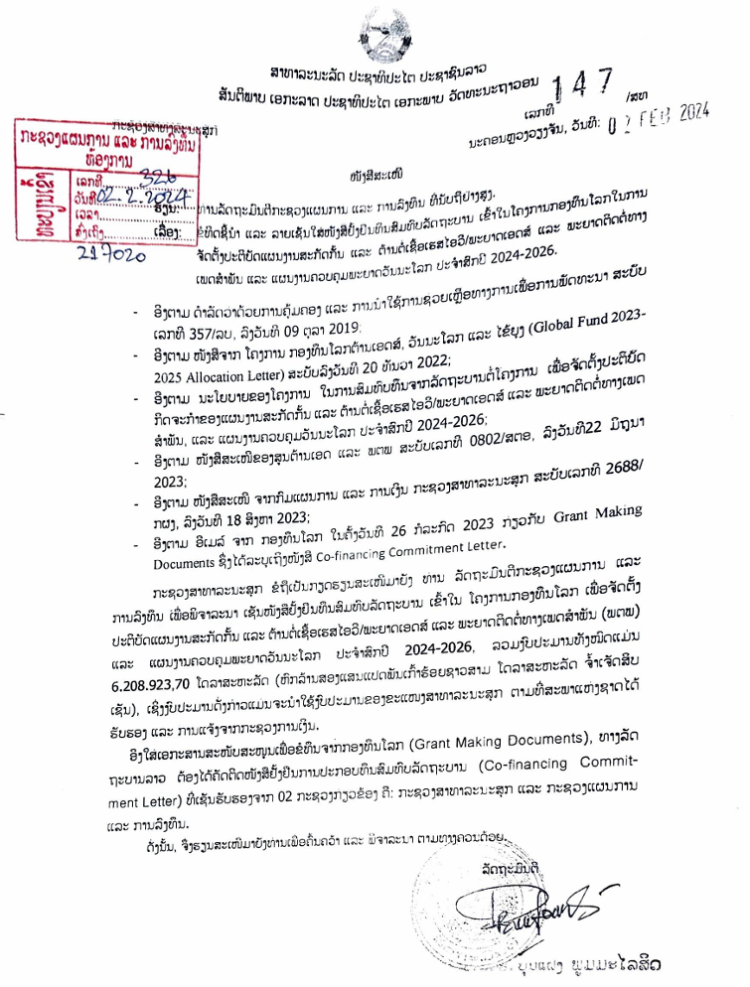
Draft GC7 co-financing commitments(September 21, 2023)
 | 2024-2026 commitments (USD) |  |  |  | Additional amount (Difference in totals) (USD)
 | Y1 | Y2 | Y3 | Total
 | Budget | Budget | Budget
HIV | 1,064,902.84 | 917,915.64 | 1,124,661.50 | 3,107,479.98 | 1,345,699.28
TB | 1,005,200.81 | 1,201,777.40 | 894,465.51 | 3,101,443.72 | 2,128,961.19
Totals | 2,070,103.65 | 2,119,693.04 | 2,019,127.01 | 6,208,923.70 | 3,474,660.47
Program | Intervention/Activity | Total domestic financing commitment for 2024-2026 (USD)
HIV | 1) Antiretroviral medicines | 390,588.68
 | 2) HIV Rapid Diagnostic Tests | 157,502.12
 | 3) HIV Viral Load and EID cartridge | 239,773.88
 | 4) Opportunistic infections and STI medicines | 590,425.10
 | 5) CD4 analyzers/ accessories and lab reagents | 216,523.56
 | 6) Lab consumables | 73,435.59
 | 7) Expanding new POC sites in provincial and district level | 88,118.00
 | 8) Capacity building on program management and strengthening on strategic Information | 481,129.00
 | 9) HIV Prevention Program (for KPs, OVP, AGYW, GP) | 165,671.00
 | 10) Differentiated HIV testing and treatment | 443,590.00
 | 11) TB/HIV collaboration | 80,000
 | 12) PMCT program | 105,223.05
 | 13) S&D survey | 75,500

Slide 26
Challenges
Increasing new HIV diagnosed (17% increased in 2023 compare to 2022 data) particularly among young MSM and TG group
GF/HANSA efforts may not be enough to create visible impact on first 95
MOU HANSA II project already started on 1/1/2024, but the budget is not transferred to PBC implementors
Integrated service delivery at PHC is challenging for HIV program
KP cross border
Expanding POC testing for HIV VL-GXP and EID-GXP at district level
KP/PLHIV stigma and discrimination still being obstacles to access health services
CLM implementation under HANSA II with CSO engagement towards to build sustainability
Government co-financing for 2024-2026 is challenging to contribute achievement of 95-95-95

Slide 27
ສິ່ງທ້າທາຍ
ອີງໃສ່ສັນຍາຂອງການຈັດຕັ້ງປະຕິບັດໂຄງການ HANSA II ແມ່ນເລີ່ມຕົ້ນ 1/1/2024 ແຕ່ປະຈຸບັນ ພວກເຮົາຍັງບໍ່ໄດ້ຮັບງົບປະມານ ແລະ ບໍ່ທັນເລີ່ມປະຕິບັດໄດ້
ການຈັດຕັ້ງປະຕິບັດກິດຈະກຳແບບເຊື່ອມສານ ຍັງເປັນສິ່ງທ້າທາຍ, ເຄື່ອງມືຕ່າງໆ ຍັງບໍ່ທັນໄດ້ປັບປຸງ
ການເຂົ້າເຖິງກຸ່ມ ສບກ ທີ່ເປັນກຸ່ມເຄື່ອນຍ້າຍ ແລະ ແອບແຝງ (ສາວມືຖື)
ການເຂົ້າເຖິງກຸ່ມ ຊພຊ ໂດຍສະເພາະ ກະເທີຍ ໄວໜຸ່ມ
ການແກ້ໄຂບັນຫາຈຳແນກ - ລັງກຽດ ຕ້ອງການການມີສ່ວນຮ່ວມຈາກຫລາຍພາກສ່ວນ
ການຂະຫຍາຍຕາໜ່າງກວດ HIV VL ແລະ EID ດ້ວຍເຄື່ອງ GXP ຢູ່ຂັ້ນເມືອງ
ງົບປະມານສົມທົບຂອງລັດຖະບານ ສຳລັບປີ 2024 – 2026 ຍັງເປັນສິ່ງທ້າທາຍ

Slide 28
ສິ່ງທ້າທາຍ
Increasing new HIV diagnosed (17% increased in 2023 compare to 2022 data) particularly among young MSM and TG group
GF/HANSA efforts may not be enough to create visible impact on first 95
ການຄົ້ນຫາຜູ້ຕິດເຊື້ອ ໃນປີ 2023 ໄດ້ 84% ຊຶ່ງຍັງບໍ່ສາມາດບັນລຸເປົ້າໝາຍໄດ້ ເນື່ອງຈາກງົບປະມານແມ່ນອີງໃສ່ໂຄງການຊ່ວຍເຫລືອເປັນຫລັກ ຊຶ່ງການຈັດຕັ້ງປະຕິບັດຍັງບໍ່ທັນກວມເອົາໄດ້ທຸກໆແຂວງ;
ຕາໜ່າງການບໍລິການກວດເລືອດຊອກຫາການຕິດເຊື້ອ HIV ຍັງບໍ່ສາມາດຂະຫຍາຍລົງຮອດທຸກສຸກສາລາ, ລວມທັງສະຖານທີ່ປິ່ນປົວດ້ວຍຢາຕ້ານຕໍ່ເຊື້ອເຮສໄອວີ (ARV) ກໍ່ຍັງມີຈຳກັດແຕ່ຢູ່ໂຮງໝໍສູນກາງ, ໂຮງໝໍແຂວງ ແລະ ເມືອງ 2 ແຫ່ງ;
ການໂຄສະນາກ່ຽວກັບຄວາມຮູ້ ແລະ ວິທີປ້ອງກັນ HIV ຍັງບໍ່ກວ້າງຂວາງ. ຈາກຜົນການສຳຫຼວດ LSIS 3 ພົບວ່າຄວາມຮູ້ກ່ຽວກັບ HIV ໃນກຸ່ມຊາວໜຸ່ມ (15-24ປີ) ຍັງຕ່ຳ (ຜູ້ຍິງ 20,1%, ຜູ້ຊາຍ 23,1%)

Slide 29
ບັນຫາ ແລະ ສີ່ງທ້າທາຍ (ຕໍ່)
ຄົນເຈັບເຂົ້າມາຮັບການປິ່ນປົວຊ້າ ແລະ ຍັງມີຈຳນວນຂາດການຕິດຕາມໃນການປິ່ນປົວ;
ບັນຫາການຈຳແນກ-ລັງກຽດຜູ້ຕິດເຊື້ອ ຍັງມີຢູ່ໃນສະຖານບໍລິການສາທາລະນະສຸກ, ຊຸມຊົນ, ສັງຄົມ ແລະ ກຸ່ມຜູ້ຕິດເຊື້ອເອງ;
ການສະໜອງນ້ຳຢາກວດເລືອດຊອກຫາການຕິດເຊື້ອເຮສໄອວີ ສຳລັບແມ່ຍິງຖືພາ, ຢາປິ່ນປົວພະຍາດແຊກຊ້ອນ ບາງລາຍການແມ່ນບໍ່ພຽງພໍ
ການມີສ່ວນຮ່ວມຂອງສັງຄົມ, ຊຸມຊົນ ແລະ ເອກະຊົນ ຍັງມີໜ້ອຍ;
ງົບປະມານໃນການຈັດຕັ້ງປະຕິບັດວຽກງານຕ້ານເອດ ຍັງບໍ່ພຽງພໍ, ແລະ ທຶນຊ່ວຍເຫຼືອຈາກສາກົນ ນັບມື້ນັບຫຼຸດລົງ, ຄວາມຍືນຍົງທາງດ້ານງົບປະມານ.
ສະນັ້ນ ການທີ່ຈະບັນລຸເປົ້າໝາຍ 95-95-95 ໃນປີ 2025 ຍັງມີຫຼາຍສິ່ງທ້າທາຍ

