Slide 1
COUNTRY COORDINATING MECHANISM The 4th Plenary Meeting – Calendar Year 2021
CCM-CSO, Key population and People Living with Diseases Constituency
09 December 2021
Don Chan Palace Hotel, The Conference Room 2nd Floor, VTE Capital
Presented by: Dr. Inleusa BASENGKHAM

Slide 2
ຫົວ​ຂໍ້​​ແລກປ່ຽນ/outline
01
Background of CCM-CSO-KPs and PLWDs contribution
02
Process Update on new Election;
03
Next step

Slide 3
Background of CCM-CSO-KPs and PLWDs contribution
ປະສົມປະສານທຶນຂອງ GF ກັບຊັບພະຍາກອນຂອງປະເທດ ອື່ນໆ
ສ້າງຄຳສະເໜີຂໍທືນ ແລະ ແຕ່ງຕັ້ງ PR
ຕິດຕາມກວດກາທືນຊ່ວຍເຫຼືອ ອະນຸມັດຄຳສະເໜີຮ້ອງຂໍການສ້າງໂຄງການຄືນໃໝ່
ເຮັດເປັນເອກກະສານ ແລະ ສື່ສານກັບຜູ້ເລືອກຕັ້ງຂອງຕົນແລະ ກັບ GF
ຈັດຕັ້ງ ແລະ ດຳເນີນການ CCM ແລະ ກອງເລຂາຂອງຕົນ

Slide 4
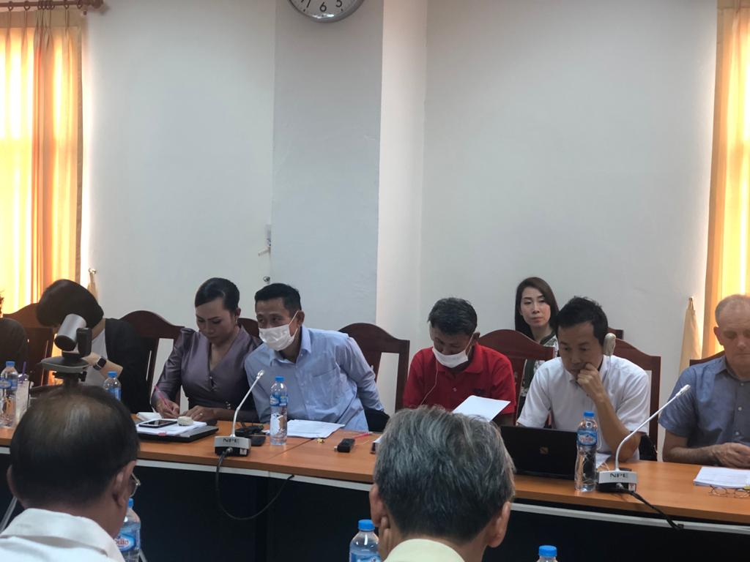
Participate the CCM Meeting
2017
2020

Slide 5
Joint field visit with CCMs
2017
2020

Slide 6
Process Update on new Election 2021 CSO-KPs-PLWDs;
The workshop is operated in accordance with its defined agenda by representing the overall view of the reform and focusing on the importance of the participation of civil society organizations. The representation is made by the experts from CCM Secretariat.
After that, the workshop is operated as follows:
The new CCM-CSO-KPs and PLWDs Representative Learn more about HANSA project and DLI indicator ( Presented by World Bank)
The new CCM-CSO-KPs and PLWDs Representative Learn more about Global Funds policy ( Presented by Global Fund Portfolio manager)
Introduction CCM ToR ( Presented by CCM Secretariat)
Review and discuss TOR for CSOs-KPs and PLWDs Sub-sector
Sharing experiences of being CCM member by chair of PLHIV network
Select the new CCM member by representation of CSO-KPs and PLWDs
Endorsed new CCM member and alternate from CSO-KPs and PLWDs
Discuss on CCM member Roadmap

Slide 7
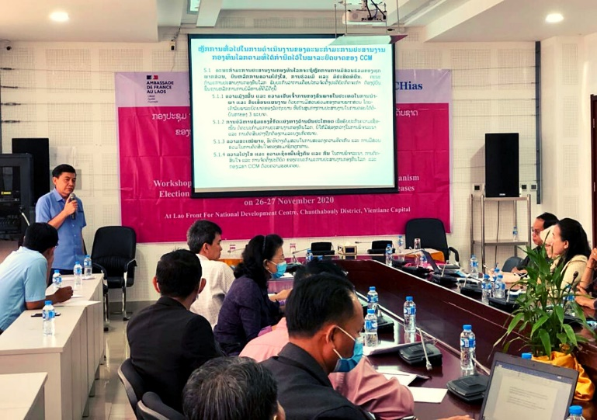
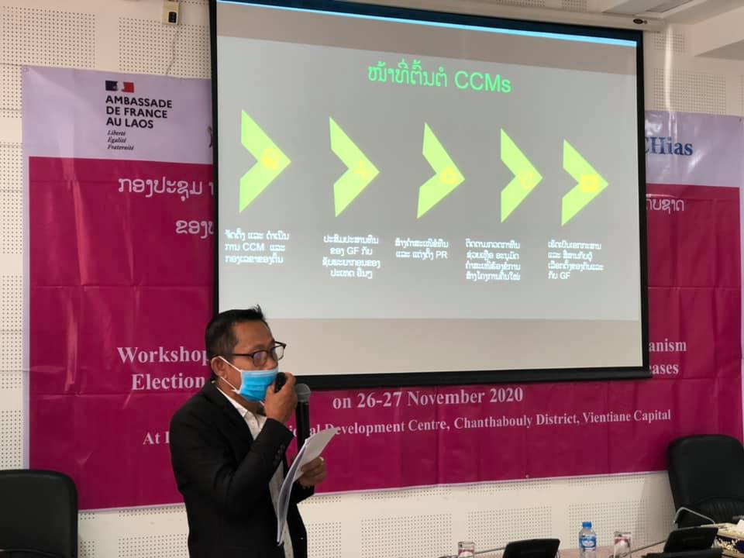
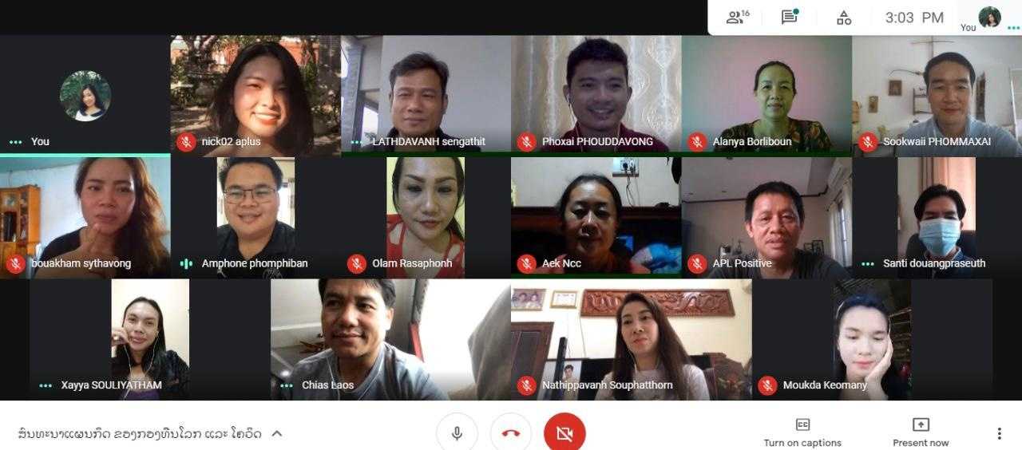
Process Update on new Election 2021 CSO-KPs-PLWDs;
CCM member present lesson learn for 3 years from his representation of PLHIV

Slide 8
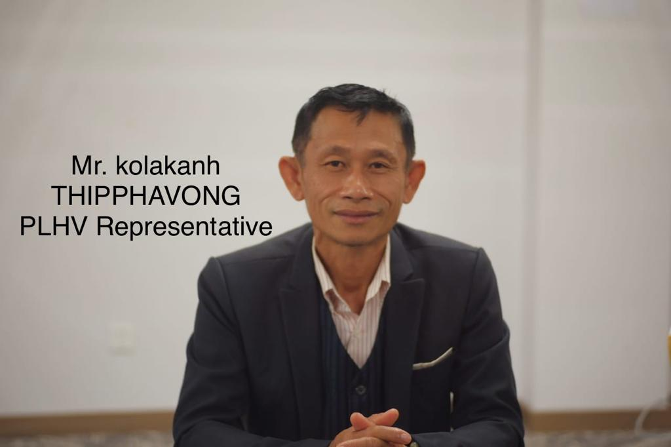
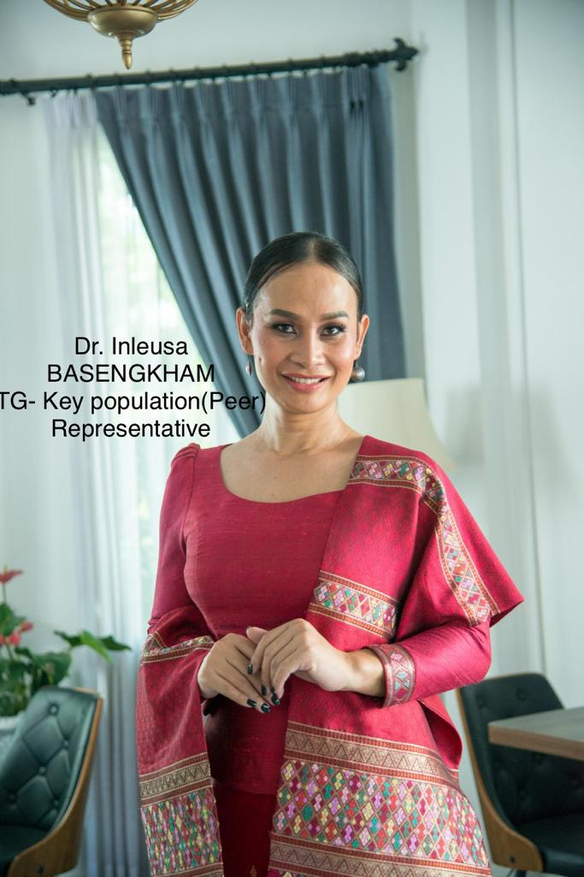
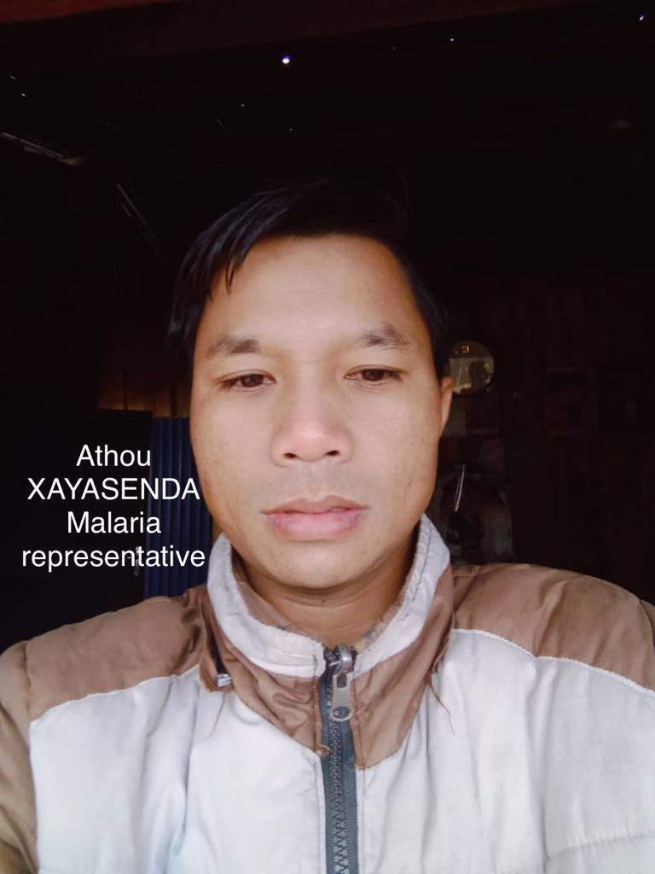
NEW CCM Member CSO-KPs and PLWDs
New CCM Member-CSO-KPs and PLWDs Endorsed

Slide 9
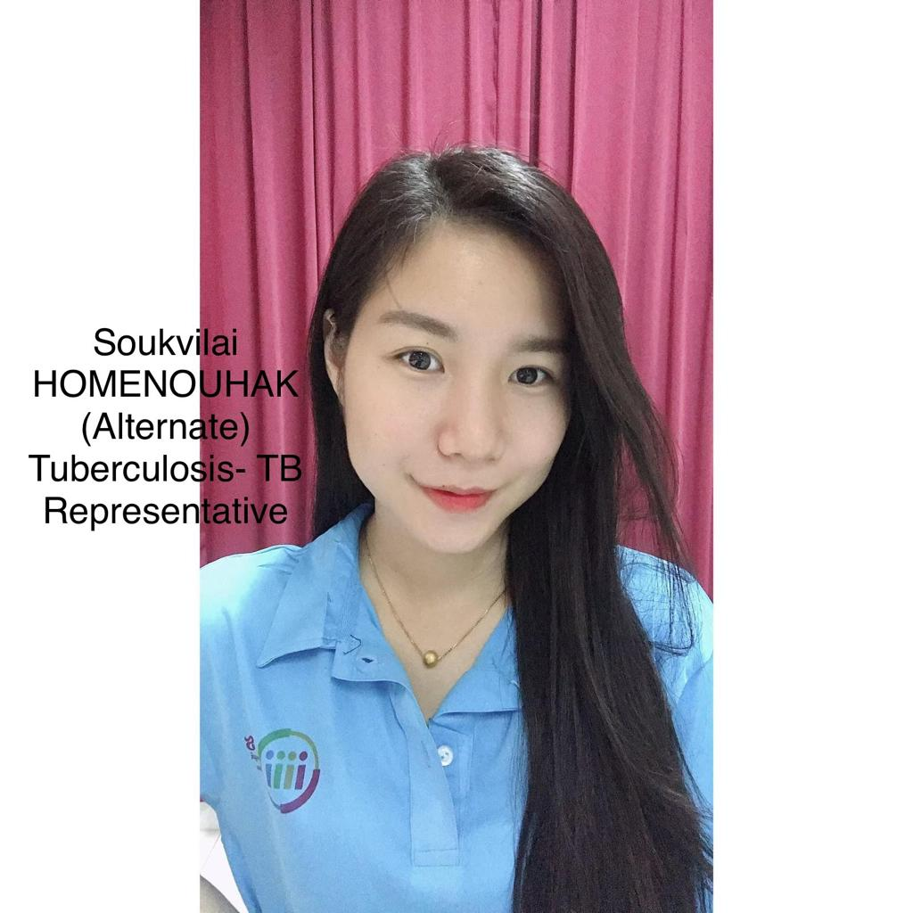
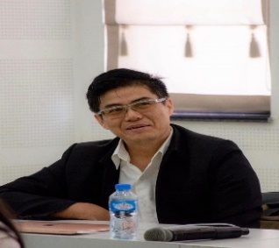
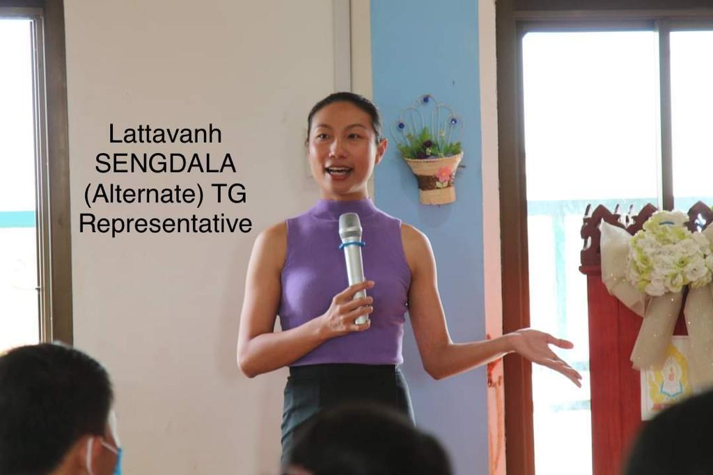
New CCM Alternate Member-CSO-KPs and PLWDs Endorsed
Dr. Souphon SAYAVONG
(Alternate) Lao CSO Representative

Slide 10
Next Step: 2022
Participate on process of CCM national transition plan
Joint field visit with CCM from other CCM-CSO, Key population and People Living with Diseases Constituency
Participate CCM regularly meeting in the year 2022
Request Technical Assistance from Expertise France Initiative on capacity building for our CCM-CSO-KPs and PLWDs

Slide 11
Thank You for your Kinds Attention

