Slide 1
HIV/TB Thematic Audit in Southeast Asia (Lao PDR)
CCM Debrief Meeting
26 October 2023
Vientiane, Lao PDR

Slide 2
The Office of the Inspector General (OIG)
Facts and Figures
The OIG exists to safeguard the assets, investments, reputation and sustainability of the Global Fund
An independent office set up in 2005, reporting directly to Global Fund Board
Promotes good practice, reduces risk and condemns abuse
A team of 52 people: auditors, investigators & support staff
Around 20-25 audit, investigation & advisory reports per year
All audit and investigations reports are published and
available on The Global Fund website: www.theglobalfund.org/oig

Slide 3
AGENDA
Audit Objectives and Scope
Key messages across audit objectives
Objective #1
The implementation modalities of the TB and HIV grants to ensure the achievement of grant objectives
Objective #2
Grant interventions and approach to implement sustainable people-centered systems for health to deliver impact
Next steps

Slide 4
Audit Objectives
Scope of work
The implementation modalities of the TB and HIV grants to ensure the achievement of grant objectives
Audit Period | July 2021 to December 2022
Principal Recipient | Ministry of Health of the Lao People’s Democratic Republic
Work Performed:
Interviewed key stakeholders incl. country coordination structures, implementers, the National Disease Programs, and development partners to discuss the audit objectives, scope, and approach
Reviewed relevant documents and implementers’ processes/controls
Reliance placed on work done by other assurance providers
Effectiveness of grant interventions and approach to implement sustainable people-centered systems for health to deliver impact
1 PH Specialist
1 Financial Auditor

Slide 5
Key messages across objectives
HIV and TB may not be ended as epidemics by 2030 in Lao PDR if the current trend continues
Challenges in implementing people centered systems for health and maximizing human rights
Challenges associated with sustainability and co-financing

Slide 6
AUDIT OBJECTIVE #1
The implementation modalities of the TB and HIV grants to ensure the achievement of grant objectives
HIV and TB may not be ended as epidemics by 2030 in Lao PDR if the current trend continues
Limited integration of TB and HIV services with primary healthcare
The absence of comprehensive, accurate, and standardized data, compounded by challenges incl. limited staff capacity and manual entry errors
Increasing incidence of HIV, particularly among Men who have Sex with Men (MSM)
HIV treatment coverage and quality
Significant challenges in TB detection, including the absence of standardized specimen collection and transportation systems, low case notifications, missed cases, shortage of GeneXpert machines, and limited resources for follow-up and verification

Slide 7
Good practices observed
HANSA has fostered ownership at the subnational level more effectively than previous initiatives, especially concerning TB
HANSA 1 experience and evaluations triggered a forward-thinking approach that is translated in the designing of the HANSA 2, to enhance the integration of disease-specific programs within the national healthcare landscape
The HANSA 2 project is committed to enhancing healthcare services for individuals with TB and HIV. This includes providing essential medicine and diagnosis, ensuring continuity of treatment, increasing health centres' capacity for counselling and screening, and improving referral systems
Technical assistance through WHO to support the TB and HIV programs to provide up to date normative guidance, and laboratory support
In HANSA 2, Technical Assistance (TA) provided by CHAI aims to align procurement cycles with domestic funding schedules, minimizing the risk of stockouts and ensuring consistent availability of TB medications
The National Strategic Plan involves comprehensive strategies such as treating all TB cases, enhancing TB/HIV collaborative activities and training healthcare professionals
Creation of a roadmap for the HIV program with USAID support, aiming for national self-reliance by 2030
Most testing activities are provided by CSOs under the new funding model while maintaining coordination with facilities who are also responsible for reporting into the DHIS2
CHAS has outlined plans to decentralize POC early infant diagnosis, a measure that helps increase accessibility and reduce costs for the government
Notes:
DSD - Differentiated Service Delivery

Slide 8
1. Limited integration of TB and HIV services with primary healthcare
HANSA 1 was not able to complete the integration of vertical programs as one of the program objectives, as a result, achieving Universal Health coverage by 2025 will not be possible
Skills and education gaps among health workers including gaps in clinical skills among frontline health workers with no training happening in HANSA 1 which was supposed to come from domestic funding
Challenges in decentralization and fund disbursement like the decentralization of TB program which was in progress before HANSA, but delays in fund disbursement due to the long administrative process hindered its effectiveness including essential activities like delayed transportation of sputum, testing and treatment initiation
Challenges in providing HIV testing services at PHC facilities:
Screening tests limited to district level, with confirmation tests performed at provincial level, discouraging the patients from following the cascade. For example, the achievement of the target for HIV rapid test for pregnant women was 10% in 2022-2023.
Coordination challenges:
Ambiguity surrounding CCM's role in relation to the HANSA steering committee, indicating oversight gap in project's initial planning.
Advisory and oversight role of CCM on joint operation after deal signing still undefined
Notes:
The delay in the registration process of HIV-positive people increases the risk of dropping out before official registration.
Decrease in HIV testing of pregnant women; shortage of tests required for testing of pregnant women at the health centers (1.9% between the first 6 months of 2022).
Lack of integration between HIV and maternal and child healthcare (MCHC) and family planning programs is limiting progress in the introduction of testing for pregnant women at health centers.
Annual increase of 7% for new infections in 2022 compared to 2021. In 2022, among an estimated 838 cases of new HIV infection, MSM will represent the majority (33%), and FSW, TG, and PWID will all together comprise 8% of all new cases

Slide 9
2. The absence of comprehensive, accurate, and standardized data, compounded by challenges incl. limited staff capacity and manual entry errors
Data challenges and verification process:
Lack of baseline data for TB and HIV during the project's inception phase poses a benchmark challenge
Issues with independent academic institution (IAI) understanding of verification tasks, inconsistencies in verification reports, and weak Quality Assurance from NPCO
Lack of formal tracking and documentation regarding error margin between paper-based and DHIS2 data; adjustments made collaboratively without written feedback
Independent Academic Institution verification was convenience-based with selected districts in pre-chosen provinces, impacting program achievements due to the selection of less performing or low TB burden provinces
HIV/TB integration obstacles:
Limited healthcare staffing and staff skills development, encompassing technical and non-technical skills
Limited M&E efforts, efforts duplications, and problems related to adherence to indicators without shortcuts
Limited collaboration across teams to expedite progress in challenging provinces and districts
Limited communication between project levels, formalized communication plans, and training in technical issues and customer service
Enhanced understanding of DLI mechanisms at the district level and below is critical

Slide 10
3. Increasing incidence of HIV, particularly among Men who have Sex with Men
Challenges with the implementation of PreP program:
Challenges in PreP implementation, including low acceptance rates (34%) and the need for root cause analysis, particularly focused on different age groups
There is confusion about PreP rollout plans and target revisions (GF targets being 49% for 2024, 35% for 2025, and 28% for 2026)
Limited resources for community-led services and rigid health facility guidelines, long waiting times, and stigma hinder PreP demand
A need for innovative training methods, emphasizing online outreach and understanding sexual and gender orientation
Risks associated with areas and needed improvements:
Lack of updated mapping, neglect of positivity yield data (It is important to update the targets and the strategy for interventions based on the positivity data/yield data), and inclusion of TG within MSM
Absence of differentiated prevention packages between MSM and TG despite inclusion in the National Strategic Plan (NSP) 2020-2025.
Insufficient materials for awareness campaigns, especially condoms, and lack of incentives for volunteers participating in HIV/AIDS awareness activities

Slide 11
4. HIV treatment coverage and quality
Discrepancy in follow-up period and WHO staging:
Guidelines suggest 28 days of to start the LTFU, the country’s guidelines indicates 90 days, causing inconsistencies in treatment evaluation
Delays in treatment initiation are not assessed against WHO staging, affecting treatment enrolment
DHIS 2 lacks updated WHO staging information, leading to incomplete and unreliable 2022 data
Inconsistent Same-Day Treatment Initiation:
Same-day treatment initiation rates were 22.1% in 2022 and 29.9% in 2023, not correlated with WHO guidelines.
Only one Point of Care (POC) facility facilitated treatment initiation in 2022, indicating limited capacity
Capacity Building and Standardized Procedures:
Capacity building for Point of Care (POC) facilities is essential to improve treatment initiation rates
Provider-initiated testing at Primary Healthcare (PHC) level is in question, urging SOP reviews for standardized procedures
Multi-month dispensing challenges:
Multi-Month Dispensing (MMD) lasting 5-6 months poses risks for VL testing mental health follow-ups.
Barriers to access and cultural challenges:
Geographical barriers, limited accessibility due to bad road conditions, and financial barriers such as indirect costs (transportation etc.) hinder patients' access to treatment
Cultural barriers, particularly regarding condom use among ethnic minorities, pose challenges in preventive measures implementation
Stock shortages and follow-up difficulties:
Insufficient opportunistic infections drugs were reported in early 2023 which became not available since June 2023 until October (the final date of the audit)
Patients' accessibility is reduced by geographical barriers, financial constraints, and stigma, leading to follow-up challenges and patients lost to follow-up due to emigration and contact changes. E.g., only during the first six months of 22, 64 out of the 978 patients for ART were lost to follow-up

Slide 12
5. Challenges in TB case detection
Significant challenges in TB detection, including the absence of standardized specimen collection and transportation systems, low case notifications, missed cases, shortages of GeneXpert machines, and limited resources for follow-up and verification
Inadequate Capacity and Monitoring: Health facility staff lack the necessary capacity for systematic TB screening among household contacts of all ages, and there's a need to enhance programmatic and funding monitoring.
Integrating TRP-recommended indicators and prioritizing systematic TB screening among household members were lacking in HANSA I.
Challenges in CSO Involvement: New WHO guidelines restrict Civil Society Organizations (CSOs) from sputum collection in TB eradication efforts. Challenges arise in aligning different donor services offered to the same target population. Balancing aspirations for Active Case Finding (ACF) with collaborative support needs to be addressed.
High percentages of deaths within one month of tuberculosis treatment in the years 2019 to 2022 (61, 65, 68 and 73%, respectively) highlight significant delays in diagnosis and initiation of treatment, indicating that patients are often diagnosed and treated at advanced disease stages.
Low performance in terms of active case finding and contact tracing
Decline in the number of identified RR-TB cases from 52 cases identified in 2018 to 44 cases in 2021 (using the estimated incidence)
Barriers to optimum TB screening:
Several barriers hinder optimum TB screening at the country level.
Inadequate Chest X-ray coverage, l
Limited accessibility to GeneXpert screening tools at district levels (GeneXpert coverage around 66%)
Remote regions face difficulties in accessing TB services, exacerbating the problem.
COVID-19 lockdowns led to decreased TB notifications, data entry delays, and funding flow issues, impeding progress

Slide 13
5. Challenges in TB case detection
Significant challenges in TB detection, including the absence of standardized specimen collection and transportation systems, low case notifications, missed cases, shortages of GeneXpert machines, and limited resources for follow-up and verification
Low TB suspected case identification: TB suspected case identification is low due to insufficient screening rates (48% compared to the expected 1% of the population).
There are challenges in sending sputum samples from health centres and district hospitals to diagnostic testing at provincial hospitals with GeneXpert (insufficient funding for transportation costs, leading to reduced staff motivation)
Inadequate treatment outcomes and high numbers of deaths and losses to follow-up among diagnosed MDR-TB patients
37% treatment coverage in multi-drug-resistant tuberculosis (MDR-TB) and RR-TB), mostly before starting treatment, partly due to diagnosis and treatment delay, malnutrition and comorbidities and refusal to be treated with long hospitalization duration far from home
Absence of a follow-up system to ensure that the patients who were referred reached the district or provincial hospital and completed the procedure
High percentages of deaths within one month of tuberculosis treatment in the following years (2019- 61%, 2020- 65%,2021- 68% and 2022 - 73%, respectively) "

Slide 14
AUDIT OBJECTIVE #2
Grant interventions and approach to implement sustainable people-centered systems for health to deliver impact.
Challenges in implementing people centered systems for health and maximizing human rights
Challenges associated with sustainability and co-financing
Challenges associated with sustainability and co-financing
Challenges in the universal health care implementation
Challenges on leveraging partners funding
Challenges in institutional capacity

Slide 15
Good practices observed
The disbursement of funding and verification through the National Health Insurance Bureau (NHIB). This approach aims to explore ways to enhance the timely disbursement of funds and potentially pave the way for the absorption of these programs in the future. Implementing this approach effectively necessitates significant capacity building within the NHIB.
The HANSA 1 experience underscores the focus on system building in HANSA 2, employing a combination of input-based and output-based financing. This strategic shift aims to address the systemic limitations, ensuring a more effective and sustainable integration of disease-specific programs within the broader healthcare framework.
HANSA financing is based on the percentage of achievement of targets
Pooled funding allowed for financial sustainability to fill gaps for future donor transition
Reduction of vertical approaches to programs, e.g. integrated outreach to KVPs, inclusion of HIV/TB services in PHC, integrated use of HMIS across diseases.
Consolidated support to strengthening national systems (PFM, HMIS) and RSSH with wide participation of global health partners
Focus on Result Based Funding (RBF) shifting the approach to managing of available funding to create more impact

Slide 16
Sustainability and co-financing
1. Challenges associated with sustainability and co-financing
Limited integration of TB and HIV in NHI packages
Further integration of disease-specific programs into the National Health Insurance (NHI) scheme appears unpromising given the current economic climate in the country
The overall macroeconomic situation is dire, marked by a lack of foreign reserves to import essential goods, including medicines.
Impact of the gaps are
7% increase in HIV cases in 2022 compared to 2021.
PLHIV that know their status 12,592 – around 3,500 are undiagnosed (27%)
1 in 5 ART patients are not receiving VL testing annually
Minimal emphasis at the HFs for HIV testing and other services
Most TB services are not included within NHI benefit packages (except TB screening)
Lack of Integration of Civil Society Organizations’ (CSOs) funding into public finance management systems for long-term sustainability
In retrospect, during the initial design phase of HANSA, there was a crucial need to assess the system's capacity to accommodate the implementation of intended activities. Attempts to integrate programs with Primary Health Care (PHC) was limited due to the constraints in funding streams and other factors including low capacity, skills and practice in TB services at PHC level
Country is unable to meet co-financing commitments due to the macro economic situation in the country. 2021 – 17% and 2022 – 36% not fulfilled
Lack of a clear linkage between financial commitments and programmatic priorities
Debt to GDP ratio as reported by IMF is 129% resulting in government reducing its financial commitment. For example, in GC 6 TB financial commitment reduced from US$ 1.57M in GC 5 to US$ 1.29m

Slide 17
Sustainability and co-financing
2. Challenges in the universal health care implementation
3. Challenges on leveraging partners funding
Different approaches in priority setting leading to misalignment with the NSP priorities. Eg Prep is prioritized by Global Fund while the implementation suffers bottlenecks like demand creation.
Failure to align reporting requirements across donors E.g Global Fund has PUDR reporting while it is a different reporting requirement for the World Bank.
Financial challenge at National Health Insurance Bureau to meet the financial need for UHC.
Reliance of heath facilities on user fees poses a financial barrier to service access, hindering UHC goals. The current requirement of 60% OOP expenses
Weak monitoring of reimbursements to HFs by the NHIB due to;
Lack of approved operational manual
Irregular monitoring of reimbursements to HFs. 40% (2/5) of semesterly monitoring reports done in GC6
Long periods taken for reimbursements to HFs (2 quarterly from HF submitting reimbursement requirement).
Description | Amount (KIP) | Amount (USD)
Estimated financial need | 400,000,000,000 | 20,000,000
Government commitment | 180,000,000,000 | 9,000,000
Additional commitment | 50,000,000,000 | 2,500,000
Financial Gap | 170,000,000,000 | 8,500,000
4. Challenges in institutional capacity
Lack of monitoring of the Independent Academic Institution (IAI) by the NPCO resulting in poor verification of achievement of DLI targets
Lack of transition of verification from the Third-party verification to NHIB impacting institutional sustainability.
5. Lack of social contracting mechanism
There is no social contracting mechanism in place to ensure use of CSO in implementation of HIV and TB programs at community level
Notes:
DLGs – District Local Governments

Slide 18
Key areas of focus – sustainability and co-financing
5. Lack of timely data for decision making
National Aids Spending Assessment (NASA) is only conducted after 2 years. The 2022 and 2023 spending on AIDS reported through NASA will only be conducted in 2024.
National Health Accounts have been delayed and as such not possible to make decision driven by the actual spending on health.
There is no formal tracking and reporting of co-financing to the Global Fund agreed with the country.
Notes:
DLGs – District Local Governments

Slide 19
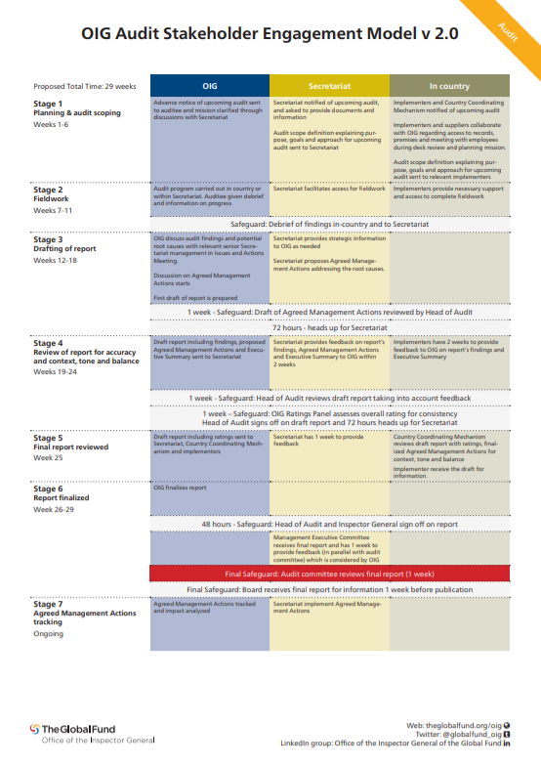
Next Steps
Audit Timeliness
Dates | Details
04 Sep - 06 Oct | Stage 1: Planning & audit scoping (desk review)
09 Oct – 26 Oct | Stage 2: Audit in-country fieldwork & debriefs
30 Oct – 17 Dec | Stage 3: Draft report prepared, shared and reconciled with Global Fund Secretariat
 | Stage 4: Draft report shared/ reconciled with the PRs
 | Stage 5: Draft report shared/ reconciled with CCM
Jan 2024 (est.) | Stage 6: Final audit report prepared/ shared with the Global Fund’s Management Executive Committee
Jan 2024 (est.) | Stage 7: Final audit report published on The Global Fund website

Slide 20
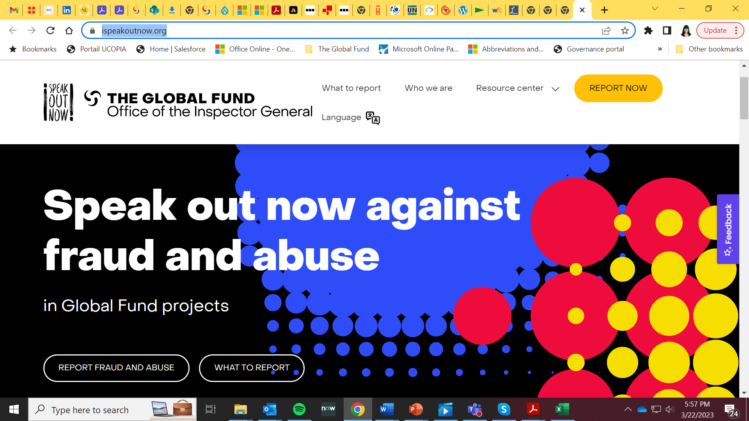
Reporting fraud and abuse
Visit www.ispeakoutnow.org to find out more about wrongdoing and how to report it

Slide 21
Inspector General | Tracy Staines | tracy.staines@theglobalfund.org
Head of Audit and Advisory | Daniel Petrescu | daniel.petrescu@theglobalfund.org
Audit Manager | Augustine Agyeman-Duah | augustine.agyeman-duah@theglobalfund.org

