Slide 1
Progress of the implementation DLI-K HANSA1 (HIV/AIDS)
Center for HIV/AIDS and STI (CHAS) MOH, Lao PDR
26 October 2023

Slide 2
Potential for a concentrated epidemic.
Unsafe sexual activity is main mode of transmission.
-The key populations: FSW, MSM,PWID.

Slide 3
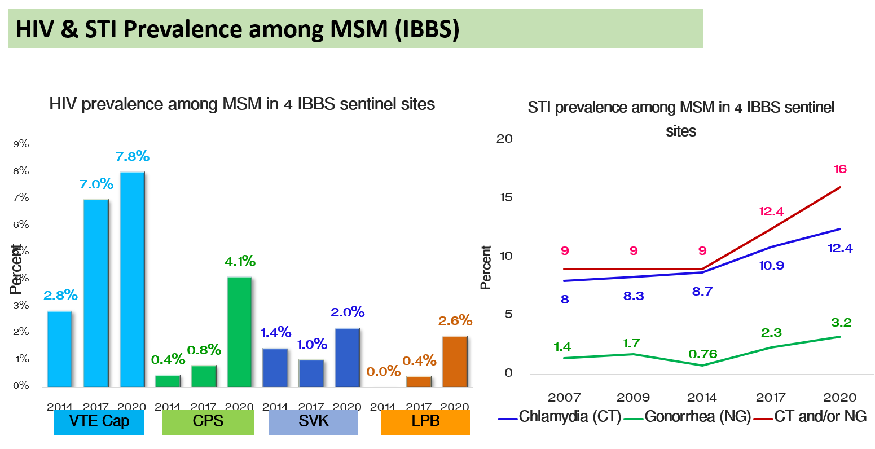
HIV epidemic updates
Number of PLHIV, AIDS and Death Since 1990-2022
1,748 of new HIV diagnosed in 2022
About 64% are among men.
About 27% are occurring among adolescents and youth (15–24 yrs)
MSM (gay men and other men who have sex with men, including TGW and MSW) accounted for 30% (522) of HIV infections.
Notes:
The HIV epidemic is concentrated among key populations, including men who have sex with men (MSM), transgender people (TG), female sex workers (FSW), people who inject drugs (PWID) and sexual partners of these populations. The predominant route of HIV transmission is sexual, with the share of cases of homosexual transmission constantly growing over recent years. But prevention coverage across all key populations is still sub-optimal to bring impact on reduction of new HIV infections.

Slide 4
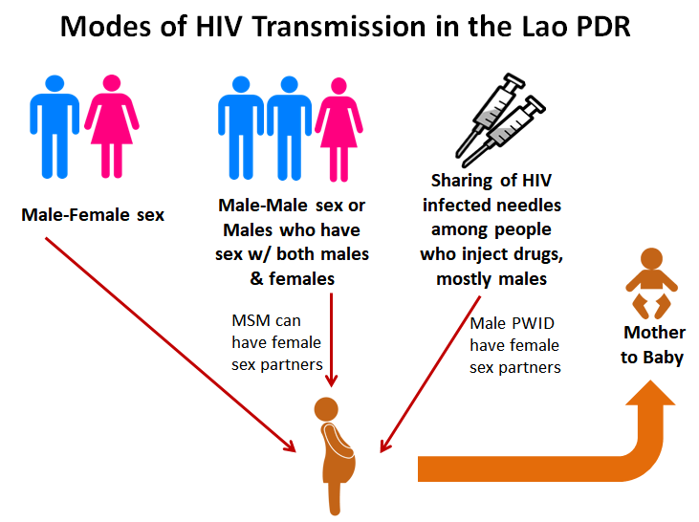
HIV transmission route
HIV transmission is occurring through:
Sexual transmission (between male – female, and between males)
Mother to child transmission
Sharing of infected needles among drug users
No record of HIV transmission due to blood transfusion

Slide 5
National Strategic response to HIV 2021-2030
Goal
End the transmission and impact of HIV/AIDS and STI in Lao PDR
by 2030.
Strategic
objectives
1. Strengthen an enabling environment for an effective HIV/AIDS response
2. Improve access to quality prevention and testing services
3. Increase access to quality testing, treatment, and care services
Strategic
Interventions
1.1: Law, policy and advocacy
1.2: Human resources
1.3: Sustainability and investment
1.4: Governance and management
1.5: Strategic information
1.6: Stigma and discrimination
1.7: International and cross-border cooperation
2.1. Female sex workers
2.2: Men who have sex with men and transgenders
2.3: People who inject drugs
2.4: General population
2.5: Pregnant women
2.6: Prisoners
2.7: Victims of human trafficking
2.8: Condoms
2.9: STI services
2.10: Blood safety
2.11: Online and social media
2.12: Pre-exposure prophylaxis
3.1: Increase access to quality testing, treatment, and care services.
3.2: Expand coverage and improve the quality of HIV testing services, increase access to HIV testing services, and improve HIV case finding
3.3: Expand coverage of, and increase access to, quality HIV/AIDS treatment
3.4: Improve joint management of HIV and TB
3.5: Increase access to HIV/AIDS care and support at home and in the community

Slide 6
HIV Continuum of Care in Laos
HIV cascade in 2022
Notes:
Recent scientific advances have shown that antiretroviral therapy (ART) not only preserves the health, quality of life, and life expectancy of people living with HIV. The global target of 95-95-95 acceleration will lead us to ending HIV epidemic by 2030. By ensuring that everyone with HIV is aware of their infection, receives the treatment they need, and achieves sustained viral suppression, we can sharply reduce new infections

Slide 7
Health and Nutrition Services Access Project Phase 1 (HANSA1) HIV – DLI.K

Slide 8
Budget and Areas of Implementation

Slide 9
Sources of Fund
23 Million USD
(Loan)
10 million USD
(Grant)
3 million USD
(Grant)

Slide 10
HANSA Project Components
Component 1: Integrating Service Delivery Performance with National Health Insurance Payments
Component 2: Service Delivery and Nutrition Convergence
Component 3: Adaptive Learning and Project Management
Component 4: Contingent Emergency Response

Slide 11
DLI-K on HIV/AIDS is under Component 2 (all 12 DLIs): HANSA focuses on improving quality integrated health service delivery through PHC
(DLI-K)

Slide 12
DLI-K: Increased coverage of a) HIV testing among key populations (female service women (FSW)) and men having sex with men (MSM)); b) and HIV treatment among people living with HIV.
Y0 (6/2019-5/2020) | Y1 (1/2021-5/2021) | Y2 (6/2021-5/2022) | Y3 (6/2022-5/2023) | Y4 (6/2023-5/2024)
1. Three baseline: i) % FSW that have received an HIV test in the past 12 months and know their results by province, II) % of MSM that have received an HIV test in the past 12 months and know their results by province; and iii) Number of HIV positive cases currently on treatment nationwide; 2. SOP for HIV/AIDS case finding and management (including HC, district and provincial level with easy access to Point of Care); 3. Mechanism for DPC to subcontract CSOs in place. | 1 2% points increase over the previous year in HIV testing coverage of estimated FSW during the past 12 months 2. 5% points increase over the previous year in HIV testing coverage of estimated MSM during the past 12 months 3. 4% points increase over the previous year in number of HIV positive cases receiving ARV treatment nationwide. | 2% points increase over the previous year in HIV testing coverage of estimated FSW during the past 12 months 6% points increase over the previous year in HIV testing coverage of estimated MSM during the past 12 months 4% points increase over the previous year in number of HIV positive cases receiving ARV treatment nationwide. | 2% points increase over the previous year in HIV testing coverage of estimated FSW during the past 12 months 8% points increase over the previous year in HIV testing coverage of estimated MSM during the past 12 months 5% points increase over the previous year in number of HIV positive cases receiving ARV treatment nationwide. | 1). 2% points increase over the previous year in HIV testing coverage of estimated FSW during the past 12 months 10% points increase over the previous year in HIV testing coverage of estimated MSM during the past 12 months 5% points increase over the previous year in number of HIV positive cases receiving ARV treatment nationwide.
ທົ່ວປະເທດ | ທົ່ວປະເທດ | ທົ່ວປະເທດ | ທົ່ວປະເທດ | ທົ່ວປະເທດ
DLI value: US$ 800,000 1. US$ 300,000 2. US$ 500,000 3. US$ 200,000 | DLI value: US$ 800,000 1. US$ 200,000 2. US$ 400,000 3. US$ 200,000 | DLI value: US$ 800,000 1. US$ 200,000 2. US$ 400,000 3. US$ 200,000 | DLI value: US$ 500,000 1. US$ 100,000 2. US$ 300,000 3. US$ 100,000 | TBD

Slide 13
DIL K: Increased coverage of a) HIV testing among key populations (female service women (FSW)) and men having sex with men (MSM)); b) and HIV treatment among people living with HIV.
Year 0 (1/4/2019 – 31/3/2020) (12 months) | The following three baseline are required: Baseline of percentage of FSW that have received an HIV test in the past 12 months and know their results by province, Baseline of percentage of MSM that have received an HIV test in the past 12 months and know their results by province; and iii) Baseline for number of HIV positive cases currently on treatment nationwide; 2). SOP for HIV/AIDS case finding and management (including HC, district and provincial level with easy access to Point of Care); 3). Mechanism for DPC to subcontract CSOs in place
Year 1 (1/1/2021– 31/5/2021) (5 months) | 2% points increase over the previous year in HIV testing coverage of estimated FSW during the past 12 months 5% points increase over the previous year in HIV testing coverage of estimated MSM during the past 12 months 4% points increase over the previous year in number of HIV positive cases receiving ARV treatment nationwide. | DLI value: 800,000

Slide 14
DIL K: Increased coverage of a) HIV testing among key populations (female service women (FSW)) and men having sex with men (MSM)); b) and HIV treatment among people living with HIV.
Year 2 (1/6/2021 – 31/5/2022) (12 months) | 2% points increase over the previous year in HIV testing coverage of estimated FSW during the past 12 months 6% points increase over the previous year in HIV testing coverage of estimated MSM during the past 12 months 4% points increase over the previous year in number of HIV positive cases receiving ARV treatment nationwide. | DLI value: 800,000
Year 3 (1/6/2022 – 31/5/2023) (12 months) | 2% points increase over the previous year in HIV testing coverage of estimated FSW during the past 12 months 8% points increase over the previous year in HIV testing coverage of estimated MSM during the past 12 months 5% points increase over the previous year in number of HIV positive cases receiving ARV treatment nationwide. | DLI value: 800,000
Total |  | 2,400,00
Means of verification |  | DHIS2 IAI verification

Slide 15
Areas of Implementation
DLI-K | Conditions | Areas | Nfc | Implementors
DLI-K1 | HIV testing coverage (%) among FSW (Y3) in the past 12 months was increased 2% comparing to the past year (Y2) | Vientiane C. (9 districts) Khammmouane (4 districts) Savannakhet (9 districts) Champassack (3 districts) Vientiane P. (5 districts) | Vtc KM SVK CPS VTP | PCCA, PEDA (30 districts)
DLI-K2 | HIV testing coverage (%) among MSM (Y3) in the past 12 months was increased 8% comparing to the past year (Y2) | Louaprabang (3 districts) Xayabouly (2 districts) Vientiane P. (5 districts) Bolikhamxay (5 districts) Khammmouane (5 districts) | VTC VTP KM | PCCA, CHIas (20 districts)
DLI-K3 | Treatment coverage (%) for PLWHA was increased (Y3) in the past 12 months 5% comparing to the past year (Y2) | 22 ART-POC 3 Central hospitals, 17 Provincial hospitals 2 District hospitals | Nationwide | (18 provinces)

Slide 16
Results of DLI-K Y1, Y2 and Y3 HANSA 1

Slide 17
DLI K-1: FSW HIV testing coverage (%) among FSW in the past 12 months was increased 2% comparing to the past year
Year | Target | Result | Progress | Value
Y1 (5 months) | 3,741 (88%) | 2,208 (59%) | 59% | Not achieved
Y2 (12 months) | 8,336 (90%) | 8,467 (91%) | 102% | Achieved
Y3 (12 months) | 8,779 (92%) | 10,831 (115%) | 124% | Achieved
Sources: DHIS2 on 12 June 2023

Slide 18
Results DLI-K FSW Y3
Y3 FSW Progress covered 124%

Slide 19
DLI K-2: MSM HIV testing coverage (%) among MSM in the past 12 months was increased 8% comparing to the past year
Year | % Increase | Target | Result | Progress | Value
Y1 (5 months) | 5% | 871 (32%) | 882 (33%) | 101% | Achieved
Y2 (12 months) | 6% | 2,198 (33%) | 2,660 (40%) | 121% | Achieved
Y3 (12 months) | 8% | 3,256 (48%) | 3,360 (50%) | 105% | Achieved
Sources: DHIS2 on 12 June 2023

Slide 20
Results DLI-K MSM Y3
Y3 MSM Progress covered 105%

Slide 21
DLI K-3: Treatment coverage (%) for PLWHA was increased in the past 12 months 5% comparing to the past year
Year | % Increase | Target | Result | Progress | Value
Y1 (5 months) | 1.7% | 7,744 | 8,433 | 109% | Achieved
Y2 (12 months) | 4% | 8,770 | 9,317 | 106% | Achieved
Y3 (12 months) | 5% | 9,808 | 10,231 | 104% | Achieved
Sources: DHIS2 on 15 May 2023

Slide 22
Result DLI-K ARV Y3
DLI K: Number of patients currently on ARV by sites
 |  |  | Y3
No. | ARV/POC Site | Baseline* | Target: 5% | 2023 | Total | Progress
 |  |  |  | May
1 | 01 PH Savannakhet | 1,296 | 1,361 | 1,358 | 1,358 | 108%
2 | 02 CH Setthathirath | 3,022 | 3,173 | 3,085 | 3,085
3 | 03 CH Mahosod | 1,435 | 1,507 | 1,581 | 1,581
4 | 04 PH Luangprabang | 560 | 588 | 613 | 613
5 | 05 PH Champasak | 995 | 1,045 | 1,034 | 1,034
6 | 07 PH Bokeo | 170 | 179 | 231 | 231
7 | 08 PH Luangnamtha | 154 | 162 | 185 | 185
8 | 09 PH Khammuane | 494 | 519 | 533 | 533
9 | 10 DH Tonpheung | 68 | 71 | 91 | 91
10 | 11 PH Huaphanh | 95 | 100 | 99 | 99
11 | 12 CH Mittaphab | 689 | 723 | 900 | 900
12 | 13 PH Saravanh | 48 | 50 | 70 | 70
13 | 14 PH Oudomexai | 97 | 102 | 151 | 151
14 | 15 DH songkhone | 76 | 80 | 89 | 89
15 | 16 PH Xainyabouli | 79 | 83 | 159 | 159
16 | 17 PH Vientiane | 48 | 50 | 161 | 161
17 | 18 PH Borlikhhamxai | 4 | 4 | 90 | 90
18 | 19 PH Xiangkhouang | 11 | 12 | 106 | 106
19 | 20 PH Xekong | 0 | 0 | 24 | 24
20 | 21 PH Atapu | 0 | 0 | 31 | 31
Total |  | 9,341 | 9,808 | 10,591 | 10,591 | 108%

Slide 23
Challenges

Slide 24
Challenges in HANSA implementation
FSW are hidden, mobilized and illegal;
Peers are always turn over – average working about 3 months
MSM are also mobilized (moving from place to place) especially young MSM/TG;
Stigma and Discrimination still exist in HFs and community, internalized stigma is also challenging
Number lost of follow up of patients on ARV and also viral load testing are challenged;
Fund flow is delayed for every year and too many steps of releasing fund to the sites;
CHAS has been deducted fund of the amount of 74,000 USD in Y3 due to the FSW target was not achieved in Y1, therefore, peers/FSW are not receiving the remuneration or income yet;
DHIS2 system is still incomplete for HIV national indicators.

Slide 25
Challenges during COVID-19 pandemic
Reduced testing availability
Community outreach programmes paused due to COVID-19
Logistically difficult to collect prescriptions during lockdown
Risk of ART interruption:
Supply chain threatened
Decrease adherence: poverty, reduced adherence counselling
Increased presentations with advanced HIV disease
Decreased HIV clinic services
Difficult for clients to attend the clinic due to strict travel restriction
Increased loss to follow up e.g. clients return to perceived safety of rural villages during pandemic

Slide 26
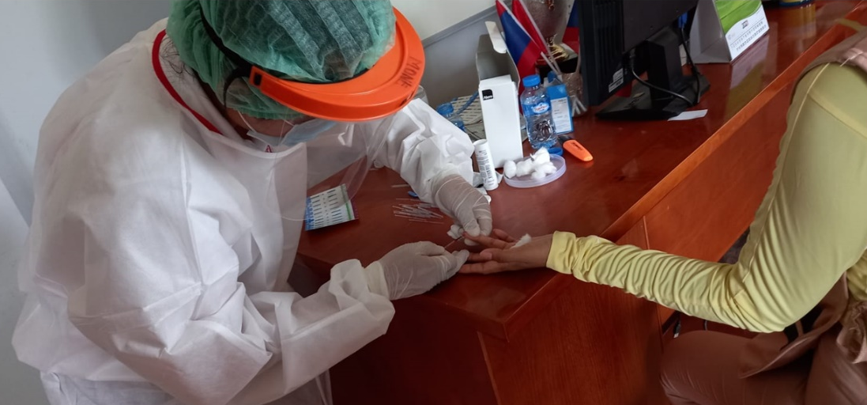
ຮ້ານ Spa & Beauty Massage
ມາດຕະການການເຂົ້າເຖິງກຸ່ມເປົ້າໝາຍ ໃນການກວດເລືອດຊອກຫາການຕິດເຊື້ອ HIV ສຳລັບ FSW ໃນຊ່ວງທີ່ມີການລະບາດຂອງະະຍາດ covid19

Slide 27
Challenges on financial issues – Budget delay transferred
Y 0
6/2019 - 5/2020
Y 2
6/2021 – 5/2022
Y 3
6/2022 – 5/2023
Y 1
6/2020 – 5/2021
Y 4
6/2023 – 5/2024
Investigate sites DLIs- Y1-2 (2021 – 2022)
CHAS received fund Y2
21 April 2023
➔ 726,000 $
Data report
IAI assessment
NPCO made a report to WB
WB validated documents and released fund
Received fund Y1
Received fund Y2
01
02
03
04
05
06
07
08
09
10
11
12
01
02
03
04
05
06
07
08
09
10
11
12
01
2022
DLIs-Y3 (2022 – 2023)
2023

Slide 28
IAI Assessment
DHIS2
Validation of data:
VCT logbook; registration book of patients on ARV; Lab logbook; documents of patients
VCT forms such V1, V2…and R1, R2...;
CSO forms;
Checking data on DHIS2 syatem: PCCA, DCCA, and CSO.
​Achievement | Releasing fund
> or = 95% | 100%
60% - 94% | 50%
< or = 59% | 0%
Report
IAI Y2
DLIs | Status
DLI-K: HIV testing among key populations (female service women and men having sex with men); b) and HIV treatment among people living with HIV | Y1: fully achieved Y2: fully achieved

Slide 29
HIV challenges based on HANSA Evaluation
Based on: HANSA Evaluation, Community Report
Concerning increase in the number of new HIV infections: 7% increase in HIV cases in 2022 compared to 2021.
Concentrated epidemic among MSM, TG and SWs (MSM - largest proportion of HIV infections).
PLHIV that know their status 12,592 – around 3,500 are undiagnosed (27%)
Treatment: 11 ART sites located in 8 provinces and POC. Small scale up on MMD (3-5 month average)
HIV testing: VCTs - Formal registration of positive cases only at ART sites → 3 level procedure: 2 screenings
and one diagnostic test
1 in 5 ART patients are not receiving VL testing annually
Low ART adherence and testing due to transportation cost, stigma and discrimination from health staff
HIV test kits used for ANC testing are from MCH program rather than CHAS.
Minimal emphasis at the HFs for HIV testing and other services
Limited Government health budget

Slide 30
Solutions
Continue strengthening the coordination between PCCA secretariat/Peers/Partners;
Review the hot spot of targets and find the ways to access to key population as needed;
Increase the variety of campaign and media including the frequency of mobility of HIV testing in the hot spot areas
Strengthen and retraining peers the skills (HIV testing and referring cases) of the outreach activities on the access to KP;
Train and re-train staffs on data management/data entry into DHIS2 including regular monitoring and mentoring data and sites;
Continue working together CHAS/DPF to improve the quality of DHIS2 system and complete 100%;
Set up the lessons learnt meeting twice a year to fix the issues.

Slide 31
(A) Planned budget DLI-K Y0
Planned budget Y0 for the implementation of Y1 (1-12/2021)
Level of responsibility | LAK | US$ | %
CHAS | 3,158,410,800 | 339,614 | 41%
Provinces | 1,981,646,000 | 213,080 | 27%
Districts | 127,224,000 | 13,680 | 2%
CSO/Chias | 1,449,092,569 | 155,816 | 19%
CSO/PEDA | 723,627,072 | 77,809 | 10%
Total | 7,440,000,441 | 800,000 | 100%

Slide 32
(B) Planned budget DLI-K Y1
Planned budget Y1 for the implementation of Y2 (1-12/2022)
Level of responsibility | US$ | %
CHAS | 317.608 | 39,70%
CHias (CSO) MSM | 157.632 | 19,70%
PEDA (CSO) FSW | 77.829 | 9,73%
ART Sethathirath Hospital | 21.783 | 2,72%
ART Mahosod Hospital | 14.488 | 1,81%
ART Mittaphab Hospital | 9.852 | 1,23%
16 Provinces (PHO) | 200.808 | 25,10%
Total | 800.000 | 100%

Slide 33
Planned budget DLI-K Y2 Planned budget Y2 for the implementation of Y3 (1-12/2023)
No | Responsibility | (USD) | (%)
1 | CHAS | 266,767 | 36.74%
2 | CHias (CSO) | 159,944 | 22.03%
3 | PEDA (CSO) | 54,916 | 7.56%
4 | 3 ART sites or 3 Central Hospitals | 37,740 | 5.21%
5 | 16 Provinces (PHO) | 206,633 | 28.46%
Total | ລວມທັງໝົດ: | 726,000 | 100%

Slide 34
Strategic interventions to Accelerate to ending HIV by 2030
Diagnose all people with HIV as soon as possible |  | Treat PLHIV rapidly and effectively to reach sustained VL suppression |  | Prevent new transmission by using proven interventions |  | Respond quickly for potential outbreak
Differentiated testing e.g. Index tesing, HIV self-test, Community based HIV Testing (CBHT), Peer-Led testing Recency testing and hotspot reach Online reach and linking to test, focus on KPs and young populations PITC for risk populations e.g., PW, TB, STI, HIV symptomatic cases |  | Referral system & Lab notification in health care facilities and link to treat Increase Same Day ART/ Rapid ART Reduce death case using rapid screening for AHD, TPT, Urine LF-LAM, CrAg RDT… Differentiated ART services delivery Integration HIV with other diseases (TB, STI, hepatitis, NCD, COVID-19) Multi-month dispensing (MMD) Telehealth and home delivery Monitoring on mental health profiles/issues Continue QI project and S&D reduction Improve VL testing coverage prioritize interventions to ensure universal access and to track viral load testing coverage POC VL & EID S&D reduction in health care facility and community |  | HIV awareness raising, U = U PrEP demand creation Differentiated PrEP with various appropriate initiation, delivery and refill modalities Combination HIV prevention package services for KPs (e.g. comdom/lubricant, needle sharing, STI/HBV/HCV rapid screening, HPV vaccinations |  | Provincial mapping, plan, resource mobilization Improve data quality and use data for program improvement and coaching Recency surveillance and using recency data for public health responses
Cross cutting activities: Update policy/guidelines, data quality improvement, M&E, training, ECHO, stigma and discrimination reduction,
QI/coaching, community-led monitoring

Slide 35
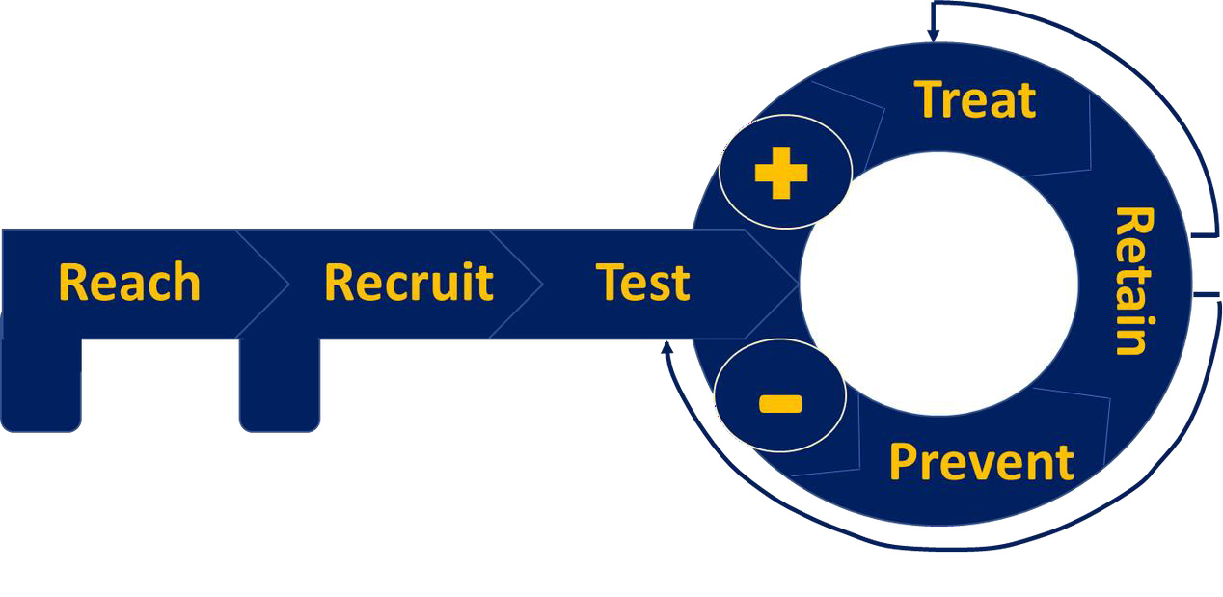
Strategies to bridge the gaps
HIV testing
POC/rapid CT/NG & Syphilis
Rapid/POC HCV
Pre-ART screening for 1st test
Same-Day ART/ U=U
Same-Day STI treatment
Same-Day HCV treatment
Partner/network testing
reactive
Link to CXR/GeneXpert
Online registration
Offline registration
HIV Self-testing
TB-RIF for HIV-positive
Mobile health and Xpress service
ART adherence support multi-month scripting, VL navigation/ U=U literacy
PrEP adherence support, repeat HIV testing
Counseling
Status-Neutral Approach aiming at
Negligible risk of HIV transmission
(U=U)
Negligible risk of HIV acquisition
(PrEP/PEP, Condom/lubricants,
needles/syringes)
Partner/network testing
Same-Day ART
Same-Day PrEP
STIs/HCV
Substance use/chemsex
TB screening
Gender affirming services for TGW
Condom/lubricant, needles/syringes Same-Day PrEP (with mixed daily & event-driven PrEP for MSM only) HPV vaccination
7

Slide 36
THANK YOU - Khob Jai

