Slide 1
RAI3E Malaria Grant - Laos
Progress Update
Executive Committee and Oversight Committee Meeting
1 December 2023

Slide 2
Presentation Outline
1
RAI3E grant implementation (Programme and financial performance)
2
3
Independent Monitoring Panel field visit and suggestions
RR
RAI3E grant closure
4
RAI4E grant – Laos country component

Slide 3
RAI3E grant implementation (Program Performance)
(Global Fund reported indicators achievement)
API (annual parasite incidence/1,000 persons per year)
 | 2021 | 2022 | 2023
Target | 1.5964 | 1.2375 | 0.7503
Result | 1.3080 | 0.99 | Not due report
Status | On-Track | On-Track | NA
MPR (Malaria Test Positivity Rate)
 | 2021 | 2022 | 2023
Target | 0.59% | 0.42% | 0.21%
Result | 0.61% | 0.28% | Not due report
Performance | Off-track | On-track | NA
Notes:
Data source: PU reported data to the GF

Slide 4
RAI3E grant implementation (Program Performance)
(Global Fund reported indicators achievement)
Malaria Deaths
 | 2021 | 2022 | 2023
Target | 0 | 0 | 0
Result | 1 | 1 | Not due report
Performance | Off-track | Off-track | NA
ABER (Annual Blood Examination Rate reported upon population at risk)
 | 2021 | 2022 | 2023
Target | 27.26 | 29.7 | 35.65
Result | 21.48 | 35.7 | Not due report
Performance | Off-track | On-track | NA

Slide 5
RAI3E grant implementation (Program Performance)
(Global Fund reported indicators achievement)
Parasitological Tests to suspected malaria cases

Slide 6
RAI3E grant implementation (Program Performance)
(Global Fund reported indicators achievement)
Reported malaria cases

Slide 7
RAI3E grant implementation (Program Performance)
(Global Fund reported indicators achievement)
Case Investigation within 3 days

Slide 8
RAI3E grant implementation (Program Performance)
(Global Fund reported indicators achievement)
Active foci received responses within 7 days

Slide 9
RAI3E grant implementation (Program Performance)
(Global Fund reported indicators achievement)
Mass LLIN distribution
 | 2022
Target | 922,100
Result | 908,468
Performance | Almost on-track
Continuous LLIN distribution
 | 2021 | 2022 | 2023 Jan-Jun
Target | 99,605 | 99,923 | 75,324
Result | 38,137 | 116,418 | 15,789
Performance | Off-track | On-track | Off-track
Notes:
Continuous distribution in 2021; The Jan-Jun target for MMP (target 74,605) did not procured because of the supplier being suspended by the OIG GF. So, the whole year target did not met as the result of no distribution happened in Jan-Jun

Slide 10
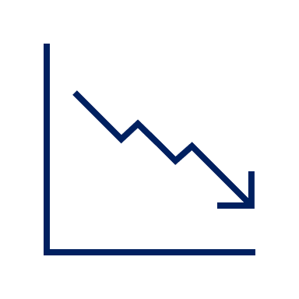
Programmatic Activities
Trainings
ICCM trainings & DHIS2 and Surveillance training - annually
Surveillance
CIFIR activities ongoing in elimination district
OB Response activities conducted
Surveillance assessment -2022
Meetings
Annual Review Meeting - all 3 years
AS review meetings - all 3 years
MTR review and validation meetings - 2022
Bottom-up planning meeting - bi-annually in all 3 years
Pf acceleration strategies
Started in 2021
on-going in 2023

Slide 11
Programmatic Activities
PSM
Assessment of Supply chain management by UNOPS and LFA in 2022
Pilot activity of district supply chain functionality in late Dec 2023 onward
Min-Max stock policy updated
RDT gap from co-financing filled from the GF fund in 2022
Guidelines updated
Malaria National Treatment Guideline to include Pv radical cure with Primaquine 0.5 mg/kg for 7 days of G6PD normal patients
Surveillance SOP in Burden Reduction
Supervisions
Supportive supervision on program implementation and RDQA , and financial verification from UNOPS

Slide 12
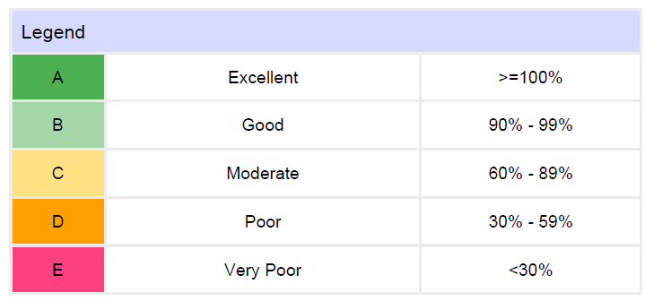
Programmatic Performance Rating from the Global Fund :
RAI3E Grant Laos
Rating is given upon performance of Indicators’ performance
Jan-Dec 2020 | 96% (B)
Jan-Dec 2021 | 83% (C)
Jan-Dec 2022 | 106% (A)

Slide 13
Financial Performance (Jan-Jun 2023)
SR | Budget | Actual | Realized exchange gain and reserve 25% FX gain | Net Absorption | remark
CHIAs | $158,064 | $116,296 | $24,545 | 87%
CMPE | $1,921,884 | $1,557,597 | $149,687 | 88%
DCDC | $26,523 | $22,876 | $3,368 | 99%
DPC | $14,473 | $10,238 | $1,919 | 82%
HPA | $197,877 | $131,959 | $23,584 | 76%
MPSC | $30,770 | $27,523 | $4,552 | 105% | Expenditure includes unspent budget carried over from previous year
PEDA | $152,700 | $114,647 | $22,627 | 88%
WHO | $209,281 | $281,897 |  | 135% | Expenditure includes unspent budget carried over from previous year
Total | $2,711,573 | $2,263,034 | $230,281 | 91%

Slide 14
Financial Performance (Jan 2021 – June 2023)
SR | Budget | Actual | Realized exchange gain and reserve 25% FX gain | Net Absorption
CHIAS | $643,848 | $556,181 | $53,330 | 94%
CMPE | $7,341,864 | $6,800,794 | $297,010 | 97%
DCDC | $106,282 | $95,548 | $7,344 | 97%
DPC | $155,978 | $134,122 | $8,114 | 91%
HPA | $834,294 | $700,227 | $64,189 | 91%
MPSC | $160,922 | $121,342 | $11,936 | 81%
PEDA | $647,390 | $572,658 | $50,869 | 96%
WHO | $1,263,538 | $1,141,508 |  | 90%
Total | $11,154,116 | $10,122,381 | $492,793 | 95%

Slide 15
Independent Monitoring Panel (IMP)
IMP is independent external monitoring group supported by the GF fund that monitors programme quality and implementation process of RAI3E grant in five GMS countries including Lao PDR.
Once a year field visit conducted in joint with CMPE, WHO and UNOPS-PR.
Key findings and suggestions are made and shared with National Programme, RSC and the GF.
The key findings and suggestions are shared as below:

Slide 16
Independent Monitoring Panel’s key suggestions
Acceleration activities
Impressive and high impact on malaria case reduction
To be considered IPTf and AFS activites are needed as there are pros and cons; labor intensive Vs effectiveness
Diagnosis and Treatment
Expand use of microscopy wherever it exists to cover all symptomatic patients
Sign-up for access to the online slide-banking facility
Introduce quarterly QA for G6PD test devices and testing procedures
The delivery of the 8-week PQ regimen by VMWs is planned but not yet approved – enhance follow up for approval
Consider switching to a pan-specific RDT for first-line use with microscopy-based or Pf/Pv RDT-based cross-check for all positives

Slide 17
Independent Monitoring Panel’s key suggestions
Community based services
Volunteers transportation should be brought in-line with costs
To prevent delay disbursement of volunteers payments, districts need to plan two weeks in advance to ensure that payments to volunteers are on time.
Integrated village volunteer network - More consistency is needed on the integration approach.
Supply chain
There were some low stocks of ACT/RDT for several months recently, should be on proper planning and replenishment
Surveillance, data, and data sharing
Provinces don’t routinely communicate or share data and information with neighboring provinces. Capacity is still too low to do this effectively. Consider the approach of HIS capacity in the periphery improves.

Slide 18
RAI3E Grant Closure
The RAI3E implementation period is ending as of 31 December 2023.
Program activities, Outstanding advance , all VMWs payments should be completed by 31 December 2023.
All RAI3E-SRs submit the grant final Progress Update report (PU) to PR by no later than 25th January 2024.
A final updated asset register should be submitted along with the PR report by no later than 25th Jan 2024 .
Audit findings in 2022 including ineligible expenditure, expenditure verifications, compliance review findings shall be cleared by 31 December 2023.
Audit 2023 shall be completed in June 2024.

Slide 19
RAI4E_ Plans and implementation readiness
1
Grant Negotiation
Done
2
Grant document preparation with SRs
On process, expected to finalize by Nov 2023
3
RAI4E pre-launch workshop
7 Nov; Aim to prepare readiness of implementation
4
RAI4E commodities procurement request plan
Ready for 2024
5
RAI4E launching and orientation
Jan 2024
6
RAI4E implementation starts
January 2024 onwards

Slide 20
Thank you

