Slide 1
Report Oversight Field Visit Borlikhamxay Province Date 28th-31st March 2016 MONITOR: (HIV/AIDS-TB-MALARIA)

Slide 2
Main Purpose: To oversight the implementation of the projects supported by the Global Fund to Fight AIDS, Tuberculosis and Malaria (GFATM) at provincial, district and health center level accordingly to the oversight schedules, which focused on five key issues: 1.Finance 2. Procurement 3. Implementation 4. Results (output/outcome) 5. Reporting system

Slide 3
Target Sites: 1.Provincial Health Department 2. Hospital of Parkkading District - Namthone Health Center - Parkkading Health Center 3. Health Office & Hospital of Thaphabath District ​​ - Houy Leuk Health Center - Ban Parkthouy Health Center

Slide 4
Summary of findings
Key Progress
HIV/AIDS Under the leadership and guidance of the leaders leading to the implementation of the project has been successful. Good cooperation in the implementation among the project team and partners at all level. Have a budget for the implementation (supported by government and international organization) The staff that is responsible for the HIV/STI of each district practices successfully their roles as assigned by the upper level, such as regular monthly report. The local authorities are cooperated as well. Patients have accessed to ARV treatment resulting in the reduction of transmission and death rate. Implementation of activities has been achieved. Monitoring on implementing activities such as IEC materials have been disseminated broadly.

Slide 5
Malaria Guided by the upper level vertically and horizontally; the local authorities are facilitated and cooperated as well. There are malaria control networks cover all target areas and villages, and there are training continuously. Received the grants and materials from the Global Fund, CDCII and government budget. All technical staffs, village volunteers of each target villages pay attention on their role and responsibility. Surveillance systems for malaria at the provincial and district levels are more strength. Able to collect the data from the target villages completely and timely. Early detection of malaria cases.
Tuberculosis Overall, the implementation of activities was conducted as planned. The case detection rate of tuberculosis is increasing Good cooperation with other organizations and partners involved in the activities of tuberculosis. The reports are usually submitted timely. Most of activities were achieved the expected targets. Ensure that the medicines will not be stock-out in the warehouse.

Slide 6
Key Issues
HIV/AIDS The staffs that are responsible for AIDS/STIs at the provincial and district levels have not experience as they are recently replaced without training. Activities can be extended to the district level only, has not yet extended to the health center The reports from some districts were delayed and incomplete. Some figures from health centers were missing and incorrect. Voluntary counseling and testing is not well done in some place due to insufficient coordination among the project staffs who are responsible for AIDS, Mother and Child Health and Tuberculosis. The activities for sex workers that implemented by PEDA in 3 districts of the province was not continued. The PCCA secretariat has not been involved in the monitoring and quarterly meeting (the PCCA secretariat only attended the training for SW once a year). Lack of equipment for the activities such as: electronic equipment (e.g. audio, LCD projector, etc,...) Limited budgets for activities. Almost of patients were not well cooperated.

Slide 7
Malaria The approval of the budget was late. Essential equipment were not enough to work (such as old computers) Staffs of some health centers have changed frequently for their responsibilities and do not understand about the work, so this caused the collection information and report to be delayed and not on time. The village volunteer of some villages seldom stays at home, so this causes the data collection of some months have not been completed.

Slide 8
Tuberculosis Detection of suspected cases was low (health workers delivered samples was low/decreased, DTM of some districts have several duties and waiting for those patients come to the hospital by themselves) Practicing of DOT in district and health center is not well done (created a problem of drug resistance) When the provincial team conducted monitoring at district level, some districts were not paid attention, failed to follow the guidance or work out of the guidance and claimed that they have a lot of works to do. Monthly monitoring for late February, March, May, June and August have not been completed as defined. When the district team conducted monitoring to the health centers, their advice was not fully captured all of their responsibilities such as: record on the patient’s treatment card, or the patient’s registration book, or recovered patients, complete treatment, dead and their cards have not returned to TB unit at the district level in order to sort a sequence numbers as registration book of the patients each year. When the teams visit villages, the screening for TB suspected patients was low.

Slide 9
Solution/Recommendation
HIV/AIDS HIV/AIDS and Tuberculosis Units have to collaborate regularly, allocate the budget for district level, health centers especially in remote areas. Planning for implementation activity should be done by the provincial level in order to cover the areas of the control of AIDS-STI broadly. The central team should conduct more monitoring and supervision. Health education should be conducted at the public health areas. The specific budget for HIV should be provided .
Malaria Staffs should be sufficient or should be selected the one who has suitable capacity for better work. Integrate work with other programs to strengthen the district level. Provide training on project management for the staffs at all levels. Conduct broadly awareness raising to the local people to understand the importance of sleeping in the mosquito nets in order to prevent malaria. Increase the budget for monitoring the district, health center and villages Improve reporting system by piloting some provinces, districts, health centers and villages to determine the actual lessons learnt. Provide some drugs that are lacking at the districts and villages.

Slide 10
Tuberculosis Reduce the responsibilities of project staffs to allow more times for them in monitoring health centers and villages which have suspected cases according to the estimated numbers cover by the health centers. When provincial and district teams conduct the monitoring, they should be more active and work well together. When district teams conduct the monitoring to health centers, they should follow their roles and responsibilities. Assign the staff of health center and district that locate near by the patient’s villages to be responsible for daily providing DOT.

Slide 11
Additional Attention Issues (Cont. TB) Increase case finding of TB patients in order to increase the detection rate and achieve the national targets. Find out the detection case of children patient with tuberculosis as growingly Find out the detection case of closed patient groups with tuberculosis Follow up the treatment to ensure the better effectiveness of treatment and reduce the drug resistance of pathogens and reduced the missing as well as the death of patients Attention for IEC advertising to those local people know and understand the symptoms, counseling and how to prevent, if a suspect or close approaching patients infected with TB to urgent medical care, prevention in case of suspected cases or closed to TB patients to be advised for diagnosis and treatment timely. Ensure for reporting timely and completely Attention for safe keeping copies of each report Attention for cooperating with organizations or other partners involved in the activities to control the tuberculosis disease.

Slide 12
Summarizing the key activities to be carried out (TB) Deliver the sample of suspected cases and following up the treatment Visit the TB patients in villages Training or training for the health staffs on how to use the DOT Retrain workers for village volunteers on how to use the DOT in community Disseminate IEC regarding TB disease via radio and TV Monitoring from province to district and from district to health centers Monitoring from district to health centers and villages Budget for office management

Slide 13
6. Work Plan (2015-2016)
HIV/AIDS Provincial Level Continue to encourage mobilization for district level to report regularly to gain the STI of all health centers of each district. Expand one more VCT Xaychamphone District Continue to propose the government budget plan to carry out activities of HIV/STIs in 7 districts for the fiscal year 2015-2016. Continue to propose the budget plan to international projects for fiscal year 2016-2017 Promote to access to counseling services and recommend for blood voluntary testing and test for STI by disseminating information campaigns in various media and promote the use of condoms. Strengthen each level of the performance team and increase the participation of communities and infected people. Encourage infected people to access to counseling service and treatment by (ARV), treat complicated diseases. On the other hand the patients also can take care at home and community. Continue to prevent HIV of MSM in 7 target districts (including 17 PE) access into 272 target people. Monitoring volunteers of MSM in 5 target districts (Pakxan, Pakkading, Borlikhan, Thaphabath and Khamkeut) Quarter meeting with partners of provincial and district level The administration work of the Secretariat and MSM Retraining activity for 17 volunteers of MSM Enlighten for Peer in the field of (OW) Continue to prevent HIV infection in the population at the aged between 15-49 years to be less than 1%. Ensure the rate of HIV infection among the risk vulnerable population to be under 5%.

Slide 14
Pakkading District: Continue to report AIDS and STIs regular to Provincial Health. Continue to promote consultation voluntary blood testing. Conduct the IEC mobile advertising regarding to the basic information of AIDS/STI at the clubs, guesthouses and villages Retrain the reporting form for partners in health centers and 2 district hospitals, 2 health centers Collection data of hotels, factories, restaurants. HIV Committee Meeting at district level. Workshop at provincial and district level.

Slide 15
Thaphabath District: Continue to mobilize the health centers to report regularly (STI) Continue to treat STI check the report to submit to the province regularly Expand more VCT in 5 health centers over the districts Continue to implement the international project budget plan of the fiscal year 2015-2016 of to be achieved Continue to implement the government budget plan of the fiscal year 2015-2016 to be completed Attend the quarterly meeting of provincial level 4 times a year Attend the training on revision of STIs treatment, and how to use the reporting form once a year Training on counseling and testing for HIV for health center workers once a year Conduct IEC and enlighten the basic knowledge to prevent HIV and STIs to people in 3 villages and students of 2 Secondary Schools. Visit 3 HIV infected families once a year Collect the information of Female Sex Workers and local training on preventing HIV and STIs by local bars once a year Monitoring in 5 health centers once a year.

Slide 16
Malaria Pakkading District: Workshop at district level. Retrain village volunteers on surveillance. Monitor all level such as: (districts, health centers-villages). Implement IEC and make community process including placing water worm. Support the operation of dengue control. Distribute dyed-mosquito nets to health centers and target villages Provide the training on malaria information management to all levels Provide training on inventory management to provincial, district and health center levels.
Tuberculosis Expansion of the covered services to treat and prevent TB broadly Raise public and organizations to participate in the control of tuberculosis broadly Coordinated with HIV task, the disease vaccination to open and testing room to know the tuberculosis treatment system and strategy of (DOT) Disseminate information to people living in the remote areas broadly Determine the child in a targeted group to be taken medicine INH Use appropriate tools to improve the activity information and IEC to find a suspected case of being cough more than 2 weeks in each health center Improve referral patients to community hospitals (Sample of phlegm)

Slide 17
Proposal
HIV/AIDS ​To provide the training of for staffs at provincial and district levels at least 1-2 times per year. To provide full set of equipment. To provide 1 laptop computer To provide study tour in locally and oversea 1 time per year. To transfer the budget timely as the plan has set quarterly. Increase DSA and incentives to the staffs of provincial level as well as all local staffs Malaria Increase DSA and incentives to the staffs of provincial level as well as all local staffs To transfer the budget timely as the plan has set quarterly. To provide full set of equipment. Tuberculosis To provide the budget for collect sputum samples in remote areas. To provide the incentive money for the village volunteers for managing the period of treatment for 6 months (remote areas). For units that detected HIV/AIDS cases to be ordered for testing sputum to find TB case To provide the budget for activities timely To provide lunch cost, gasoline for delivery samples from the health center

Slide 18
​ HIV/AIDS Pakkading District: ​To be provided the training for work on HIV/STI at least 1-2 times per year. To be provided study tour 1 time per year. Thaphabath District: ​To be provided the training for work on HIV/STI at least 1-2 times per year. To be provided fully set of equipment, audio system, LCD Projector To be provided 1 laptop computer To be provided 1 motorbike To be provided the incentives to Secretariat staff of district To be provided study tour in locally and oversea 1 time per year.
Malaria To be provided help through the vertical authority to encourage the one who is responsible for work to be more intentionally for his/her responsibilities. Develop clearing and destroying procession the source of the mosquito regularly in each village. In case of illness (fever), don’t be advised to buy the drugs by themselves, but advise for their medical care immediately. Tuberculosis To be provided a printer To be provided a document cabinet Health Center Level No Identified

Slide 19
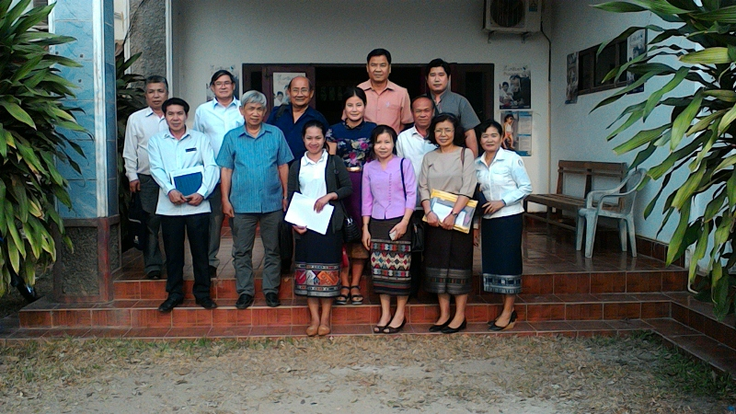
Photo of Monitoring Team
Provincial Health Department

Slide 20
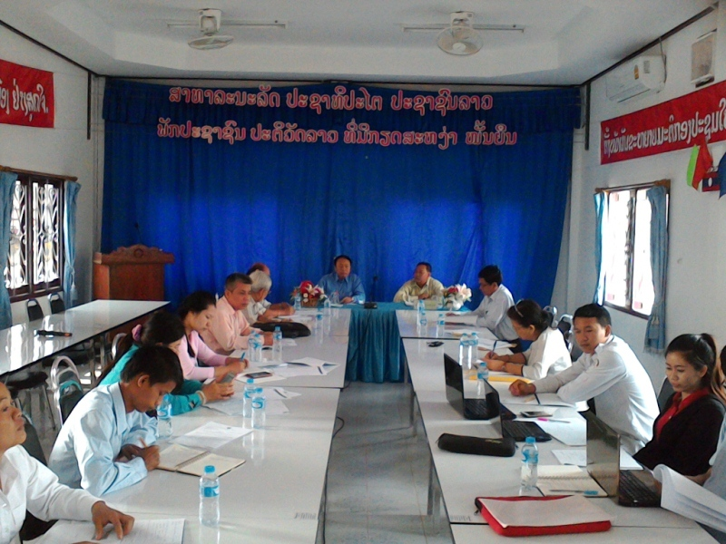
Health Office of Pakkading District

Slide 21
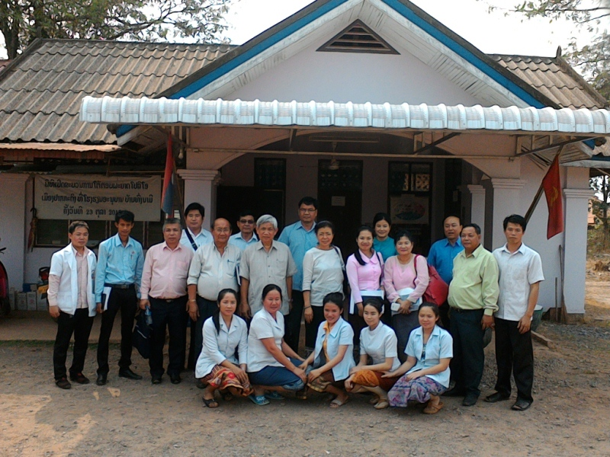
Nam Thone Health Center

Slide 22
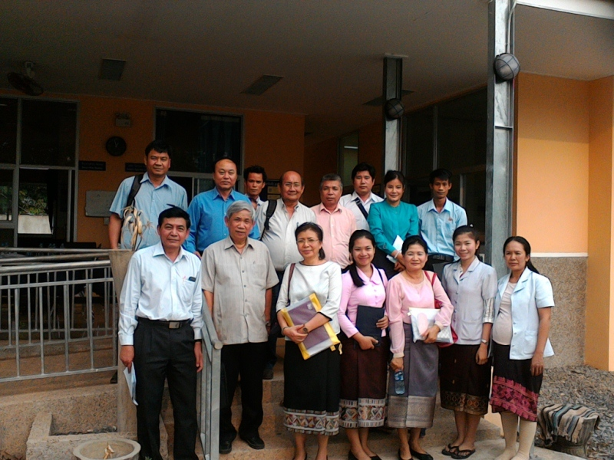
Pakkading Health Center

Slide 23
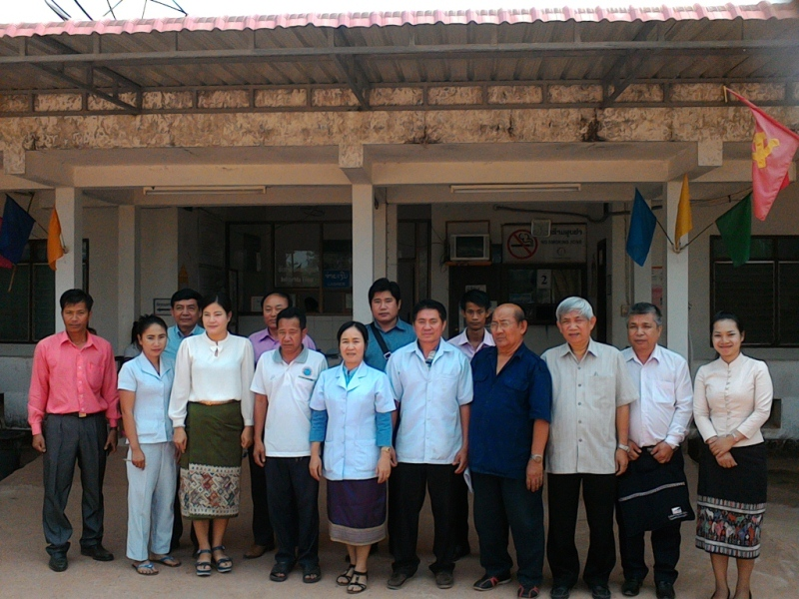
Health Office/Hospital of Thaphabaht District

Slide 24
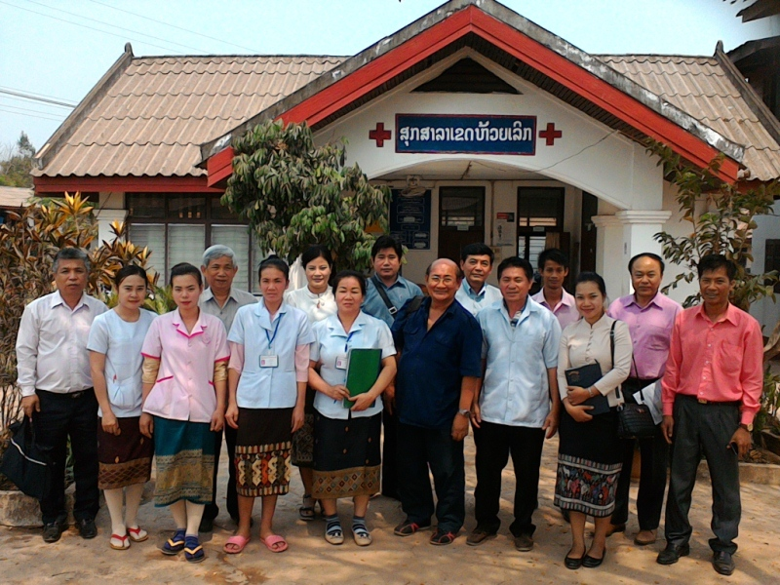
Houy Leuk Health Center

Slide 25
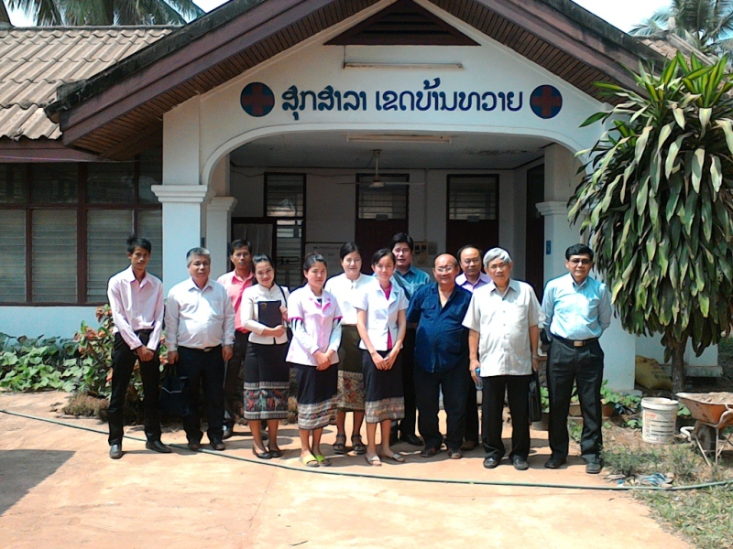
Ban Thouy Health Center

Slide 26
Thanks: Provincial Health Department, BLX Prov. Health Office of Pakkading Dist. Nam Thone Health Center, Pakkading Health Center, Health Office and Hospital of Thaphabath District, Houy Leuk Health Center Ban Thouy Health Center All participatants

