Slide 1
ໂຄງການ ເຂົ້າເຖິງການບໍລິການສຸຂະພາບ ແລະ ໂພຊະນາການ Health and Nutrition Service Access (HANSA) Center for HIV/AIDS and STI
ສູນຕ້ານເອດ ແລະ ພຕພ

Slide 2
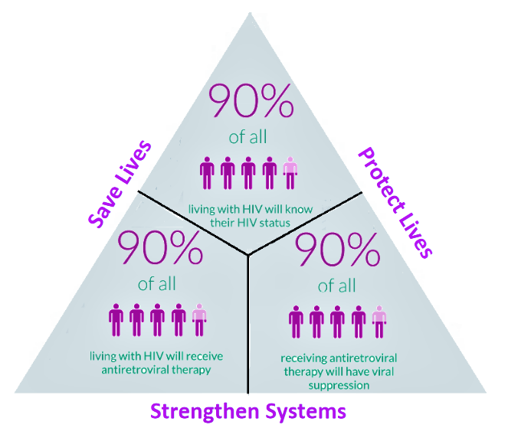
95%
95%
95%

Slide 3
ອົງປະກອບທີ 2 Component 2 DLI K

Slide 4
DLI-K: Increased coverage of (a) HIV testing among key populations (female service women (FSW) ) and men having sex with men (MSM)), (b) and HIV treatment among people living with HIV.
# DLI-K (a1) : Increased coverage of (a) HIV testing among key populations, female service women (FSW)
Increased coverage of (%) FSW that have received an HIV test in the past 12 months | Percentage Increase (FSW)
 | Y0 | Y1 | Y2 | Y3 | Y4
 | 0% | 2% | 2% | 2% | 2%
# DLI-K (a2): Increased coverage of HIV testing among key populations, men having sex with men (MSM)
Increased coverage of (%) MSM that have received an HIV test in the past 12 months | Percentage Increase (MSM + TG)
 | Y0 | Y1 | Y2 | Y3 | Y4
 | 0% | 5% | 6% | 8% | 10%
# DLI-K (b): Increased coverage of HIV treatment among people living with HIV.
Number of HIV positive cases currently on treatment nationwide | Percentage Increase (on ART)
 | Y0 | Y1 | Y2 | Y3 | Y4
 | 0% | 1.7% | 4% | 5% | 5%

Slide 5
1. Implementation period of DLI K
YEAR | Implementation period
Y 1 | 01 /01/ 2021 to 31 /05/ 2021 (5 months)
Y 2 | 01 /06/ 2021 to 31 /05/ 2022 (12 months)
Y 3 | 01 /06/ 2022 to 31 /05/ 2023 (12 months)
Y 4 | 01 /06/ 2023 to 31 /05/ 2024 (12 months)
Notes:
FSW: Consider 2 more provinces for FSW intervention such as LNT and XK
MSM

Slide 6
2. Areas of implementation on Key Population (FSW and MSM) ພື້ນທີ່ຈັດຕັ້ງປະຕິບັດກິດຈະກຳໃນກຸ່ມສ່ຽງສາວບໍລິການ ແລະ ຊາຍມີເພດສຳພັນກັບຊາຍ
FSW
HANSA (2021-2023) | implementers
1. Vientiane Capital | PCCA
4. Savannakhet | PCCA
2. Vientiane Province | CSO: PEDA
3. Khammouane | CSO: PEDA
4. Champasack | CSO: PEDA
MSM
HANSA (2021-2023) | implementers
1. Vientiane province | CSO: LaoPHA (CHias)
2. Louangprabang | CSO: LaoPHA (CHias)
3. Khammouane | CSO: LaoPHA (CHias)
4. Xayaboury | CSO: LaoPHA (CHias)
5. Bolikhamxay | PCCA
Notes:
FSW: Consider 2 more provinces for FSW intervention such as LNT and XK
MSM

Slide 7
3. Areas of implementation for ARV treatment
Province | Implementer
1. Vientiane Capital | Setthathirath Prov Hosp ARV Mahosoth Prov Hosp ARV Mittaphab Prov Hosp ARV
2. Khammouane province | Khammouane Prov Hosp ARV
3. Savannakhet province | Savannakhet Prov Hosp ARV Songkhone Dist Hosp POC
4. Champasack province | Champasack Prov Hosp ARV
5. Salavanh province | Salavanh Prov Hosp POC
6. Louangprabang province | Louangprabang Prov Hosp ARV
7. Oudomxay province | Oudomxay Prov Hosp POC
8. Louangnamtha province | Louangnamtha Prov Hosp ARV
9. Bokeo province | Bokeo Prov Hosp ARV Tonepheuang Dist Hosp ARV
10. Houaphanh province | ໂຮງໝໍແຂວງ ຫົວພັນ ARV
11. Vientiane province | 15. Vientiane Prov Hosp POC ➔ 9/2021
12. Xayabouly province | 16. Xayabouly Prov Hosp POC ➔ 8/2021
13. Borikhamxay province | 17. Borikhamxay Prov Hosp POC ➔ ທ້າຍປີ 2021
14. Xiengkhouang province | 18. Xiengkhouang Prov Hosp POC ➔ ທ້າຍປີ 2021
ARV & POC
14 ແຂວງ
11 ARV
7 POC
Notes:
FSW: Consider 2 more provinces for FSW intervention such as LNT and XK
MSM

Slide 8
ເປົ້າໝາຍທີ່ຈະຕ້ອງໄດ້ບັນລຸ ປີທີ 2 DLI K Y2 (1/6/2021 – 31/5/2022)

Slide 9
Target Year 2 (6/2021 - 5/2022)
(FSW and MSM)
DLI 1. Increased coverage of (2%) FSW that have received an HIV test in the
past 12 months, compare last year (Year 1).
DLI 2. Increased coverage of (6%) MSM that have received an HIV test in the
past 12 months, compare last year (Year 1).
DLI 3. Increased coverage of (4%) HIV treatment among people living with HIV
in the past 12 months, compare last year (Year 1).

Slide 10
HIV testing among key populations, female service women (FSW)
Increase 2% FSW that have received an HIV test in the past 12 months
Province | Baseline year 1 (06/2020-05/2021) |  |  | Target year 2 (06/2021-05/2022)
 | Estimated FSW 2021 | Number of FSW testing | percentage | +2% | Estimated FSW 2022 | Target Number of FSW testing
Vientiane Capital | 3,412 | 3,399 | 99.6 % | 101.6% | 3,465 | 3,521
Vientiane Province | 1,563 | 1,077 | 69 % | 70.9% | 1,587 | 1,125
Khammouane | 1,299 | 1,218 | 93 % | 95.8% | 1,319 | 1,263
Savannakhet | 1,580 | 1,311 | 83 % | 85% | 1,605 | 1,363
Champasack | 1,265 | 1,022 | 80.8 % | 82.8% | 1,285 | 1,064
Target DLI K FSW | 9,119 | 8,027 | 88 % | 90% | 9,260 | 8,336

Slide 11
HIV testing among key populations, men having sex with men (MSM)
Increased coverage of (6%) MSM that have received an HIV test in the past 12 months
Province | Baseline year 1 (06/2020 - 05/2021) |  |  | Target year 2 (06/2021 - 05/2022)
 | Estimated MSM 2021 | Number of MSM testing | Percentage | +6% | Estimated MSM 2021 | Target MSM testing
Louangprabang | 1,659 | 57 | 3% | 9% | 1,689 | 159
Xayabouly | 1,119 | 57 | 5% | 11% | 1,139 | 126
Vientiane Prov | 1,905 | 1,067 | 56% | 62% | 1,940 | 1,203
Bolikhamxayt | 694 | 14 | 2% | 8% | 706 | 57
Khammouane | 1,077 | 577 | 54% | 60% | 1,097 | 653
Target DLI K MSM | 6,454 | 1,772 | 27% | 33% | 6,570 | 2,198

Slide 12
Number of HIV positive cases currently on treatment nationwide increase 4%
No. | Health Facilities | Y1 (end of may.21) | Y2 (4%) (end of may.22)
1 | Savannakhet | 1367 | 1422
2 | Setthathilath HP | 2736 | 2845
3 | Mahosot HP | 1420 | 1477
4 | Louangphrabang | 596 | 620
5 | Champasack | 946 | 984
6 | Bokeo | 156 | 162
7 | Louangnamtha | 158 | 164
8 | Khammouane | 443 | 461
9 | Tonpheung Dist. Hospital | 51 | 53
10 | Houaphan | 80 | 83
11 | Friendship HP | 460 | 478
12 | Saravanh | 0 | 0
13 | Oudomxay | 20 | 21
14 | Songkhone Dist. Hospital | 0 | 0
15 | Sayaboury | 0 | 0
16 | Vientiane Province | 0 | 0
17 | Bolikhamxay | 0 | 0
18 | Xiengkuang | 0 | 0
Total |  | 8433 | 8770

Slide 13
ຕົວເລກຈັດຕັ້ງປະຕິບັດ ປີທີ 1 DLI K Y1 (1/1/2021 – 31/5/2021)

Slide 14
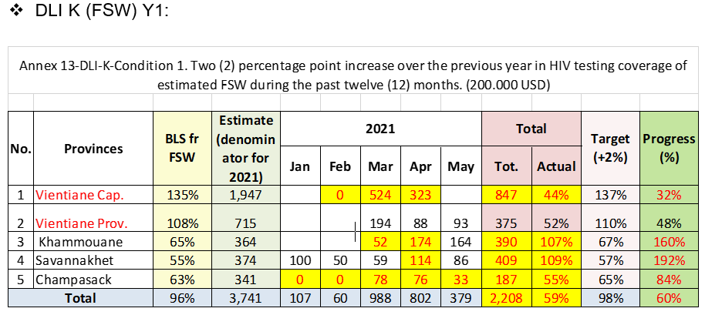

Slide 15
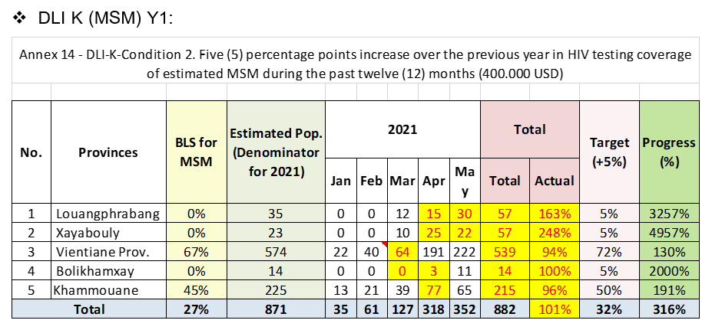

Slide 16
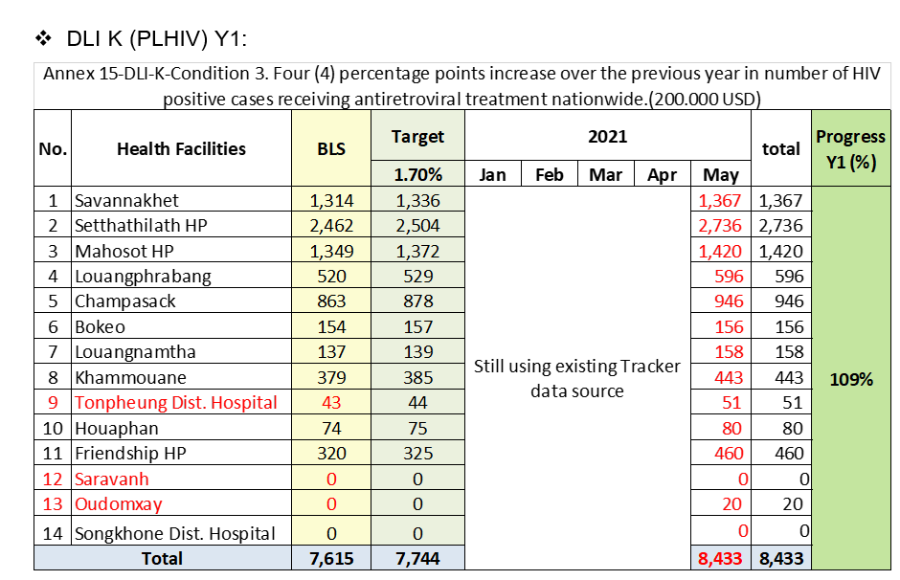

Slide 17
ລາຍງານຄວາມຄືບໜ້າການຈັດຕັ້ງປະຕິບັດ DLI K ປີທີ 2 DLI K Y2 (1/6/2021 – 31/10/2021)

Slide 18
Progress-DLI K Y2: HIV testing coverage of FSW
No. | Provinces | Denominator | Baseline | 2021 |  |  |  |  |  |  | 2022 |  |  |  |  | Total |  | Target: +2% | Progress
 |  |  |  | Jun | Jul | Aug | Sep | Oct * | Nov | Dec | Jan | Feb | Mar | Apr | May | Sum | %
1 | Vientiane Capital | 3,465 | 99.6% | 178 | 408 | 239 | 33 | 38 |  |  |  |  |  |  |  | 896 | 26% | 101.6% | 25%
2 | Vientiane Pro. | 1,587 | 68.9% | 90 | 88 | 69 | 58 | 35 |  |  |  |  |  |  |  | 340 | 21% | 70.9% | 30%
3 | Khammouan Pro. | 1,319 | 93.8% | 30 | 41 | 89 | 0 | 139 |  |  |  |  |  |  |  | 299 | 23% | 95.8% | 24%
4 | Savannakhet Pro. | 1,605 | 83% | 80 | 117 | 0 | 0 | 0 |  |  |  |  |  |  |  | 197 | 12% | 85% | 14%
5 | Champasak Pro. | 1,285 | 80.8% | 65 | 9 | 81 | 69 | 5 |  |  |  |  |  |  |  | 229 | 18% | 82.8% | 22%
Total |  | 9,260 | 88% | 443 | 663 | 478 | 160 | 217 |  |  |  |  |  |  |  | 1,961 | 21% | 90% | 24%

Slide 19
Progress-DLI K Y2: HIV testing coverage of MSM
No. | Provinces | Denominator | Baseline | 2021 |  |  |  |  |  |  | 2022 |  |  |  |  | Total |  | Target: +6% | Progress
 |  |  |  | Jun | Jul | Aug | Sep | Oct * | Nov | Dec | Jan | Feb | Mar | Apr | May | Tested | %
1 | Louangphabang | 1,689 | 3% | 34 | 33 | 34 | 82 | 2 |  |  |  |  |  |  |  | 185 | 11% | 9% | 116%
2 | Xayabouli | 1,139 | 5% | 23 | 22 | 22 | 79 | 33 |  |  |  |  |  |  |  | 179 | 16% | 11% | 142%
3 | Vientiane | 1,940 | 56% | 80 | 142 | 103 | 52 | 99 |  |  |  |  |  |  |  | 476 | 25% | 62% | 40%
4 | Bolikhamxai | 706 | 2% | 5 | 3 | 16 | 11 | 0 |  |  |  |  |  |  |  | 35 | 5% | 8% | 62%
5 | Khammouan | 1,097 | 54% | 44 | 74 | 94 | 19 | 32 |  |  |  |  |  |  |  | 263 | 24% | 60% | 40%
Total |  | 6,570 | 27% | 186 | 274 | 269 | 243 | 166 |  |  |  |  |  |  |  | 1,138 | 17% | 33% | 52%

Slide 20
Progress-DLI K Y2: Coverage of HIV treatment among people living with HIV
No. | ARV/POC Site | Baseline* | Target: 4% | 2021 |  |  |  |  |  |  | 2022 |  |  |  |  | Total | Progress
 |  |  |  | Jun | Jul | Aug | Sep | Oct | Nov | Dec | Jan | Feb | Mar | Apr | May
1 | 01 PH Savannakhet | 1,367 | 1,422 |  |  |  | 1,323 |  |  |  |  |  |  |  |  | 1,323 | 100.5%
2 | 02 CH Setthathirath | 2,736 | 2,845 |  |  |  | 2,884 |  |  |  |  |  |  |  |  | 2,884
3 | 03 CH Mahosod | 1,420 | 1,477 |  |  |  | 1,414 |  |  |  |  |  |  |  |  | 1,414
4 | 04 PH Luangprabang | 596 | 620 |  |  |  | 606 |  |  |  |  |  |  |  |  | 606
5 | 05 PH Champasak | 946 | 984 |  |  |  | 930 |  |  |  |  |  |  |  |  | 930
6 | 07 PH Bokeo | 156 | 162 |  |  |  | 171 |  |  |  |  |  |  |  |  | 171
7 | 08 PH Luangnamtha | 158 | 164 |  |  |  | 166 |  |  |  |  |  |  |  |  | 166
8 | 09 PH Khammuane | 443 | 461 |  |  |  | 484 |  |  |  |  |  |  |  |  | 484
9 | 10 DH Tonpheung | 51 | 53 |  |  |  | 53 |  |  |  |  |  |  |  |  | 53
10 | 11 PH Huaphanh | 80 | 83 |  |  |  | 93 |  |  |  |  |  |  |  |  | 93
11 | 12 CH Mittaphab | 460 | 478 |  |  |  | 570 |  |  |  |  |  |  |  |  | 570
12 | 13 PH Saravanh | 0 | 0 |  |  |  | 22 |  |  |  |  |  |  |  |  | 22
13 | 14 PH Oudomexai | 20 | 21 |  |  |  | 54 |  |  |  |  |  |  |  |  | 54
14 | 15 DH songkhone | 0 | 0 |  |  |  | 44 |  |  |  |  |  |  |  |  | 44
15 | 16 PH Xainyabouli | 0 | 0 |  |  |  | 0 |  |  |  |  |  |  |  |  | 0
16 | 17 PH Vientiane | 0 | 0 |  |  |  | 0 |  |  |  |  |  |  |  |  | 0
17 | 18 PH Borlikhhamxai | 0 | 0 |  |  |  | 0 |  |  |  |  |  |  |  |  | 0
18 | 19 PH Xiangkhouang | 0 | 0 |  |  |  | 0 |  |  |  |  |  |  |  |  | 0
Total |  | 8,433 | 8,770 |  |  |  | 8,814 |  |  |  |  |  |  |  |  | 8,814 | 100.5%
* ເນື່ອງຈາກ ຜູ້ຕິດເຊື້ອເຮສໄອວີທີ່ຮັບຢາ ເປັນຕົວເລກສະສົມ ຈຶ່ງຂໍລາຍງານສະເພາະເດືອນທີ່ລາຍງານ

Slide 21
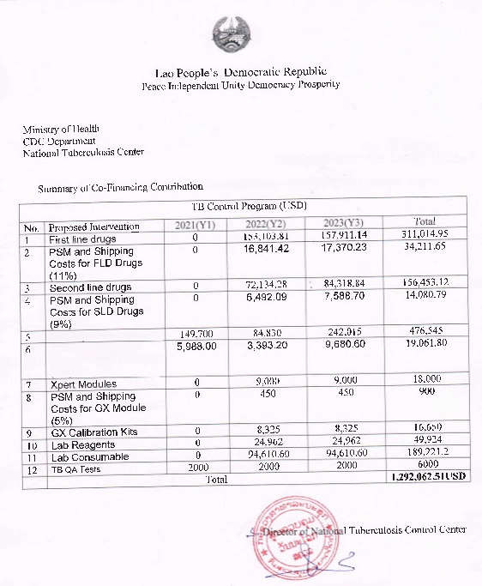
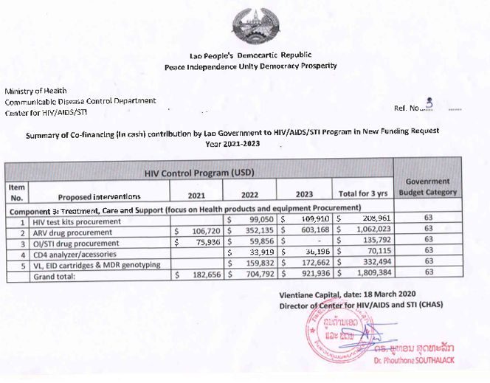
HIV/AIDS/STI program: $ 1,809,384
TB program: $ 1,292,062.51
Total: $ 3,101,446.51

Slide 22
Challenges
Covid-19 pandemic the country was lock down ( since 1 April 2020 ) had impact of target reached;
Transport and travel restrictions delayed access to medications and commodities;
The vulnerable groups cannot travel to receive diagnostic and treatment services;
Patients reluctant to come to the hospital, decreased incidence including emergency;
The increased patient lost to follow up;
Reporting system to DHIS2 not yet completed.

Slide 23
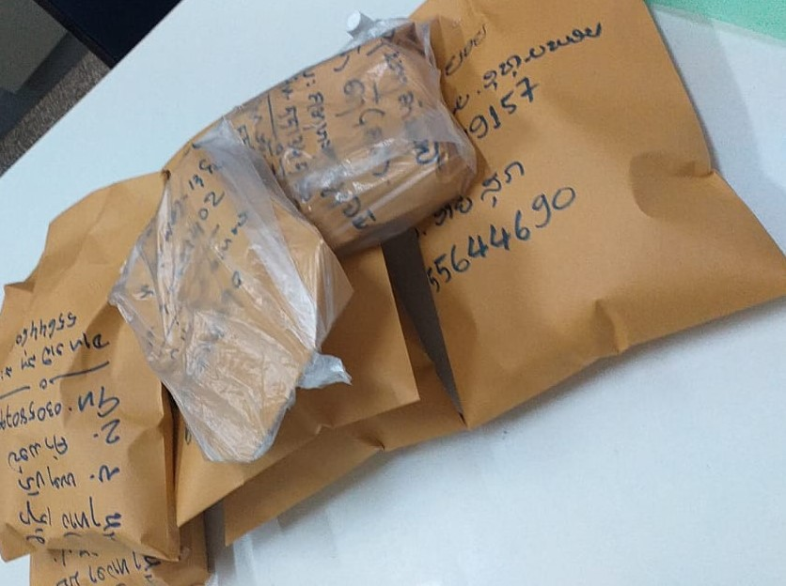
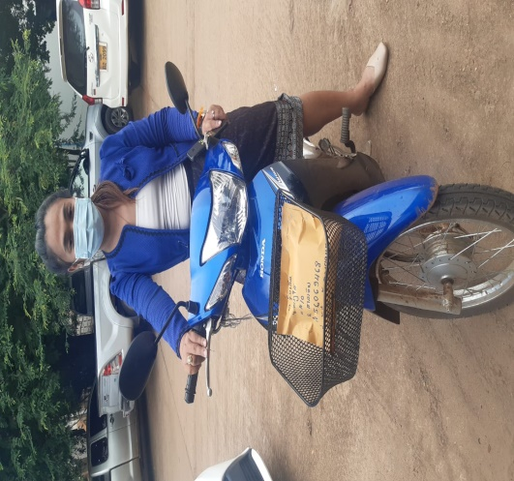
COVID-19 & HIV in Lao PDR –
Strategies access to services and persistence for treatment
Scenario | Strategies
PLHIV living near ART sites | Fast track ART pick-up at ART sites
PLHIV living in the urban area | Home-based ART delivery by peers and health care workers
PLHIV living in the rural area | Community ART group delivery by peers Family group ART delivery
PLHIV living in other countries e.g., Thailand | ART refill by post

