Slide 1
Achievements of RAI3E
Grant - Laos
2021-2023
The Joint Meeting of Ex-com and OC Meeting
19 March 2024

Slide 2
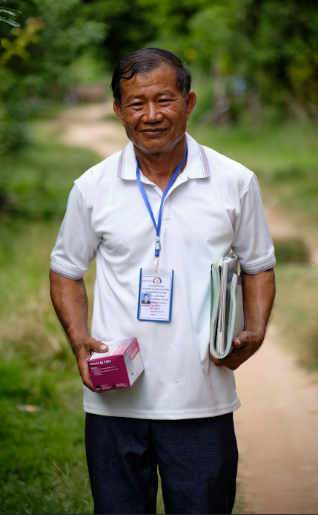
Presentation Outline
Programme Performance & Achievements against Indicators
Key Implemented Activities
Financial Performance

Slide 3
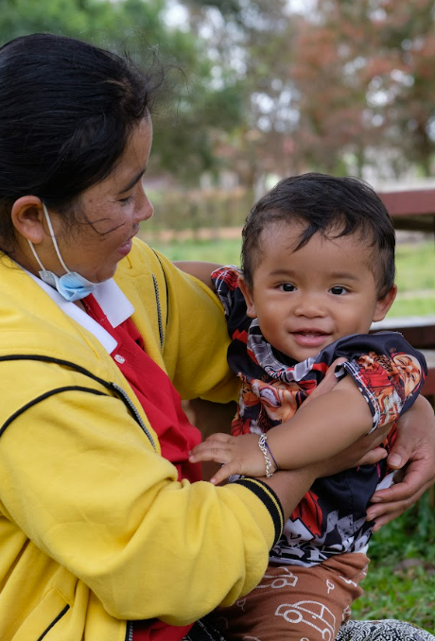
RAI3E Key Achievements
1,200,320
1,089
6,964
LLINs/LLIHNs distributed *
(including 360,000 from PMI & 152,000 from co-financing)
Confirmed malaria cases in low endemic areas investigated.
Confirmed malaria cases were detected. 100% were treated as per national treatment guidelines
2,381 VMWs
2,347,203
88
Suspected malaria cases that received a parasitological test.
Active foci received response within 7 days.

Slide 4
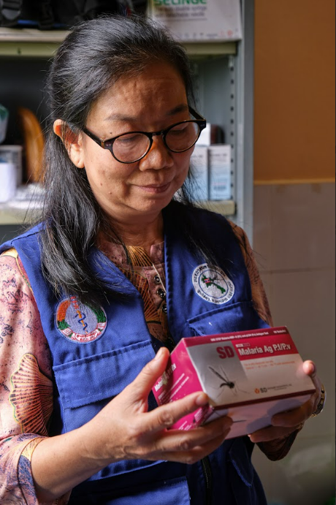
Programme Performance
& Achievements against Indicators

Slide 5
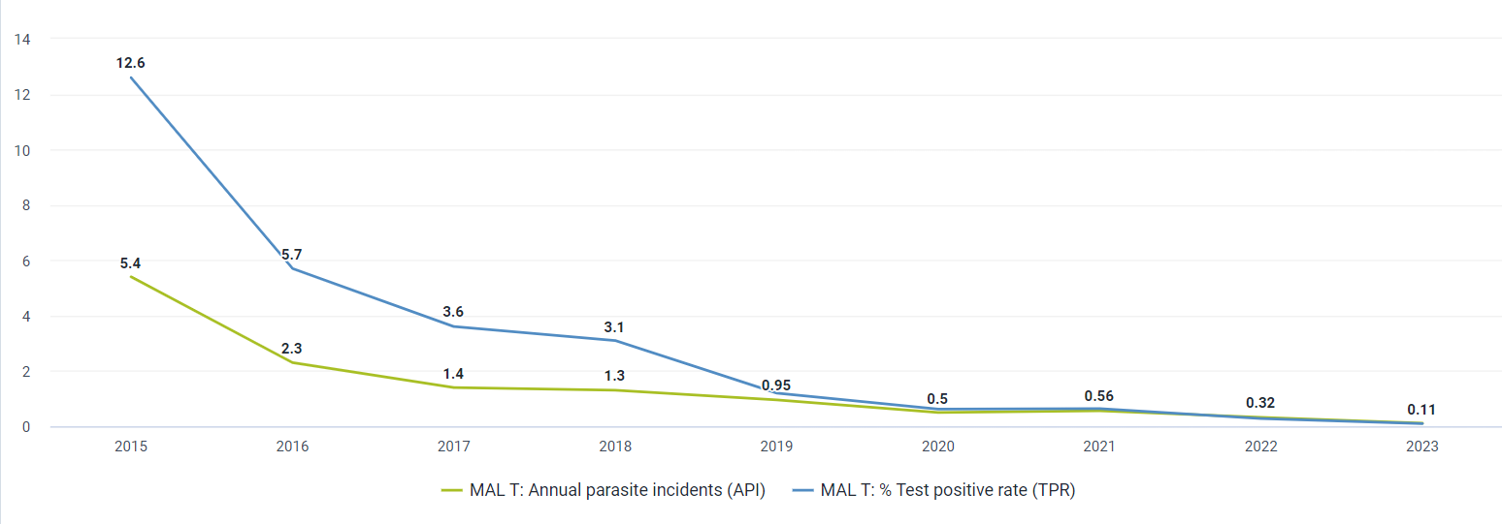
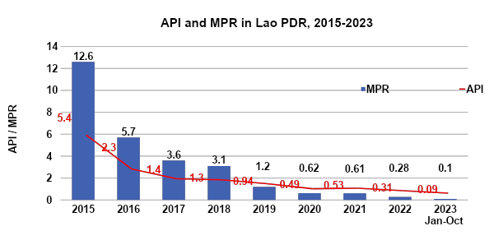
Programme Performance - API and MPR
—-API (Annual Parasite Incidence)
—-MPR (Malaria Test Positivity Rate)
API | 2021 | 2022 | 2023
Target | 1.5964 | 1.2375 | 0.7503
Result | 1.3080 | 0.99 | 0.2920
Performance | On-Track | On-Track | On-Track
MPR | 2021 | 2022 | 2023
Target | 0.59% | 0.42% | 0.21%
Result | 0.61% | 0.28% | 0.08%
Performance | Off-track | On-track | On-track

Slide 6
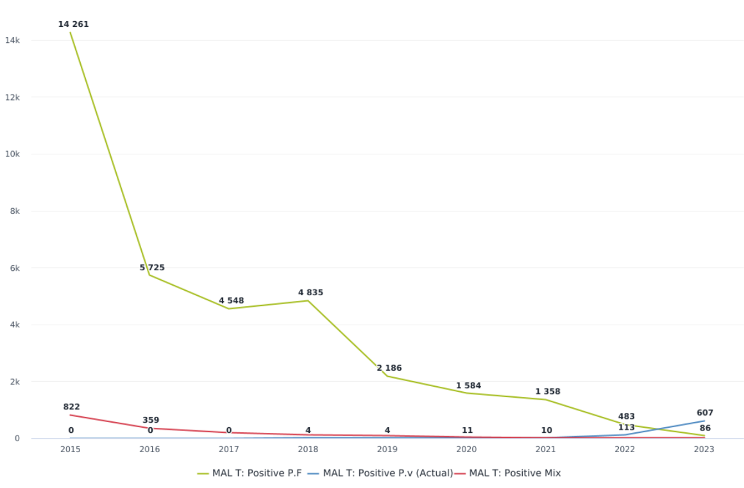
Programme Performance - Malaria Cases & Deaths
Zero severe malaria cases and zero deaths in 2023
Deaths | 2021 | 2022 | 2023
Target | 0 | 0 | 0
Result | 1 | 1 | 0
Performance | Off- track | Off- track | On- track

Slide 7
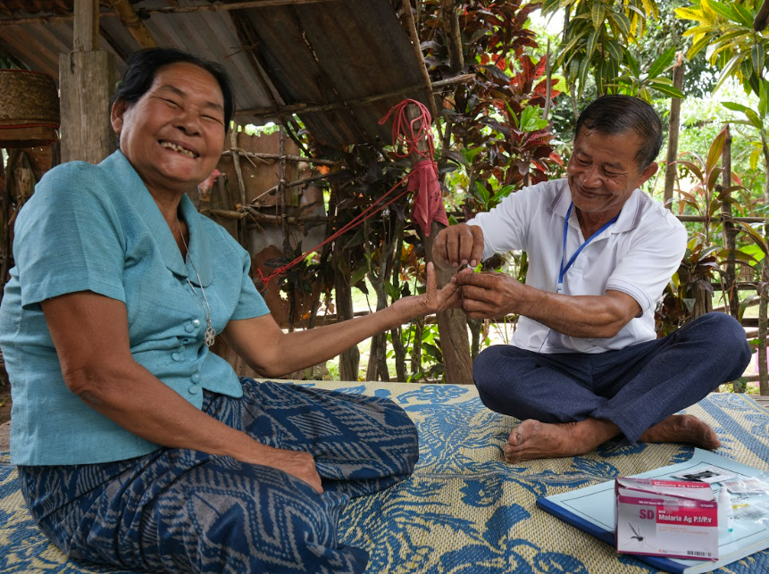
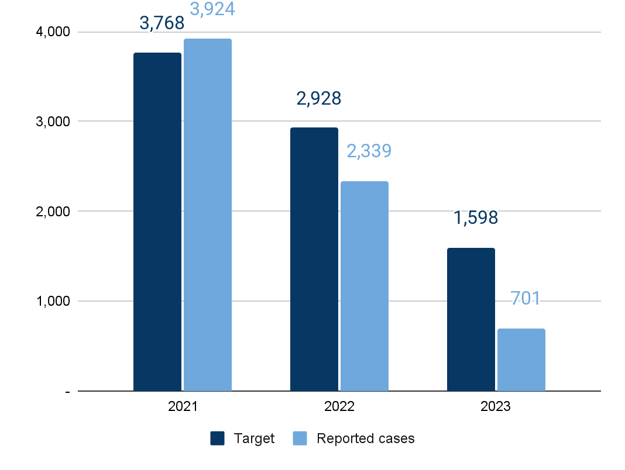
Programme Performance - Malaria Cases
Reported Malaria Cases
100% of reported cases were treated as per national treatment guidelines
The malaria cases decreased by 70% in 2023 compared with the last year's cases (# 701 in 2023 vs. 2,339 in 2022). Regarding species analysis to compare with last year, Pf/mix cases reduced by 82%, and Pv cases decreased by 67% in 2023. AS acceleration strategies interventions of Pf species were conducted since 2022 and continue in 2023 at targeted Pf hotspots areas in 5 southern provinces which showed a significant impact on Pf case reduction in 2022, and 2023

Slide 8
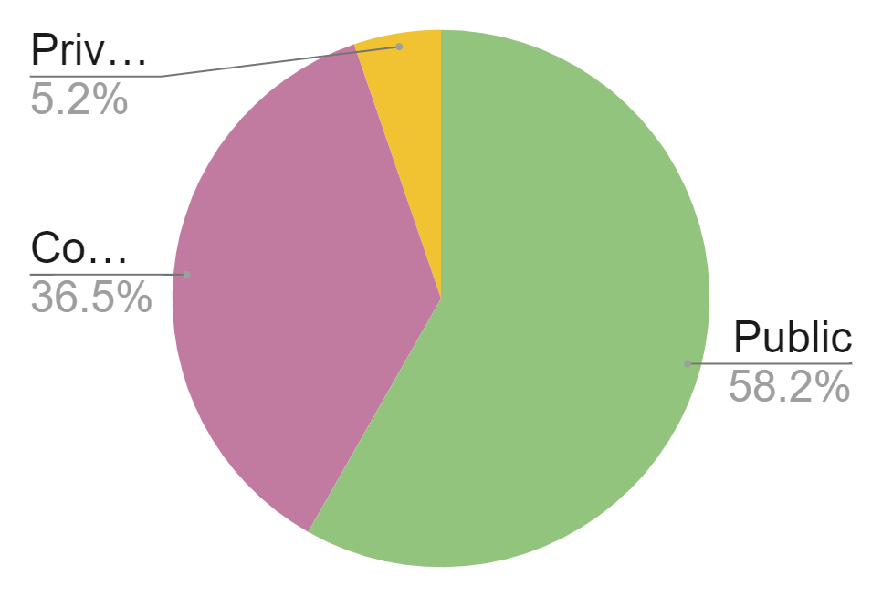
Achievements by Sectors (2021 - 2023)
Expected cases nationwide
8,294
Malaria Cases
Public | Community | Private | Total
4,055 | 2,544 | 365 | 6,964
Reported cases nationwide
6,964
(84% of expected cases)
58.7%
public sector

Slide 9
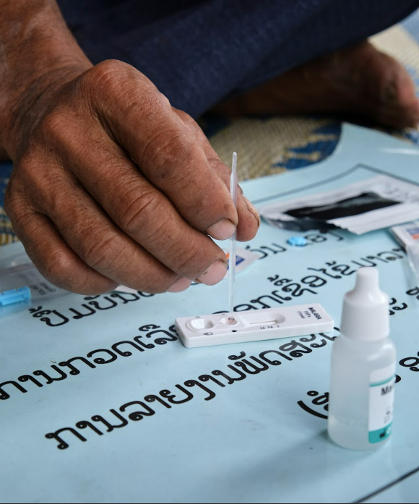
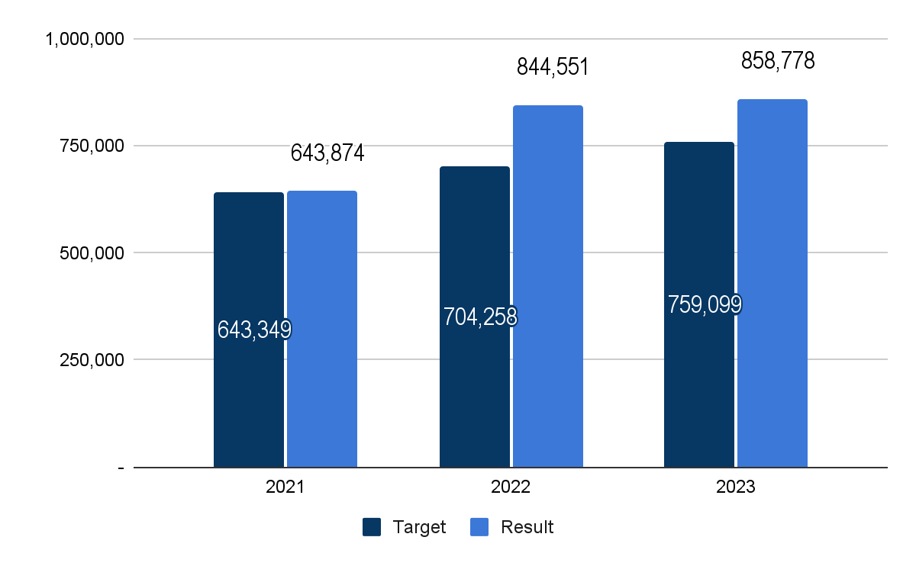
Programme Performance - Testing (2021-2023)
Parasitological Tests to Suspected Malaria Cases
Total tests: 2021-2023
2,347,203

Slide 10
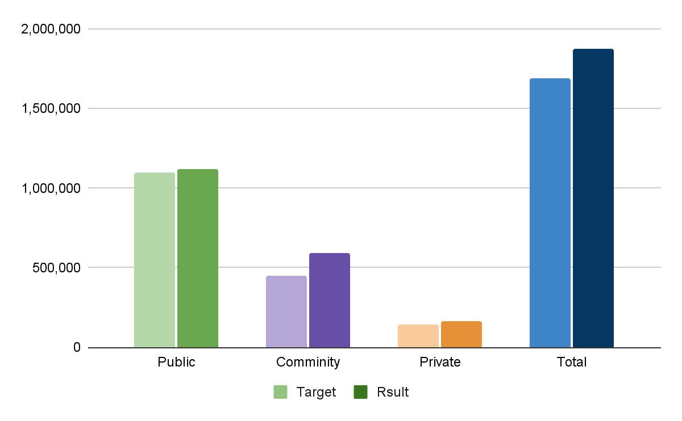
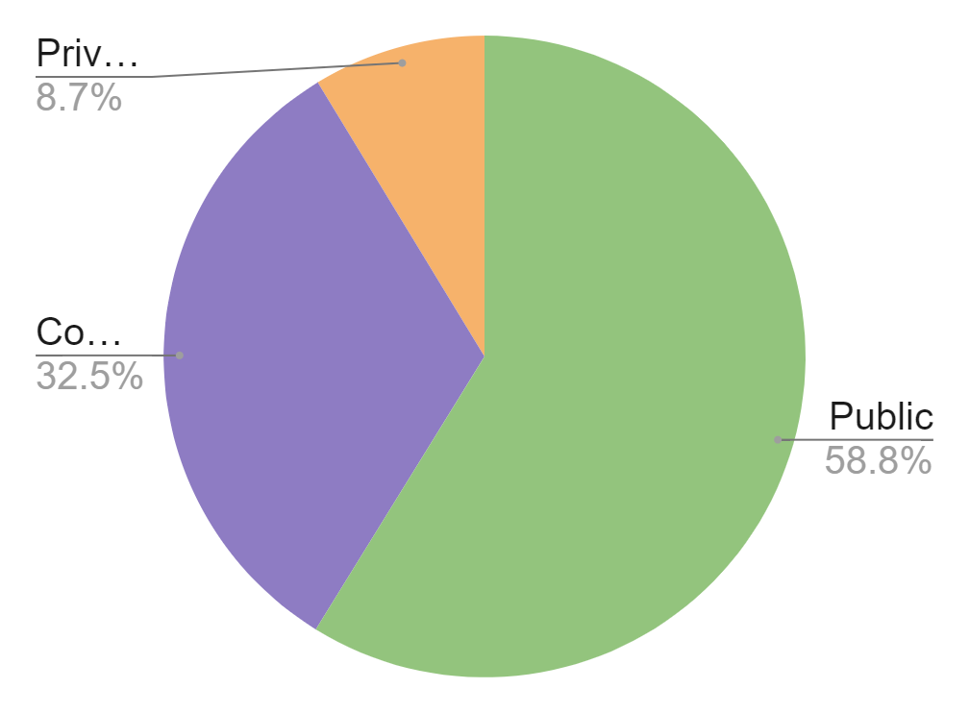
Programme Performance - Testing by Sector
Parasitological testings
Achieved % against targets
Public | Community | Private | Total
1,380,334 | 762,778 | 204,091 | 2,347,203
111%
102%
133%
118%

Slide 11
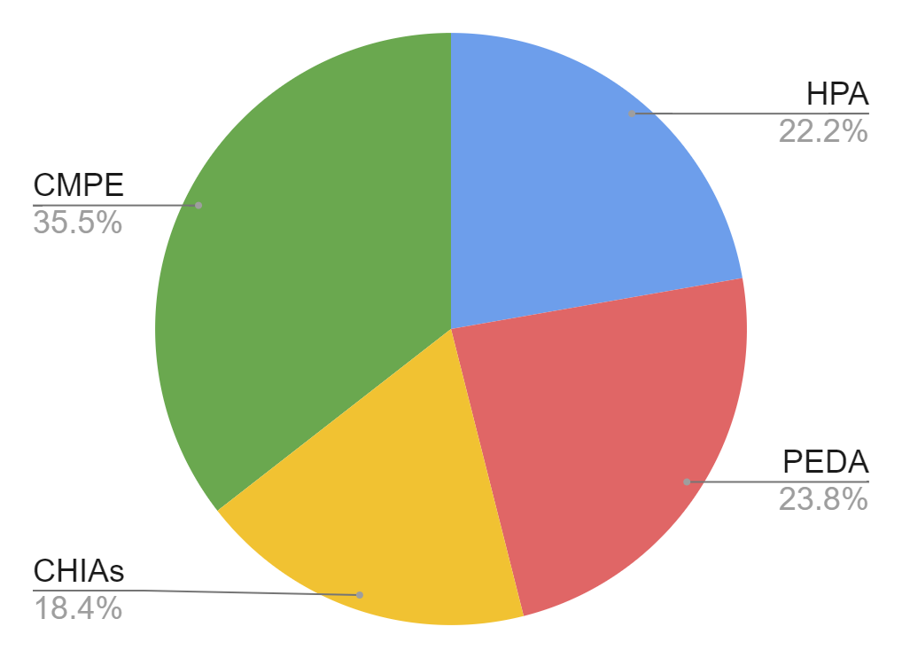
Programme Performance - Testing by Community
Community Tests : 762,778
Partner name | Test% | # of VMWs
HPA | 22.2% | 497
PEDA | 23.8% | 398
CHIAs | 18.4% | 402
CMPE | 35.5% | 1,084
Total | 100% | 2,381

Slide 12
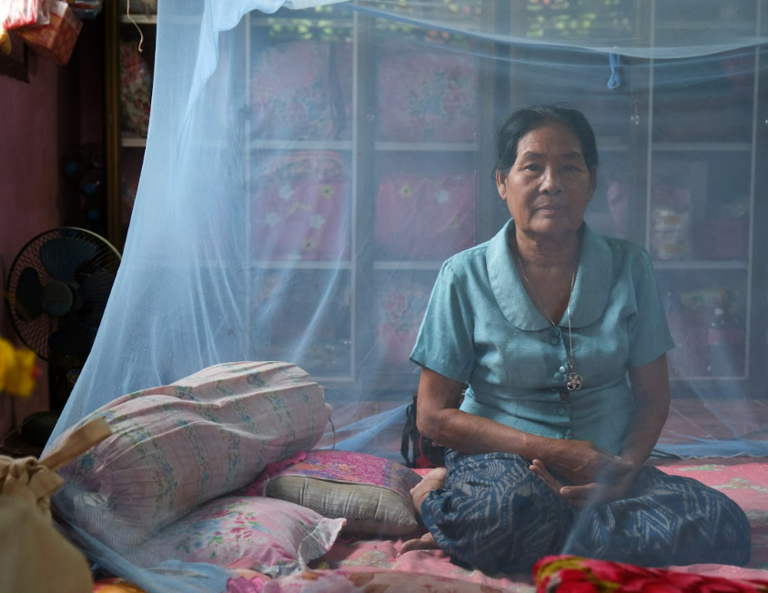
Programme Performance - LLINs Distribution
908,468 LLINs
were distributed during the mass campaign
in 2022
Continuous Distribution | 2021 | 2022 | 2023
Target | 99,605 | 99,923 | 150,647
Result | 38,137 | 116,418 | 137,297
Performance | Off-track | On-track | On-track

Slide 13
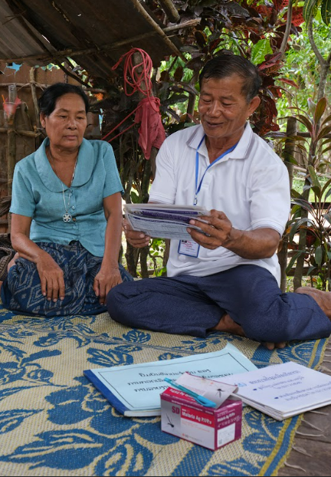
Key Implemented Activities

Slide 14
RAI3E Implemented Activities - Acceleration Strategies
Pf AS
Started in 2021
Effective advocacy resulted in community acceptance
Continued in 2022 & 2023
High coverage rates and target achievement
Resulted in
Significant decrease of cases & shrinking in Pf hotspots
 | 2019​ | 2020​ | 2021​ | 2022​ | 2023​
No. of HFCA reporting >5 malaria cases​ | 125​ | 75​ | 72​ | 64​ | 27
No. of HFCA reporting >5 P.f cases​ | 42​ | 39​ | 32​ | 14​ | 2

Slide 15
RAI3E Implemented Activities - CIFIR & OB Responses
CIFIR Activities
OB Response
Guidelines & Assessment
Strong surveillance system
Launch of real time reporting through the EoC hotline in 2023
High achievements on 1-3-7 elimination surveillance and response
Ongoing rapid OB response in less than 7 days
There were an unprecedentedly low number of outbreaks in 2023, with only 12 reported.
Burden reduction surveillance and guidelines were updated in 2022
Surveillance assessment conducted in 2022; with recommendations planned for RAI4E
An unusual OB occured in Nakai (malaria-free) in July 2023; Global Fund approved the usage of additional funds to conduct a serosurvey, PCR testing and SeroTAT to identify possible drivers of transmission and gaps in the current surveillance.

Slide 16
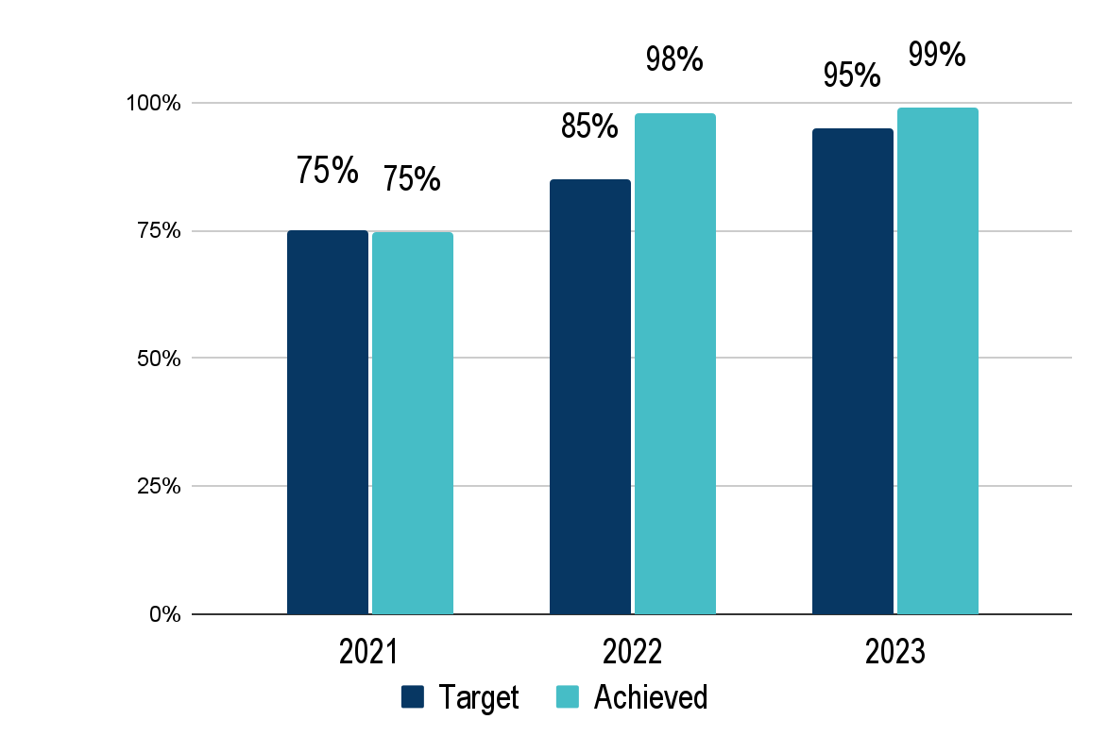
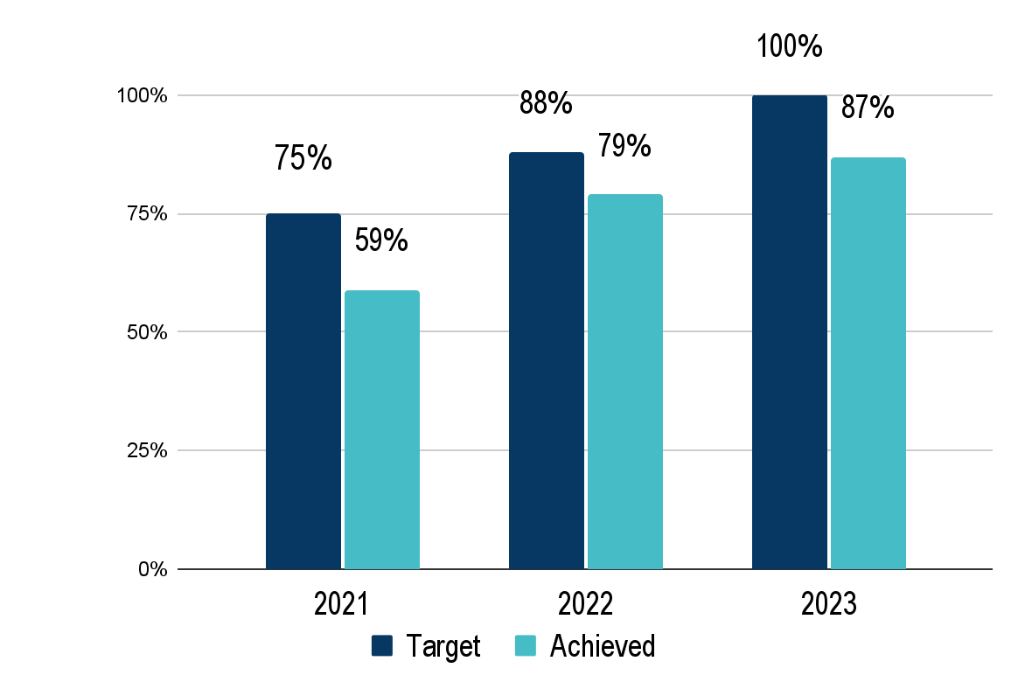
Programme Performance - CIFIR
Case investigation within 3 days
Active foci received responses within 7 days
 | 2021 | 2022 | 2023
Total EL cases | 214 | 155 | 300
CI < 3 days | 160 | 152 | 297
% achievement | 75% | 98% | 99%
 | 2021 | 2022 | 2023
Total foci responded to | 58 | 43 | 23
FIR < 7 days | 34 | 34 | 20
% achievement | 59% | 79% | 87%

Slide 17
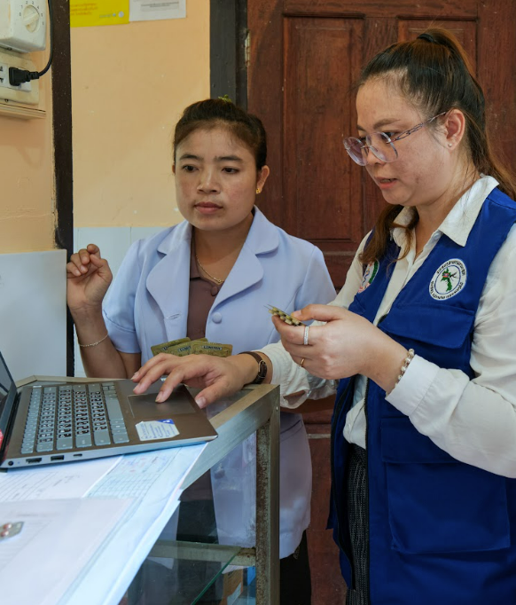
RAI3E Implemented Activities - Supervision
Supervision
Supervision and monitoring visits from CMPE central to sub-national levels; covering areas of programme management, case management, vector control, surveillance, etc…
Supervision and monitoring visits from province, district and health centers to lower levels;
Entomological monitoring - monthly visit in hotspot areas;
Supportive supervisory visits to provinces under DPF
Monitoring and supervision visits for integrated PSM program for LMIS - Provincial to District Level under MPSC

Slide 18
RAI3E Implemented Activities - Training
Training
Annual training on DHIS2, Surveillance and Supervision visit protocol, including Training of Trainers for Provincial staff, and training of district staff;
Annual ICCM, testing and treatment, reporting, and stock management training; including training of trainers for provinces (including provincial hospitals), and training for district, health centers and VMWs.
Refresher training for HTM programmes, HMIS team and managers (central level) under DPF
Training of Trainers - Capacity building of provincial level FDU super users to coordinate PSM activities in province under MPSC
PSM strengthening training for province and district staff on integrated distribution, forecasting and data utilization under MPSC
Refresher training on Monitoring and Evaluation to CSO and CMPE provincial project coordinator in 2021 by UNOPS
ToT for Prevention of Sexual Exploitation and Abuse (PSEA) to CSO colleagues by UNOPS

Slide 19
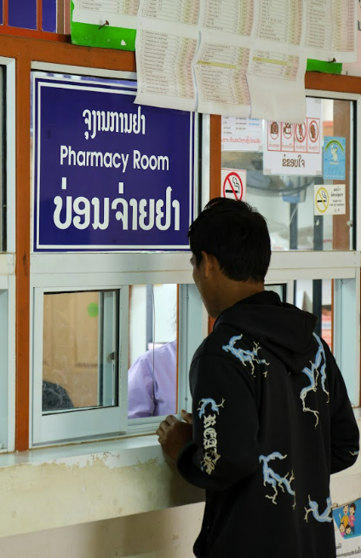
RAI3E Implemented Activities - Health Products Procurement
RDTs &
Antimalarial drugs
USD 700,000
Entomological monitoring, IR testing, Lab equipment, supplies & consumables
Additional and Upfront Procurement (approved by GF)
645,000 RDTs to cover co-financing gap for 2023
88,000 blisters of Pyramax to cover 2024 needs
126,000 tablets of Primaquine to cover 2024 needs
364,000 tablets of Chloroquine to cover 2024 needs
11,700 blisters of ACT6*4 to compensate expired stock
87,000 RDTs to mitigate risk of stock out in Q1 2024
LLINs
USD 3,650,000

Slide 20
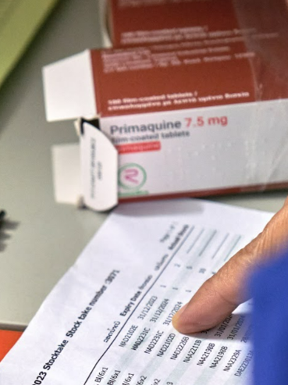
RAI3E Implemented Activities - PSM
UNOPS conducted a holistic assessment of the supply chain management of Malaria commodities in Dec 2022.
Recommendations have been adopted by CMPE. CMPE, CHAI, UNOPS have designed a pilot to address PSM issues at sub-national levels launched in 2023 and will be scaled up in 2024.
A new minimum stock policy has been put in place in May 2023, to account for substantial provincial differences in cases, minimize expiries, and optimize costs. In the new model, minimums are determined differently between Burden Reduction Districts and Elimination Districts. The new policy was used for forecasting commodities for RAI4E.

Slide 21
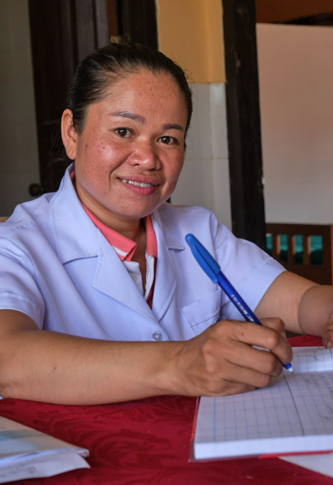
Financial Performance

Slide 22
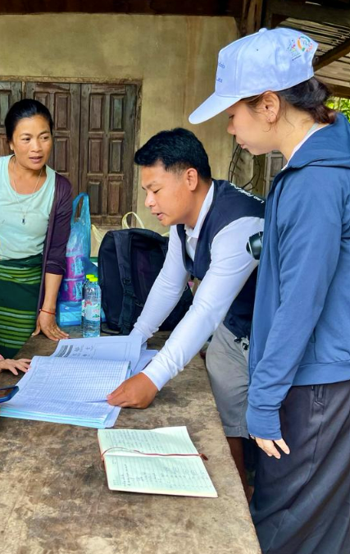
RAI3E Budget v/s Actual (2021 - 2023) - by SR
SRs | Budget | Actual | Absorption
CMPE | $8,072,007 | $7,931,523 | 98%
DCDC | $128,354 | $112,175 | 87%
DPC | $170,949 | $142,352 | 83%
HPA | $1,024,399 | $843,067 | 82%
MPSC | $197,167 | $152,004 | 77%
PEDA | $789,853 | $680,700 | 86%
WHO | $1,472,819 | $1,472,819 | 100%
Grand total | $12,641,701 | $11,981,150 | 95%

Slide 23
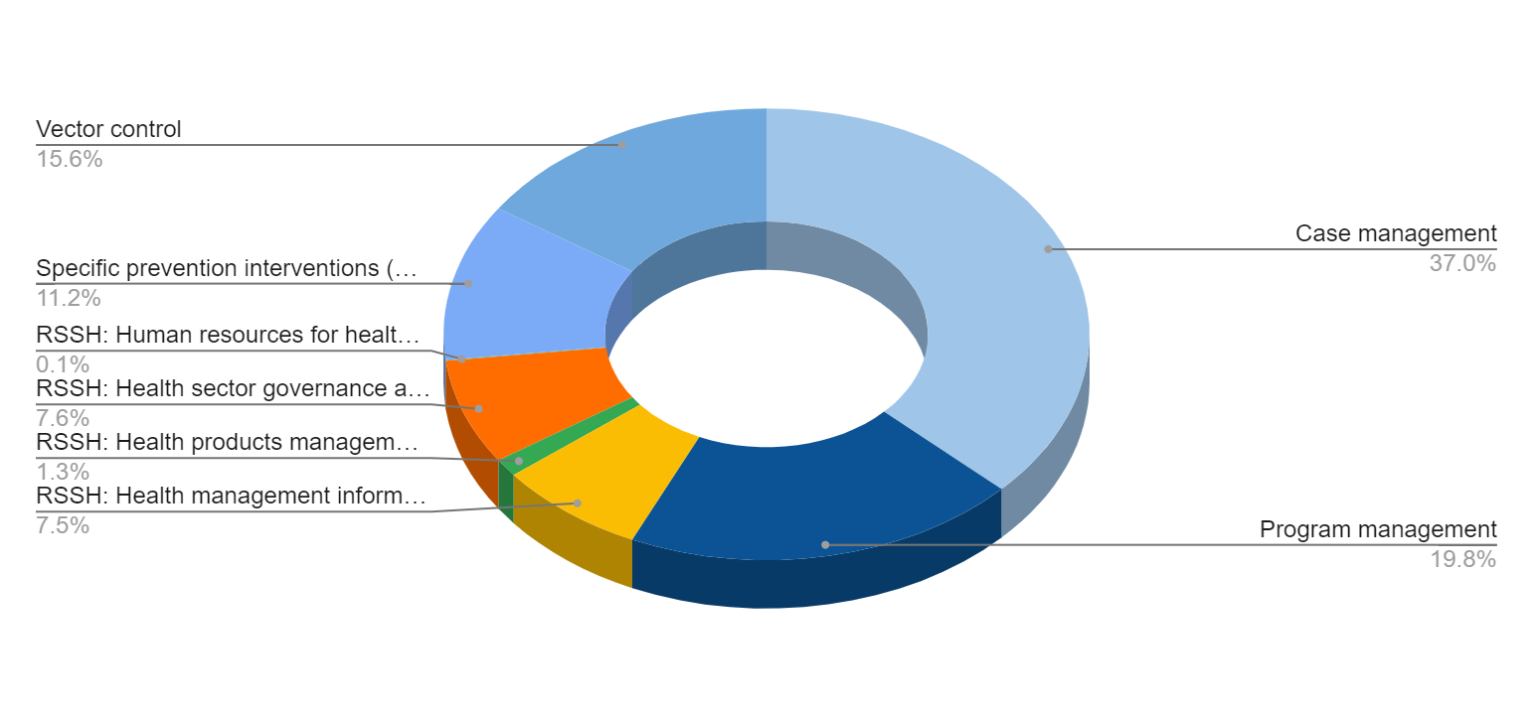
RAI3E Budget v/s Actual (2021-2023) - by Module

Slide 24
Capacity Building Activities on Finance
Accounting software installation and Chart of Account development for all SRs, except international organizations
Refresher training on Accpac accounting tool for all SRs, except international organization
Training/refresher training on financial guidelines at least once a year for all central SRs
Update of financial guideline for SRs in 2023
Updated RAI HR manual specific for CMPE in 2023
Training/refresher training on finance for all province accountants at least once a year (in person) and online quarterly meetings were organized in 2023

Slide 25
Challenges and Areas of Improvement
Supportive supervision visits and expenditure verification: at least 9 targeted provinces per year
During 3 years, DCDC, PR and CMPE organized visits to provinces 27 times, where about 3,182 expenditure vouchers amounting to 10,6 billion Kip were verified. Of this amount, 311 millions Kip classified as potential non compliant were found. As a result of the expenditures verification in provinces in 2021-2023, preventive actions were taken on corrections of the supporting documentation for a total 99.95% and only 0.05% was classified as ineligible expenditure and refunded to the grant.
The key findings are as follows:
Missing supporting documentation
Expenditure overstatement
Mismatched VMW Signature
Missing copy log-book for project car
Incomplete supporting documents

Slide 26
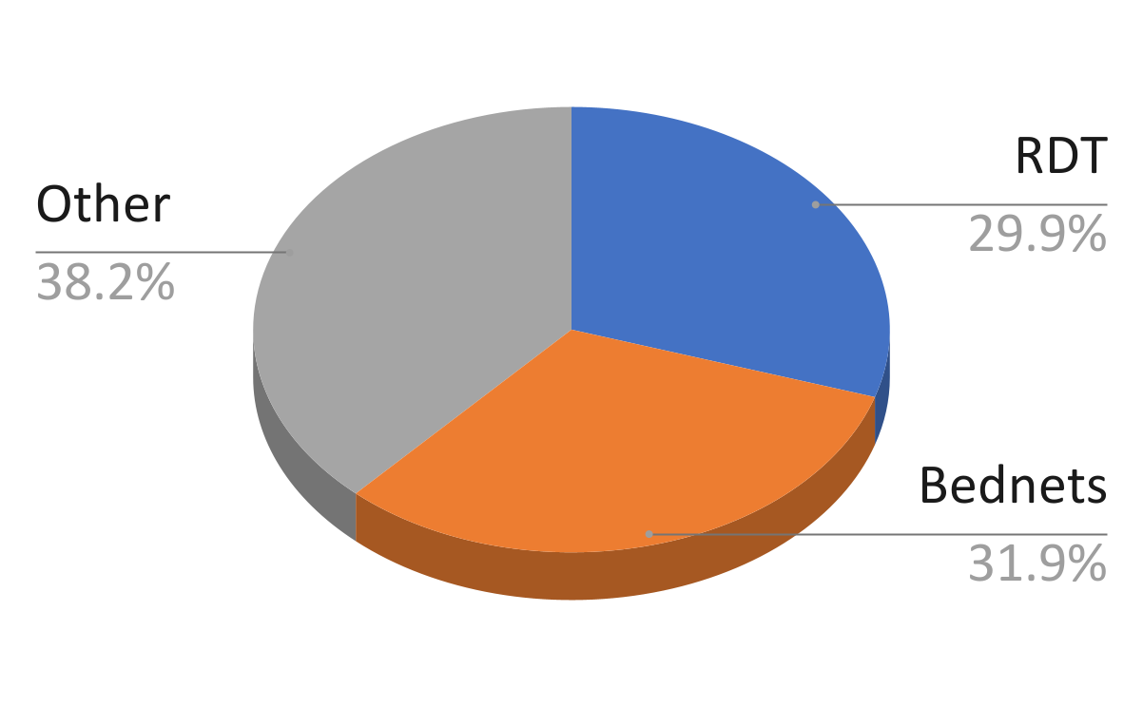
Government Co-financing Expenditure (2021-2023)
 | 2021 | 2022 | 2023 | Total
Total Commitment | 643,836 | 516,251 | 288,123 | 1,448,210
Total Expenditure | 643,677 (~100%) | 504,201 (~98%) | 288,081 (~100%) | 1,435,962
Main contribution is to RDT procurement and bednets ( 61.8%)
Other activities:
Annual review meeting
LLIN-mass distribution microplannings
Elimination certification preparation meeting/training
Dissemination meeting for IQA guideline
Microscopy training
LMIS SOP trainings
PPM training materials/job aids printing
ToT training for PPM
PPM refresher training
PPM and FDD meetings
Transition Review meeting

Slide 27
Kop Chai

