Slide 1
Youth Engagement in GF and CSO_KPs_PLWDs New Election Plan 2024

Slide 2
https://www.theglobalfund.org/en/strategy/

Slide 3
CSO-KPs-PLWD structure

Slide 4
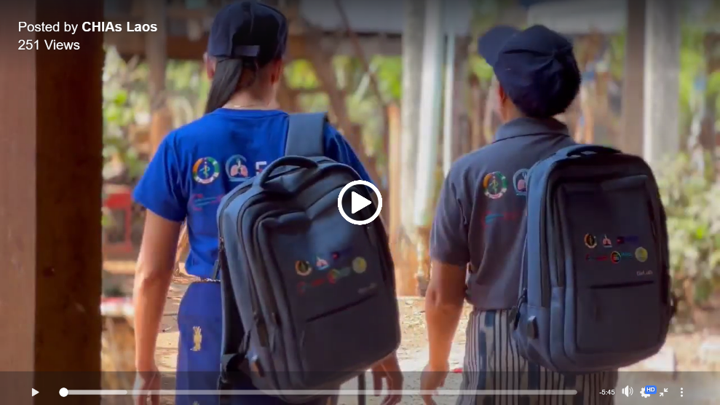
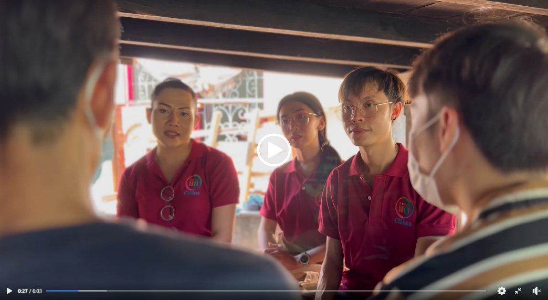
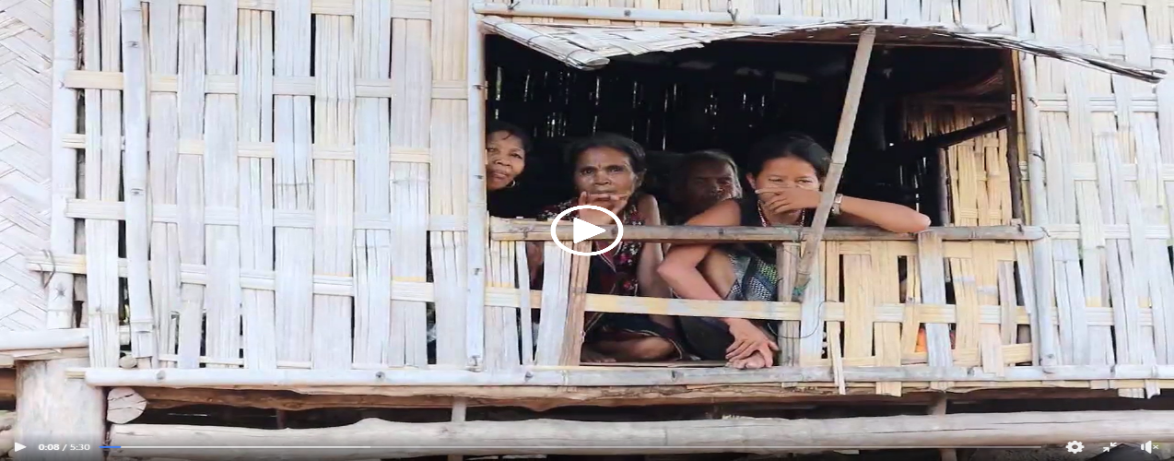
Produced three cases studies related to community engagement for HIV, TB, MALARIA elimination

Slide 5
Plan Reform CSO_KPs and PLWDs 2024
HANSA 1 Ended in December 2023
Term of CSO_KPs_PLWDs ended by December 2023
Preparing the HANSA2 monitoring which fully Engement with CSO_KPs and PLWDs representatives as CCM
We plan to conduct new CCM election for CSO_KP _PLWD
Main needs identified:
Definition of a common vision of CSO_KPs and PLWD_CCM
Improvement in conducting Oversight
Clear definition of role/responsibilities of each constituency rep
Communication strategy (internal and external)
Strengthening of the CCM Secretariat for CSO_KP and PLWD Rep

Slide 6
Action Plan for CSO_KPs and PLWDs CCM election 2024
ACTIVITY | TIME
Endorsed by CCM and Submit the Technical Assistance from L’Inititative and approval TA | Jan-March 2024
Internal review of CCM_CSO_KPs and PLWD Terms of Reference – including definition of role and responsibilities of Civil Society | May 2024
External review of CCM CSO_KPs and PLWD TOR and revise of guidelines & role for CCM_CSO_KPs and PLWDs constituency | Jun 2024
Consultation workshop with different member, network and community representatives | July 2024
Support new election process member of CCM_KPs and PLWD | August 2024-

Slide 7
Action Plan for CSO_KPs and PLWDs CCM election 2024
ACTIVITY | TIME
- Capacity need assessment - Capacity building and initial implementation of CCM_CSO_KPs_PLWDs TOR | Sep-Oct 2024
Develop the action plan for CCM_CSO_KPs and PLWDs | Oct 2024
CCM TOR Implementation and monitoring HANSA2 | Oct 2024
Attend the Regularly meeting and field visit with other CCM from constituency | Oct 2024-2025 and 2026

Slide 8
THANK YOU

