Slide 1
Progress Update on HANSA2 Preparation
Prepared by: DPF/PR/NPCO Team
LAO-C-MOH for HANSA2 Project
March 26, 2024

Slide 2
HANSA2 - Project Preparation
Grant Agreement/Grant Confirmation between Department of Planning and Finance (DPF), Ministry of Health and the Global Fund (GF) has been signed on December 20, 2023.
Grant Fund in the total of USD 17,537,388
First Annual Funding Decision for the LAO-C-MOH (the “Grant”) for the period 1 January 2024 - 30 June 2025 (“Disbursement Period”) has been sent from the Global Fund to the Department of Planning and Finance, Ministry of Health (The Project/PR/NPCO) on January 26, 2024.

Slide 3
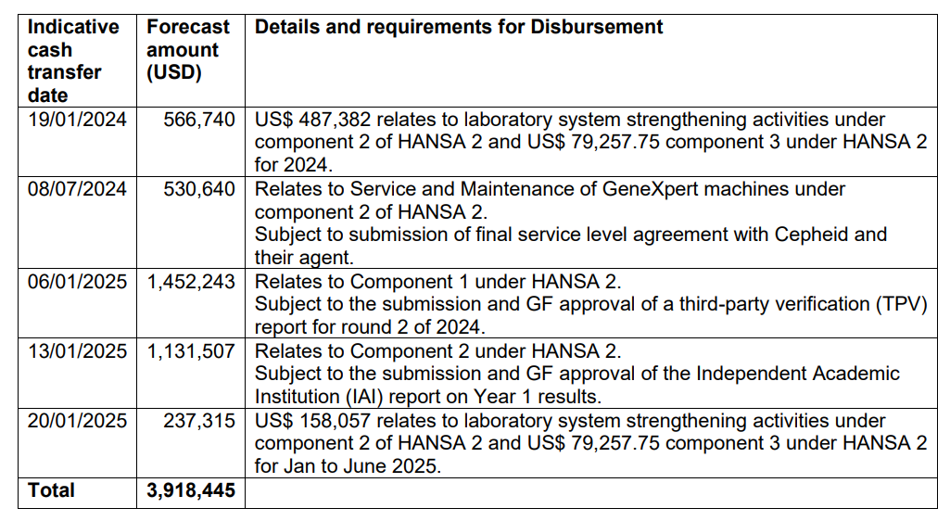
HANSA2 - Project Preparation, (Cont.)
The disbursement schedule for the Ministry of Health of Lao PDR is planned as follows:

Slide 4
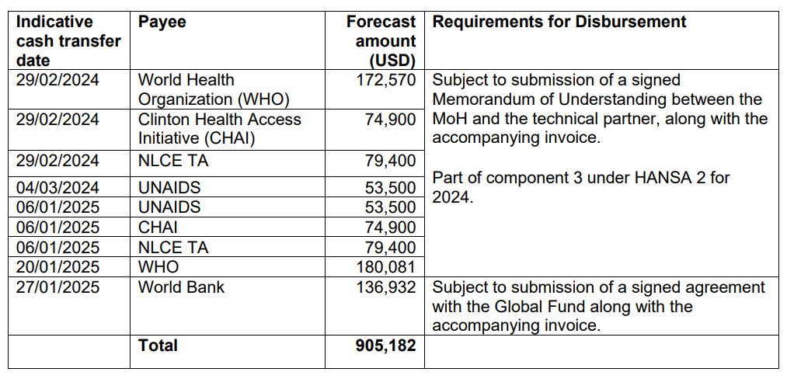
HANSA2 - Project Preparation, (Cont1)
The disbursement schedule to technical and development partners for technical assistance is planned as follows:

Slide 5
HANSA2 - Project Preparation, (Cont2)
Contracting of CSOs: NTC and CHAS have already signed the contracts with CSOs in early March 2024.
Contracting with development partners for Technical Assistance (WHO, CHAI, and UNAIDS):
WHO: DPF expected to sign the contract with WHO within this week.
CHAI: DPF has already signed the contract with CHAI yesterday (March 25, 2024).
UNAIDS: UNAIDS is now in the process of preparing the draft of contract and will be submitted to DPF soon according to the call with UNAIDS on March 7, 2024.
Co-financing Commitment Letter: The MOH Minister has already signed the commitment letter on February 2, 2024, and has also been submitted to the MPI Minister for signature the same day. Currently still waiting for the signing-off from the Minister of MPI.
AOP for NTC, CHAS, and NCLE has already finalized.
POM for NTC, CHAS, and NCLE not yet finalized. Expected to finalize within this week and/or next week.

Slide 6
Thank You!

