Slide 1
RAI3E Malaria Grant
Progress Update
Ad-hoc CCM Plenary Meeting
26 October 2023

Slide 2
Audit Observation 2021-2022

Slide 3
Summary of audit findings 2022
Functional area | Audit finding title | Priority rating (high / medium / low) | Number of findings | Financial impact (US$)
Human resources | Ineligible salary costs | Medium | 2 | 518
Finance | Lack of accounting software | Low | 1
Asset management | Weaknesses in asset identification tags | Low | 1
Finance | Foreign exchange gain not reported in PUDR and foreign exchange loss relating to 2021 reported in 2022 | Medium | 2
Finance | Excessive use of cash payments | Medium | 2
Procurement | Weakness in procurement procedures | Medium | 1
Total |  |  | 9 | 518

Slide 4
Summary of audit findings 2021-2022
Functional area | Number of findings |  | Finance impact (USD)
 | 2021 | 2022
Finance | 12 | 5 | 13
Human resources | 1 | 2 | 518
Procurement | 1 | 1
Asset management |  | 1
Total | 14 | 9 | 531

Slide 5
Co-financing

Slide 6
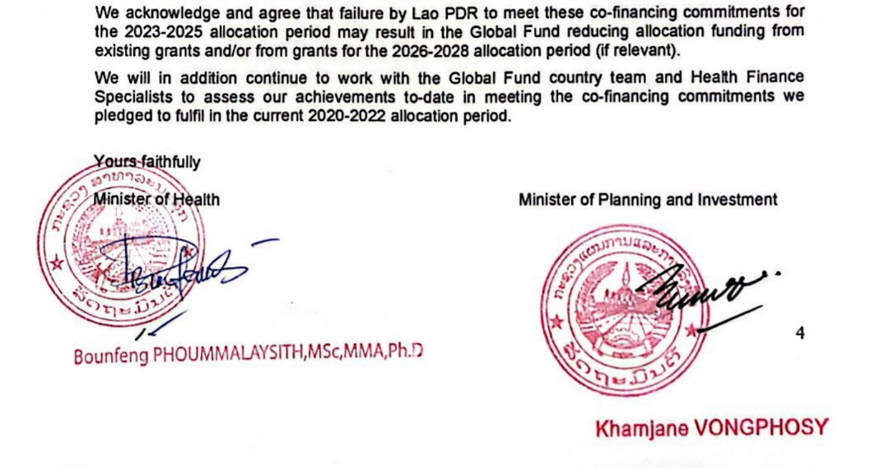
Co-financing Letter (2024-2026)

Slide 7
Co-financing (2024-2026)
Activity | Total | Percentage
Training | $258,975 | 20.25%
Meetings | $60,867 | 4.76%
Malaria commodities procurement | $781,799 | 61.13%
Non-malarial procurement | $4,195 | 0.33%
Office supplies | $90,565 | 7.08%
Printed material | $82,599 | 6.46%
Total | $1,279,000 | 100%

Slide 8
Grant Making process

Slide 9
Timeline
GAC Decision
Board Approval
Advance grant-making priorities during funding request
Approve / Nov
Get Ready/
Dec
Plan
1
3
5
2
4
Negotiate / Sep
Sign / Dec
PR submits final grant-making documents
PR signs and CCM acknowledges Grant Confirmation
GF signs Grant Confirmation

Slide 10
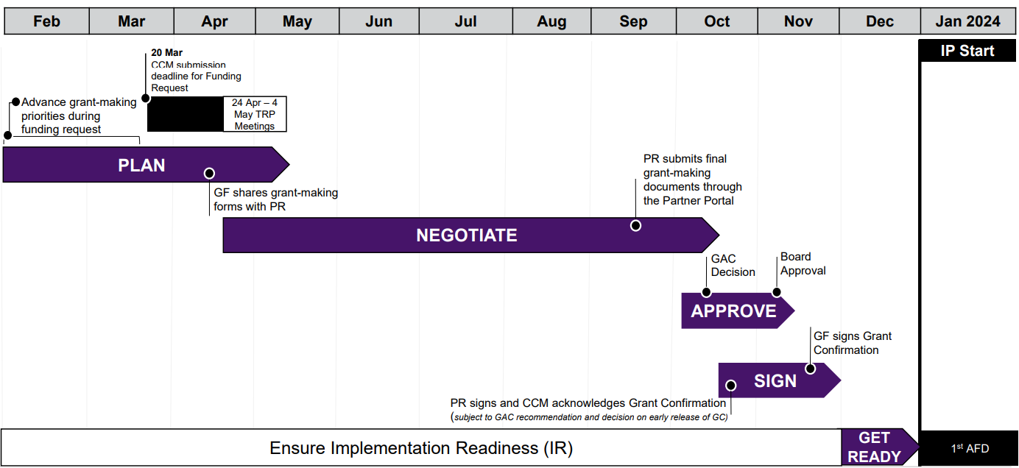
Timeline
We are here

Slide 11
RAI4E Prelaunch Workshop

Slide 12
Pre-launch Workshop
Discussion Topics
Changes in Operation Areas
Scale up ICCM
P.v referral SOP and follow up adherence and pharmacovigilance
PPM Monitoring and Supervision
Testing Algorithm
District facilitators new roles and responsibilities
PSM improvement plan
CMPE
PR UNOPS
CSOs
Nov 09
MPSC
Technical Partners

Slide 13
Thank you

