Slide 1
Progress report on DLI-K (HIV)
Health and Nutrition Service Access (HANSA)
(Center for HIV/AIDS and STI)

Slide 2
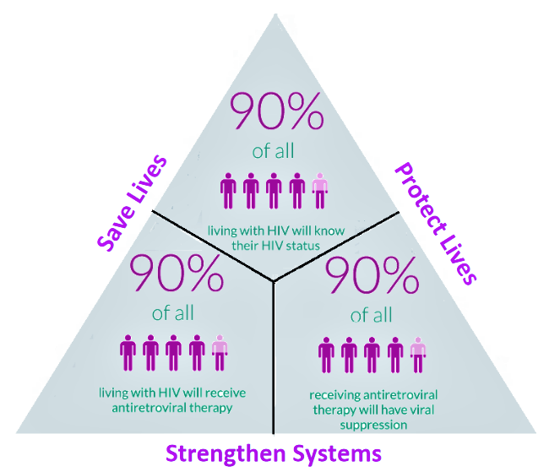
HIV/AIDS strategy to ending AIDS 2030
95%
95%
95%

Slide 4
1. Period of implementation on DLI K
YEAR | Period
Y 1 | 01/01/2021 ເຖິງ 31/05/2021 (5 months)
Y 2 | 01/06/2021 ເຖິງ 31/05/2022 (12 months)
Y 3 | 01/06/2022 ເຖິງ 31/05/2023 (12 months)
Y4 | 01/06/2023 ເຖິງ 31/05/2024 (12 months)
2. Implementers DLI-K : CHAS, PCCAs, CHIAs and PEDA
Notes:
FSW: Consider 2 more provinces for FSW intervention such as LNT and XK
MSM

Slide 5
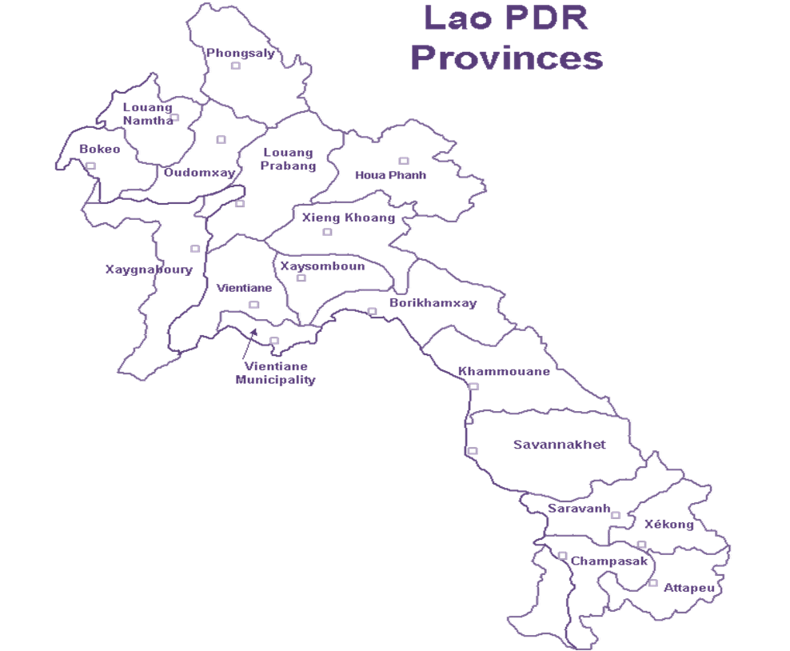
FSW
VTE PCCA
Chanthaboury
Sikhottabong
Sisattank
Hadsayphong
Saysettha
Saythany
Nasaythong
Pargnum
Sangthong
VTP (PEDA)
1.Keo Oudom
2.Phonhong
3.Vengvieng
4.Thoulakhom
5.Vengkham
SVK (PCCA)
KaysonePhomvihan
Sayphouthong
Songkhone
Outhonphone
Atsaphangthong
Phin
Sepone
Champhone
PhalanXay
KM (PEDA)
Thakhek
Hinboun
Nongbok
Mahaxai
CPS (PEDA)
Pakse
Phonthong
Bachieng

Slide 6
MSM
LPB (CHIas)
Luangphrabang
Chomphet
Xiengnguen
BKX (PCCA)
Pakson
Thaphabath
Pakkading
Borikham
Khamkerth
SBL (CHIas)
Sayya
Paklay
KM (CHIas)
Thakhek
Nongbok
Mahaxai
Hinboun
Saybangfay
VTP (CHIas)
Phonhong
Keooudom
Toulakhom
Vengvieng
Vengkham

Slide 7
4. Health facilities provide services on ARV drugs for PLHIV
Provinces | Health Facilities (ART and POC sites)
1. Vientiane Capital | Sethathirath Hospital ARV Mahosoth Hospital ARV Friendship Hospital ARV
2. Khamouane | Khamouane Provincial Hospital ARV
3. Savanaket | Savanaket Provincial Hospital ARV Songkhone District Hospital POC
4. Champasack | Champasack Provincial Hospital ARV
5. Saravanh | Saravanh Provincial Hospital POC
6. Louangprabang | Louangprabang Provincial Hospital ARV
7. Oudumxay | Oudumxay Provincial Hospital POC
8. LouangNumtha | LouangNumtha Provincial Hospital ARV
9. Borkeo | Borkeo Provincial Hospital ARV Tonpeung District Hospital ARV
10. Huaphanh | Huaphanh Provincial Hospital ARV
11. Vientiane Provincial | 15. Vientiane Provincial Hospital POC ➔ 9/2021
12. Xayabury | 16. Xayabury Provincial Hospital POC ➔ 8/2021
13. Borikhamxay | 17. Borikhamxay Provincial Hospital POC ➔ End 2021
14. Xiengkoung | 18. Xiengkoung Provincial Hospital POC ➔ End 2021
ARV & POC
14 Provinces
11 ARV
7 POC
Notes:
FSW: Consider 2 more provinces for FSW intervention such as LNT and XK
MSM

Slide 8
Progress report on DLI K Y2

Slide 9
Progress-DLI K Y2:
DLIK-A: Increasing 2% of FSW received an HIV test in the past twelve (12) months and know their results
No. | Provinces | Denominator | Baseline | 2021 |  |  |  |  |  |  | 2022 |  |  |  |  | Total |  | Target: +2% | Progress
 |  |  |  | Jun | Jul | Aug | Sep | Oct | Nov | Dec | Jan | Feb | Mar | Apr | May | Sum | %
1 | Vientiane Capital | 3,465 | 99.6% | 178 | 408 | 239 | 33 | 162 | 209 | 190 | 535 | 617 | 539 | 238 | 186 | 3534 | 102% | 102% | 100%
2 | Vientiane | 1,587 | 68.9% | 90 | 88 | 69 | 58 | 117 | 196 | 187 | 95 | 40 | 82 | 30 | 82 | 1134 | 71% | 71% | 101%
3 | Khammouan | 1,319 | 93.8% | 30 | 41 | 89 | 0 | 139 | 177 | 202 | 114 | 239 | 45 | 69 | 120 | 1265 | 96% | 96% | 100%
4 | Savannakhet | 1,605 | 83% | 80 | 117 | 0 | 0 | 0 | 60 | 200 | 77 | 90 | 353 | 93 | 372 | 1442 | 90% | 85% | 106%
5 | Champasak | 1,285 | 80.8% | 65 | 9 | 81 | 69 | 5 | 237 | 240 | 79 | 66 | 94 | 74 | 73 | 1092 | 85% | 83% | 103%
Total |  | 9,260 | 88% | 443 | 663 | 478 | 160 | 423 | 879 | 1,019 | 900 | 1,052 | 1,113 | 504 | 833 | 8,467 | 91% | 90% | 102%
Target Y2= 8,336
Notes:
# Data export on 13/6/2022

Slide 10
Progress-DLI K Y2:
DLIK-B: Increasing 6% of MSM who received an HIV test in the past twelve (12) months and know their results
No. | Provinces | Denominator | Baseline | 2021 |  |  |  |  |  |  | 2022 |  |  |  |  | Total |  | Target: +6% | Progress
 |  |  |  | Jun | Jul | Aug | Sep | Oct | Nov | Dec | Jan | Feb | Mar | Apr | May | Tested | %
1 | Louangphabang | 1,689 | 3% | 34 | 33 | 34 | 82 | 2 | 40 | 100 | 14 | 13 | 12 | 12 | 12 | 388 | 23% | 9% | 243%
2 | Xainyabouli | 1,139 | 5% | 23 | 22 | 22 | 79 | 33 | 22 | 90 | 13 | 9 | 8 | 8 | 8 | 337 | 30% | 11% | 267%
3 | Vientiane | 1,940 | 56% | 80 | 142 | 103 | 52 | 100 | 141 | 123 | 62 | 116 | 122 | 86 | 89 | 1,216 | 63% | 62% | 101%
4 | Bolikhamxai | 706 | 2% | 4 | 3 | 16 | 11 | 0 | 0 | 5 | 20 | 1 | 1 | 0 | 1 | 62 | 9% | 8% | 109%
5 | Khammouan | 1,097 | 54% | 44 | 74 | 94 | 19 | 32 | 104 | 72 | 45 | 57 | 39 | 37 | 40 | 657 | 60% | 60% | 101%
Total |  | 6,570 | 27% | 185 | 274 | 269 | 243 | 167 | 307 | 390 | 154 | 196 | 182 | 143 | 150 | 2,660 | 40% | 33% | 121%
Target Y2= 2,198
Y2=2,198
Notes:
# Data export on 13/6/2022

Slide 11
Progress-DLI K Y2: DLIK-(C) increase + 4% of Number HIV positive cases currently on treatment
No. | ARV/POC Site | Baseline* | Target: 4% | 2021 |  |  |  |  |  |  | 2022 |  |  |  |  | Total | Progress
 |  |  |  | Jun | Jul | Aug | Sep | Oct | Nov | Dec | Jan | Feb | Mar | Apr | May
1 | 01 PH Savannakhet | 1,367 | 1,422 |  |  |  |  |  |  |  |  |  |  |  | 1,295 | 1,295 | 106.2%
2 | 02 CH Setthathirath | 2,736 | 2,845 |  |  |  |  |  |  |  |  |  |  |  | 3,019 | 3,019
3 | 03 CH Mahosod | 1,420 | 1,477 |  |  |  |  |  |  |  |  |  |  |  | 1,433 | 1,433
4 | 04 PH Luangprabang | 596 | 620 |  |  |  |  |  |  |  |  |  |  |  | 559 | 559
5 | 05 PH Champasak | 946 | 984 |  |  |  |  |  |  |  |  |  |  |  | 994 | 994
6 | 07 PH Bokeo | 156 | 162 |  |  |  |  |  |  |  |  |  |  |  | 170 | 170
7 | 08 PH Luangnamtha | 158 | 164 |  |  |  |  |  |  |  |  |  |  |  | 154 | 154
8 | 09 PH Khammuane | 443 | 461 |  |  |  |  |  |  |  |  |  |  |  | 495 | 495
9 | 10 DH Tonpheung | 51 | 53 |  |  |  |  |  |  |  |  |  |  |  | 68 | 68
10 | 11 PH Huaphanh | 80 | 83 |  |  |  |  |  |  |  |  |  |  |  | 95 | 95
11 | 12 CH Mittaphab | 460 | 478 |  |  |  |  |  |  |  |  |  |  |  | 689 | 689
12 | 13 PH Saravanh | 0 | 0 |  |  |  |  |  |  |  |  |  |  |  | 48 | 48
13 | 14 PH Oudomexai | 20 | 21 |  |  |  |  |  |  |  |  |  |  |  | 97 | 97
14 | 15 DH songkhone | 0 | 0 |  |  |  |  |  |  |  |  |  |  |  | 76 | 76
15 | 16 PH Xainyabouli | 0 | 0 |  |  |  |  |  |  |  |  |  |  |  | 65 | 65
16 | 17 PH Vientiane | 0 | 0 |  |  |  |  |  |  |  |  |  |  |  | 45 | 45
17 | 18 PH Borlikhhamxai | 0 | 0 |  |  |  |  |  |  |  |  |  |  |  | 4 | 4
18 | 19 PH Xiangkhouang | 0 | 0 |  |  |  |  |  |  |  |  |  |  |  | 11 | 11
Total |  | 8,433 | 8,770 |  |  |  |  |  |  |  |  |  |  |  | 9,317 | 9,317 | 106.2%
Notes:
Data is not complete # Data export on 13/6/2022

Slide 12
Challenges & Solutions Y2

Slide 13
Challenges
Corona virus 19(COVID-1) pandemic since 1 April 2020 the country was lock down, it have been harder to reach the target group (Key population FSW and MSM) .
The approved budgets have been delayed, the access and referral the target groups has decreased.
The health facilitators infected coronavirus, it have impacted to the data entry to DHIS2 software has been delayed.
The incomplete DHIS2 database has impacted for data entry and the consistency of reporting.
Reaching target groups (key population FSW and MSM) has not achieved to the national strategic target (92% by 2022).

Slide 14
Solutions
Strengthening the closed coordination, collaboration and plan due to Covid-19 situation among CHAS, PCCAs/DCCAs, PE and CSOs to fit the real time situation.
Review the hotspots area to ensure the access and services for target groups .
Raising Awareness on HIV/AIDS and STI by using social media.
Increase advertising in various forms and frequency of community testing (Peer testing/mobile testing) in hotspots area included the referral to HIV services.
PE capacity building in reaching, testing and referrals to care.

Slide 15
Perform the COVID-19 prevention measures during the implementation activities.
Continue the ARV drug delivery for PLHIV during the COVID-19 pandemic.
Closely monitoring activities and ensuring data entry through DHIS2 system.
Improve and strengthen the data entry, timely and accuracy through DHIS2 system,
closely and regular monitoring the quality of data from DHIS2 reporting.
10. Continue working and collaboration with Department of Planning and Finance to
improve the database and reporting from DHIS2 platform.
11. Organize lesson learned meeting and regular field supervision

Slide 16
Estimate target Y3 for FSW,MSM and ARV Treatment in DLI K

Slide 17
Indicator DLI K - (a1) Percentage of FSW received an HIV test in the past twelve (12) months and know their results
Indicators of DLI-K Y3
Percentage of FSW that have received an HIV test in the past twelve (12) months and know their results | Percentage Increase (FSW)
 | Y0 | Y1 | Y2 | Y3 | Y4
 | 0% | 2% | 2% | 2% | 2%
Indicator DLI-K (a2): Percentage of MSM received an HIV test in the past twelve (12) months and know their results
Percentage of MSM received an HIV test in the past twelve (12) months and know their results | Percentage Increase (MSM + TG)
 | Y0 | Y1 | Y2 | Y3 | Y4
 | 0% | 5% | 6% | 8% | 10%
Indicator DLI-K (b): Number of HIV positive cases currently on treatment
Number of HIV positive cases currently on treatment | Percentage Increase (on ART)
 | Y0 | Y1 | Y2 | Y3 | Y4
 | 0% | 1.7% | 4% | 5% | 5%

Slide 18
DLIK-A: Percentage of FSW received an HIV test in the past twelve (12) months and know their results (Y3)
Increase 2% of FSW received an HIV test in the past twelve (12) months and know their results
Area of implementation | Baseline Y2 (06/2021-05/2022) |  |  | Target Y3 (06/2022-05/2023)
 | Estimate number FSW of 2022 | Number of FSW received HIV test Y2 | % of FSW received HIV test | +2% | Estimate number of FSW 2023 | Estimate number of FSW have HIV test
Vientiane Capital | 3,464 | 3,534 | 102% | 104% | 3,517 | 3,658
Vientiane Province | 1,587 | 1,134 | 71% | 73% | 1,611 | 1,183
Khammouane Province | 1,318 | 1,265 | 96% | 98% | 1,339 | 1,311
Savannakhet Province | 1,604 | 1,442 | 90% | 92% | 1,629 | 1,496
Champasack Province | 1,284 | 1,092 | 85% | 87% | 1,304 | 1,135
Target FSW | 9,257 | 8,467 | 91% | 93% | 9,400 | 8,783

Slide 19
DLIK-B: Percentage of MSM received an HIV test in the past twelve (12) months and know their results (Y3)
Increase 8% of MSM received an HIV test in the past twelve (12) months and know their results
Area of umplementation | ຂໍ້ມູນພື້ນຖານ (06/2021-05/2022) |  |  | ເປົ້າໝາຍ ປີທີ 3 (06/2022-05/2023)
 | Estimate number MSM of 2022 | Number of MSM received HIV test Y2 | % of MSM received HIV test | +8% | Estimate number of MSM 2023 | Estimate number of MSM have HIV test
Luangphrabang P. | 1,689 | 388 | 23% | 31% | 1,719 | 532
Xayabury P. | 1,139 | 337 | 30% | 38% | 1,159 | 436
Vientiane P. | 1,940 | 1,216 | 63% | 71% | 1,974 | 1,395
Borykhamxay P. | 706 | 62 | 9% | 17% | 719 | 122
Khammouane P. | 1,097 | 657 | 60% | 68% | 1,116 | 758
Target MSM | 6,570 | 2,660 | 40% | 48% | 6,686 | 3,242

Slide 20
Roadmap
The main activities as the following:
Outreach activities and HIV testing among FSW and MSM as a daily basic
(Facility testing, Community testing and self testing).
Prevention, Mobile testing and campaign activities.
Refresh IEC and skill training for outreach activities ;
Raising Awareness on HIV/AIDS and STI by using social media.
Quality improvement on treatment, referring and monitoring for the PLHIV access and retention in care.
Support equipment to prevention Covid-19.
PCCAs/DCCAs/CSOs supervision and monitoring by coaching on sites.
Monthly meeting for sharing the lessons learn and planning;

Slide 21
FSW target breakdown for Y3
FSW Area implementation | No. HIV test | June-22 | Jul-22 | Aug-22 | Sep-22 | Oct-22 | Nov-22 | Dec-22 | Jan-23 | Feb-23 | Mar-23 | Apr-23 | May-23
Vientiane Capital | 3.658 | 345 | 345 | 345 | 335 | 345 | 335 | 325 | 315 | 315 | 215 | 205 | 233
Vientiane Province | 1.183 | 119 | 134 | 122 | 112 | 112 | 98 | 97 | 89 | 80 | 75 | 75 | 70
Khammouane Province | 1.311 | 135 | 145 | 140 | 130 | 111 | 110 | 99 | 96 | 96 | 83 | 83 | 83
Savannakhet Province | 1.496 | 125 | 125 | 125 | 125 | 125 | 125 | 125 | 125 | 125 | 125 | 125 | 121
Champasack Province | 1.135 | 115 | 130 | 125 | 125 | 115 | 105 | 100 | 80 | 65 | 65 | 60 | 50
Target FSW | 8.783 | 839 | 879 | 857 | 827 | 808 | 773 | 746 | 705 | 681 | 563 | 548 | 557

Slide 22
MSM target breakdown for Y3
MSM Area of implementation | No. HIV test | June-22 | Jul-22 | Aug-22 | Sep-22 | Oct-22 | Nov-22 | Dec-22 | Jan-23 | Feb-23 | Mar-23 | Apr-23 | May-23
Luangphrabang P. | 532 | 45 | 45 | 45 | 45 | 45 | 45 | 45 | 45 | 45 | 45 | 42 | 40
Xayabury P. | 436 | 36 | 40 | 36 | 36 | 36 | 36 | 36 | 36 | 36 | 36 | 36 | 36
Vientiane P. | 1395 | 116 | 119 | 116 | 116 | 116 | 116 | 116 | 116 | 116 | 116 | 116 | 116
Borykhamxay P. | 122 | 19 | 9 | 9 | 10 | 10 | 10 | 9 | 10 | 9 | 9 | 9 | 9
Khammouane P. | 758 | 63 | 65 | 63 | 63 | 63 | 63 | 63 | 63 | 63 | 63 | 63 | 63
Target MSM | 3243 | 279 | 278 | 269 | 270 | 270 | 270 | 269 | 270 | 269 | 269 | 266 | 264

Slide 23
Target Y3: DLIK-(C) Increase 5% of Number HIV positive cases currently on treatment
No. | Health Facilities (ART and POC sites) | Y2 (end of may.22) | Y3 (5%) (end of may.23)
1 | Savannakhet | 1,295 | 1,360
2 | Setthathilath HP | 3,019 | 3,170
3 | Mahosot HP | 1,433 | 1,505
4 | Louangphrabang | 559 | 587
5 | Champasack | 994 | 1,044
6 | Bokeo | 170 | 179
7 | Louangnamtha | 154 | 162
8 | Khammouane | 495 | 520
9 | Tonpheung Dist. Hospital | 68 | 71
10 | Houaphan | 95 | 100
11 | Friendship HP | 689 | 723
12 | Saravanh | 48 | 50
13 | Oudomxay | 97 | 102
14 | Songkhone Dist. Hospital | 76 | 80
15 | Sayaboury | 65 | 68
16 | Vientiane Province | 45 | 47
17 | Bolikhamxay | 4 | 4
18 | Xiengkuang | 11 | 12
Total |  | 9,317 | 9,783

Slide 24
Review the needs to reprogram for C19 RM funds HIV program

Slide 25
Overview of C19RM funding for HIV program
Implementation Period 3 years : 1 January 2021 - 31 December 2023
Activities and Budget 3 years: 597.283 USD
Main Focus of C19RM Funding: Mitigation of Covid19 risks for the HIV programs
The Signed contract between DPC/NPOC/PR and CHAS to Implementation Project: 1st October 2021
Completed open bank account for COVID-19 funding 2021.
Recruited Project coordinator and Finance officer .

Slide 26
Overview of C19RM funding approved for HIV program
Approved budget | 2021 | 2022 | 2023 | Total
C19RM grant total (USD) | 120,741 | 246,411 | 230,131 | 597,283
Procurement Non-HP | 54,895 | 0 | 0 | 54,895 (9%)
Implement activities & admin cost | 65,846 | 246,411 | 230,131 | 542,388 (91%)
Remark: CHAS does not have any procurement of health product in this grant

Slide 27
12 activities under C19 RM Y1/2021
120, 141 $
Budget amount 54, 895.05$ in line 227, 229, 230 is kept with PR account for procurement, and those activities are now in process.
CHAS received budget for year 1 on 28 December 2021 with total amount 65,846$ for implementing 9 activities which is impossible to utilize as planned.

Slide 28
Reprogramming budget (from saving) in 2022-2023
Items | Saving Y1 | Saving Y2 | Saving Y3 | Total
C19RM - 2020 (4 BL: 102,110,126,130) | 46,613 $ | - | - | 46,613 $
C19RM - 2021 | 56,110 $ | 53,504 $ | 51,762 $ | 161,376 $
Total | 102,723 $ | 53,504 $ | 51,761 $ | 207,988 $
Budget saving for Y1 excluded 3 budget lines for IT procurement # 54,895 $ which was transferred to CHAS in May 2022, and these budget are carry over to Q6/2022

Slide 29
Prioritized Reprogramming Activities in 2022-2023
Items | Saving Y1 | Saving Y2 | Saving Y3 | Total
C19RM - 2020 | 46,613 $ | - | - | 46,613 $
C19RM - 2021 | 56,110 $ | 53,504 $ | 51,762 $ | 161,376 $
Total | 102,723 $ | 53,504 $ | 51,761 $ | 207,988 $
Scale up Point of Care (POC) sites in 2 provinces (PSL+XSB) and 4 central hospitals (MNCH, Children, 103, 5 Mesa)
Improve data management for CSOs partners – develop SOP/Guidance and Training workshop
Strengthening/Creating mechanism for PLHIV and KPs to access national health insurance through discussion and consultation workshop, develop SOP or guidance for PEs education.
Public awareness raising through printing communication materials, special events, Radio advertisement, social media…
Enhance S&D reduction activities into on-going QI efforts
(e.g. develop Training curriculum, TOT workshop,

Slide 30
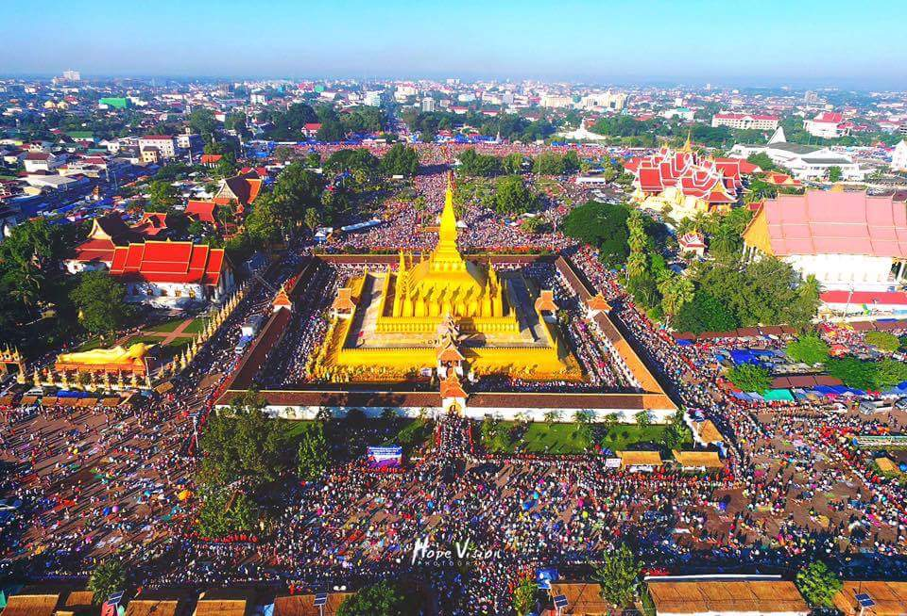
ຂໍ​ຂອບ​ໃຈ

