Slide 1
Report Oversight Field Visit Borlikhamxay Province Date 28th-31st March 2016 MONITOR: (HIV/AIDS-TB-MALARIA)

Slide 2
Main Purpose: To oversight the implementation of the projects supported by the Global Fund to Fight AIDS, Tuberculosis and Malaria (GFATM) at provincial, district and health center level according to the oversight schedules and focused on five key issues: 1.Finance 2. Procurement 3. Implementation 4. Results (output/outcome) 5. Reporting system

Slide 3
Target Sites: 1.Provincial Health Department 2. Hospital of Parkkading District - Namthone Health Center - Parkkading Health Center 3. Health Office & Hospital of Thaphabath District ​​ - Houy Leuk Health Center - Ban Parkthouy Health Center

Slide 4
Summary of findings
Key Progress
HIV/AIDS Under the guidance of the leaders, the projects were successfully implemented. Good cooperation in the implementation among the project team and partners at all levels. The project has a budget for the implementation (supported by the government and international organizations) The staff that is responsible for the HIV/STI of each district successfully practiced their roles as assigned by the upper level, such as regular monthly report. The local authorities cooperated as well. For the patients: the access to ARV treatment resulted in the reduction of transmission and death rate. Implementation of activities has been achieved. Monitoring on implementing activities such as IEC materials have been broadly disseminated.

Slide 5
Malaria Guided by both vertically and horizontal levels, the local authorities were cooperative and very accessible. The malaria control networks covered all target areas and villages. Received grants and materials from the Global Fund, CDCII and government. Technical staff and village volunteers from each target villages paid attention on their role and responsibility, acquiring continuous training. Surveillance systems for malaria at the provincial and district levels were strengthened. Data collection from the target villages was completely and timely. Early detection of malaria cases.
Tuberculosis Overall, the implementation of the activities was conducted as planned. The Tuberculosis case detection rate was increased. Good cooperation with other organizations and partners involved in the activities of tuberculosis. The reports were usually submitted on time. Most of the activities achieved the expected targets. Ensured that the medicines will not be out of stock in the warehouse.

Slide 6
Key Issues
HIV/AIDS The staffs that are responsible for AIDS/STIs at the provincial and district levels have not experience as they were recently replaced without any training. Activities can be extended to the district level only, have not been extended yet to the health center level. The reports from some districts were delayed and incomplete. Some figures from health centers were missing and incorrect. Voluntary counseling and testing is not well performed in some place due to insufficient coordination among the project staffs who are responsible for AIDS, Mother and Child Health and Tuberculosis. The activities for sex workers implemented by PEDA in 3 districts of the province was not continued. The PCCA secretariat has not been involved in the monitoring and quarterly meeting (the PCCA secretariat only attended the training for SW once a year). Lack of equipment for the activities such as: electronic equipment (e.g. audio, LCD projector, etc,...) Limited budget for the implementation of the activities. Patients were not very cooperative.

Slide 7
Malaria Approval of the budget was late. Essential equipment was not enough to work (such as old computers) Staffs of some health centers have changed frequently their task and responsibilities leading to a poor understanding of their work and delay in the reports and data collection. The village volunteer of some villages rarely stayed at home causing the data collection of many months to be missing.

Slide 8
Tuberculosis Very low detection of suspected cases (DTMs of some districts have several duties thus health workers samples delivery was low, and reduced to the fact of waiting to the patient to approach to the hospital) Practicing of DOT in district and health center is not well performed (creating a problem of drug resistance) When the provincial team conducted monitoring at district level, some districts did not paid attention, failing to follow the guidance or work out of the guidance and claiming they have lot of work to do. Monthly monitoring for the months of February, March, May, June and August were not completed as defined. When the district team conducted monitoring in the health centers their advices were not fully captured, such as: record on the patient’s treatment card, patient’s registration book, recover patients, complete treatment, in the case of dead - cards have not been returned to TB unit at the district level. When the team visit the villages, the screening for TB suspected patients was low.

Slide 9
Solution/Recommendation
HIV/AIDS HIV/AIDS and Tuberculosis Units have to collaborate regularly, allocate the budget for district level, health centers especially in remote areas. Planning for implementation activity should be done by the provincial level in order to cover the areas of the control of AIDS-STI broadly. The central team should conduct more monitoring and supervision. Health education should be conducted at the public health areas. The specific budget for HIV should be provided .
Malaria Staffs should be sufficient or should be selected the one who has suitable capacity for better work. Integrate work with other programs to strengthen the district level. Provide training on project management for the staffs at all levels. Conduct broadly awareness raising to the local people to understand the importance of sleeping in the mosquito nets in order to prevent malaria. Increase the budget for monitoring the district, health center and villages Improve reporting system by piloting some provinces, districts, health centers and villages to determine the actual lessons learnt. Provide some drugs that are lacking at the districts and villages.

Slide 10
Tuberculosis Reduce the responsibilities of project staffs to allow more times for them to monitor the health centers and villages (according to suspected cases and estimated number cover by the health centers). When provincial and district teams conduct the monitoring, they should be more active and teamwork proactive. When district teams conduct the health centers monitoring, they should follow their roles and responsibilities. Allocate the staff of the health centers and districts near to the patient’s villages to provide better assistance and daily DOT.

Slide 11
Additional Attention Issues (Cont. TB) Intensify case finding of TB patients in order to have a better detection rate and achieve national targets. Improve the case detection of children patient with tuberculosis Improve the case detection of closed patient groups with tuberculosis Follow up the treatment to ensure a better effectiveness of treatment, reduce the drug resistance of pathogens and reduced the death of patients IEC advertising for the local people to know and understand the symptoms, counseling and prevention, including advise, diagnosis and treatment for people close to TB patients. Ensure timely and completely reporting Ensure to keep safe copies for each report Ensure to support cooperation with organizations and/or other partners involved in the activities to control the tuberculosis disease.

Slide 12
Summarizing the key activities to be carried out (TB) Deliver the sample of suspected cases and following up the treatment Visit the TB patients in villages To retrain the health staffs on how to use the DOT Retrain workers for village volunteers on how to use the DOT in community Disseminate IEC regarding TB disease via radio and TV Monitoring from province to district and from district to health centers Monitoring from district to health centers and villages Budget for office management

Slide 13
6. Work Plan (2015-2016)
HIV/AIDS Provincial Level Continue to encourage mobilization for district level to report regularly to gain the STI of all health centers of each district. Expand in VCT Xaychamphone District Continue to propose the government a budget plan to carry out the HIV/STIs activities in 7 districts for the fiscal year 2015-2016. Continue to propose the budget plan for international projects fiscal year 2016-2017 Promote the access to counseling services, blood voluntary testing, test for STI and the use of condoms. Strengthen each level of team performance and increase the participation of communities and infected people. Encourage infected people to access counseling service, receive ARV treatment and treat complicated diseases. Continue to prevent HIV of MSM in 7 target districts (including 17 PE) access into 272 target people. Monitoring volunteers of MSM in 5 target districts (Pakxan, Pakkading, Borlikhan, Thaphabath and Khamkeut) Quarter meeting with partners of provincial and district level Retraining activity for 17 volunteers of MSM Enlighten for Peer in the field of (OW) Continue to prevent HIV infection in the population at the aged between 15-49 years to be less than 1%. Ensure the rate of HIV infection among the risk vulnerable population to be under 5%.

Slide 14
Pakkading District: Continue to report AIDS and STIs regular to Provincial Health. Continue to promote voluntary blood testing. Conduct the IEC mobile advertising regarding to the basic information of AIDS/STI at the clubs, guesthouses and villages Retrain the reporting form for partners in health centers and 2 district hospitals, 2 health centers Collect data of hotels, factories, restaurants. HIV Committee Meeting at district level. Workshop at provincial and district level.

Slide 15
Thaphabath District: Continue to mobilize the health centers to report regularly (STI) Continue to treat STI and check the report to submit to the province regularly Expand more VCT in 5 health centers over the districts Continue to implement the international project budget plan of the fiscal year 2015-2016 (to be completed). Continue to implement the government budget plan of the fiscal year 2015-2016 (to be completed). Attend the quarterly meeting of provincial level 4 times a year Once a year, attend training on revision of STIs treatment, and how to use the reporting form Once a year, train on counseling and testing for HIV for health center workers Conduct IEC and enlighten the basic knowledge to prevent HIV and STIs to people in 3 villages and students of 2 Secondary Schools. Once a year, visit 3 HIV infected families Collect the information of Female Sex Workers and local training on preventing HIV and STIs by local bars once a year Once a year, monitor 5 health centers.

Slide 16
Malaria Pakkading District: Workshop at district level. Retrain village volunteers on surveillance. Monitor at all levels: districts, health centers-villages. Implement IEC and make community process including placing water worm. Support the operation of dengue control. Distribute dyed-mosquito nets to health centers and target villages Provide the training on malaria information management to all levels Provide training on inventory management to provincial, district and health center levels.
Tuberculosis Expansion of the covered services to treat and prevent TB Raise public and organizational participation in the control of tuberculosis Coordinate with HIV task, vaccination, room testing and better understanding of tuberculosis treatment system and DOT strategy Broadly disseminate information for people living in the remote areas Determine children in a targeted group to taken INH medicine Use appropriate tools to improve the information activities and IEC to find a suspected case of being cough more than 2 weeks in each health center Improve referral patients to community hospitals (Sample of phlegm)

Slide 17
Proposal
HIV/AIDS ​To provide the training for the staff at provincial and district levels at least 1-2 times per year. To provide full set of equipment. To provide 1 laptop To provide study tour in locally and oversea -1 time per year. To quarterly and timely transfer the budget. Increase DSA and incentives for the provincial and local staff Malaria Increase DSA and incentives for the provincial and local staff To quarterly and timely transfer the budget. To provide full set of equipment. Tuberculosis To provide the budget for collect sputum samples in remote areas. To provide the incentive money for the village volunteers for managing the period of treatment for 6 months (remote areas). For units that detected HIV/AIDS cases to be ordered for testing sputum to find TB case To provide the budget for activities timely To provide lunch cost, gasoline for delivery samples from the health center

Slide 18
​ HIV/AIDS Pakkading District: ​To provide the training for work on HIV/STI at least 1-2 times per year. To provide study tour 1 time per year. Thaphabath District: ​To provide the training for work on HIV/STI at least 1-2 times per year. To provide fully set of equipment, audio system, LCD Projector To provide 1 laptop To provide 1 motorbike To provide the incentives to Secretariat staff of district To provide study tour in locally and oversea 1 time per year.
Malaria To provide help through the vertical authority to encourage the one who is responsible for work to be more intentionally for his/her responsibilities. Develop clearing and destroying procession the source of the mosquito regularly in each village. In case of illness (fever), don’t be advised to buy the drugs by themselves, but advise for their medical care immediately. Tuberculosis To provide a printer To provide a document cabinet Health Center Level No Identified

Slide 19
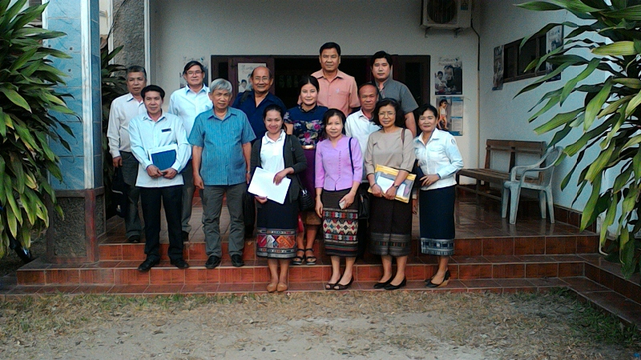
Photo of Monitoring Team
Provincial Health Department

Slide 20
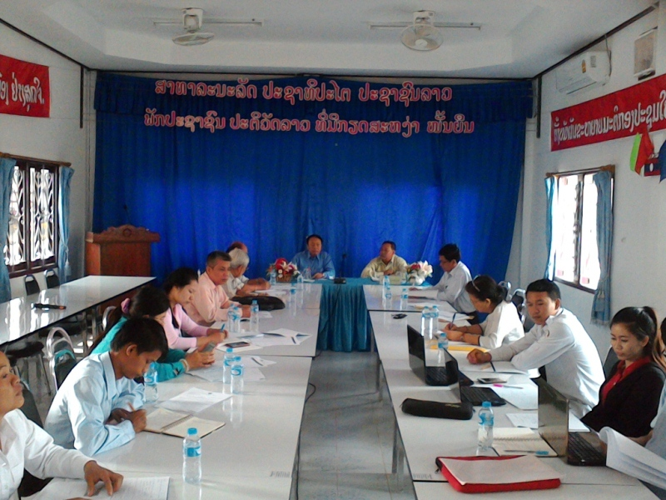
Health Office of Pakkading District

Slide 21
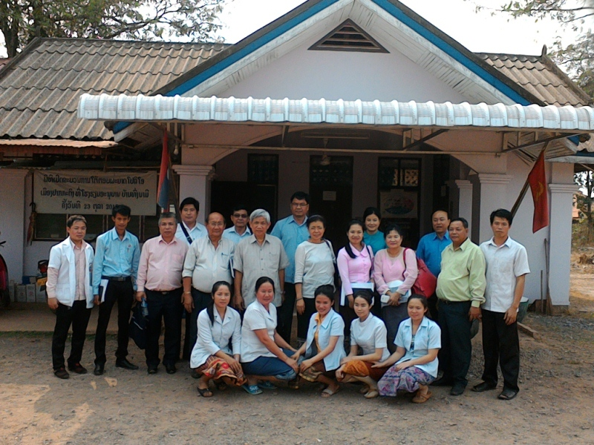
Nam Thone Health Center

Slide 22
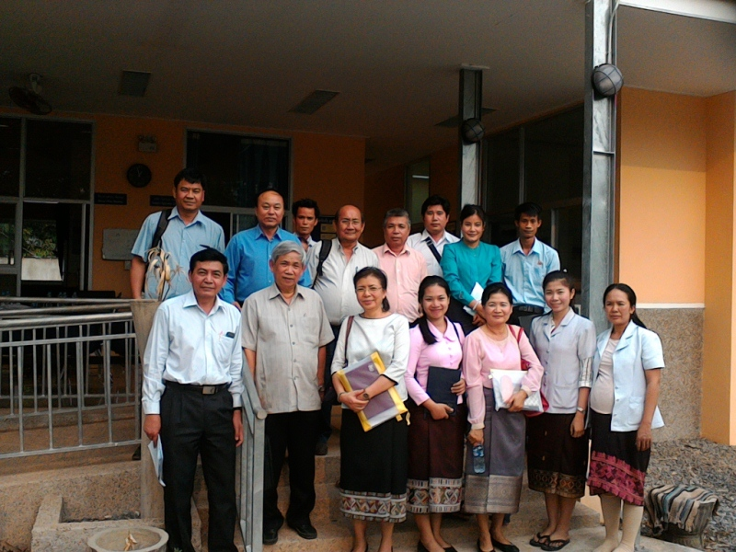
Pakkading Health Center

Slide 23
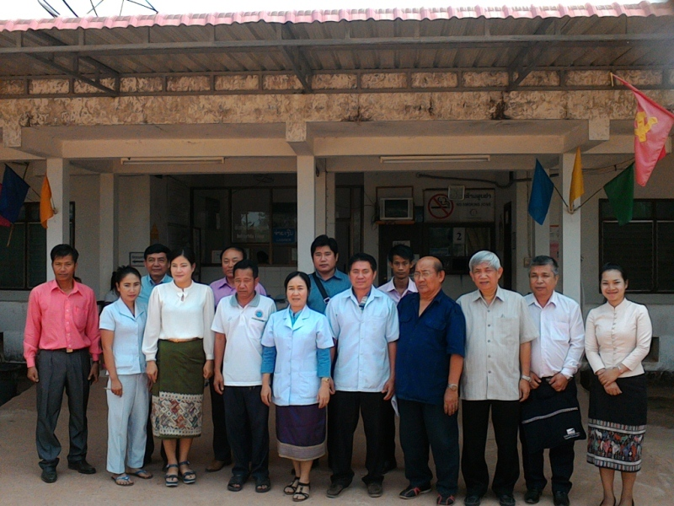
Health Office/Hospital of Thaphabaht District

Slide 24
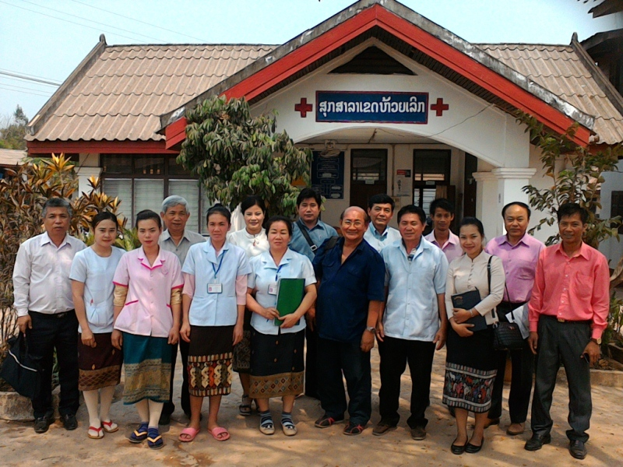
Houy Leuk Health Center

Slide 25
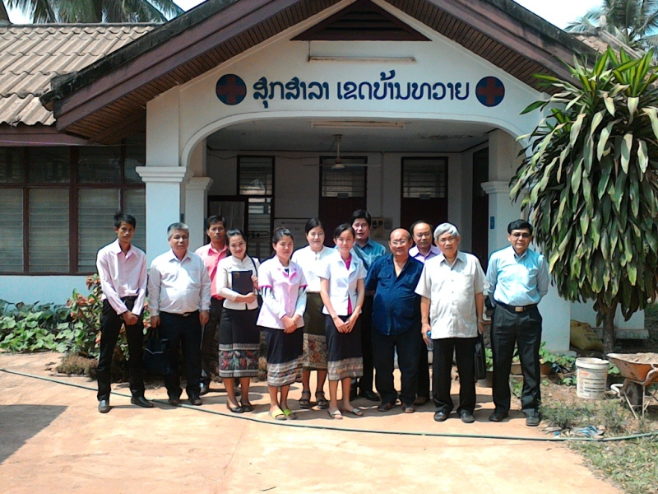
Ban Thouy Health Center

Slide 26
Thanks: Provincial Health Department, BLX Prov. Health Office of Pakkading Dist. Nam Thone Health Center, Pakkading Health Center, Health Office and Hospital of Thaphabath District, Houy Leuk Health Center Ban Thouy Health Center All participatants

