Slide 1
C19RM Progress Update DPC, MOH, Lao PDR
Prepared by: DPC, GF-C19RM Team
LAO-C-MOH for COVID-19 Response Mechanism Project
March 25, 2022

Slide 2
Project Progress Update
Received grant funds from GF on November 23, 2021 in the amount of US$ 2,654,356.26.
Completed opening bank account for PR and each SR on December 22, 2021 and updated into MOU signed between PR and each SR, and sent to GF on December 23, 2021.
Completed transferring C19RM activities budget to all SRs for Q3 & Q4 on December 28, 2021 and January 27, 2022, as well as Q5 on March 21, 2022 (Only PEDA, ALP+ and LWU not transfer yet).
Completed 1st Quarterly Meeting with 12 SRs on January 20, 2022.
Completed C19RM Progress Update Meeting with GF on February 3, 2022.
Submitted Government Co-financing Commitment Letter to GF on February 11, 2022.
Completed sending the PPE data to GF after received information from MPSC in 4 times (1st and 2nd time on December 10 & 24, 2021, 3rd time on February 14, 2022, and 4th time on March 4, 2022).
Completed Meeting with GF to discuss on Government Co-financing on March 24, 2022.
Completed purchase COVID-19 Ag Rapid Test Device (6.680 sets (25 kit, set = 167.000), and distributed to the target provinces on December 7, 2021.
Completed Procurement of GX C19 Xpress SARS-COV-2, Test kit, 10.000 test.
All procurements related to each SR are now on-going process.

Slide 3
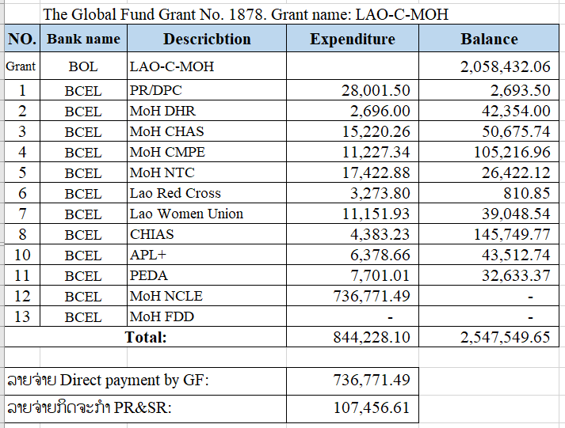
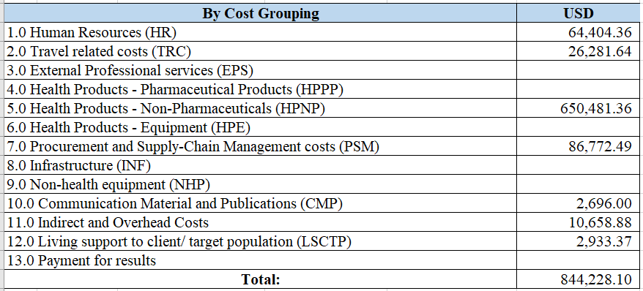
Project Progress Update, (Cont.).
The total fund received from GF in the amount of 2,654,356.25 USD and already used for the Project Implementation as detailed in the table below:

Slide 4
Next Step
Meeting with GF to discuss about revised 2022-2023 work plan and reprogramming on the TB, HIV, and malaria activities on March 28, 2022.
Submit revised 2022-2023 work plan and reprogramming on the TB, HIV, and malaria activities to GF on April 30, 2022 based on GF notice on March 17, 2022.
2nd Quarterly Meeting with 12 SRs on 3rd week of April, 2022.
Transfer C19RM activities budget to 3 SRs for Q5 (PEDA, ALP+ and LWU).
Follow up all procurements related to each SR which is now on-going process.

Slide 5
2022 Work Plan

Slide 6
Thank You!

