Slide 1
National TB Center (NTC) Progress of HANSA Project Implementation-DLI-J
Ad-hoc CCM plenary Meeting on 26 October 2023

Slide 2
Contents
Progress of HANSA1 Project Implementation-DLI-J (TB) 2021-2023
Co - financing period 2018- 2020 and 2021- 2023

Slide 3
Progress of HANSA1 Project Implementation –
DLI-J (TB) 2021-2023

Slide 4
HANSA1 project DLI-J TB- condition 1: TB notification targets and achievements
Y1 Jan 2021-May 2021
Y2 Jun 2021-May 2022
Y1 Jun 2022- May 2023

Slide 5
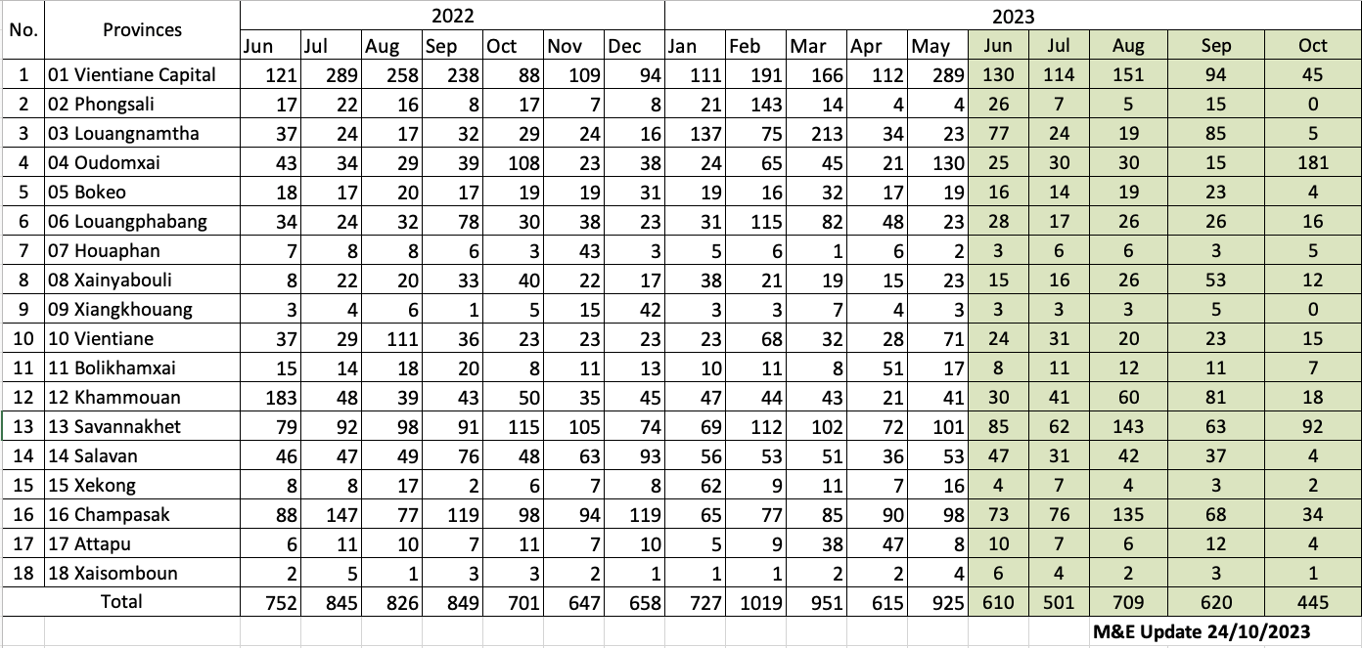
TB DLI-J Condition 1: Y3 achievement by provinces
DLI J Indicator 1: Number of notified TB cases of all forms (i.e. bacteriologically confirmed and clinically diagnosed new and relapse cases) HANSA 1 Year 3 (Jun 2022 – May 2023)

Slide 6
HANSA1 project DLI-J TB- condition 2: GeneXpert coverage targets and achievements
Condition2: Proportion (%) of presumptive TB or MDR‐TB patients examined by GeneXpert (source: DHIS2)
99,5 %
99 %

Slide 7
GeneXpert testing for Routine and ACF Presumptive TB Jan 2021 to May 2023

Slide 8
Co - financing period
2018-2020 and 2021-2023

Slide 9
Government Co- financing committed and expended overview ( in USD) 2018 -2020
Program | Co- financing 2018 - 2020
 | 2018 |  | 2019 |  | 2020 |  | 2018 - 2020
 | Committed | Expended | Committed | Expended | Committed | Expended | Committed | Expended
Tuberculosis | 782,194 | 432,675 | 401,096 | 514,388 | 620,136 | 456,339 | 1,803,426 | 1,403,402

Slide 10
Government Co- financing committed and expended overview ( in USD) 2021 -2023
Program | Co- financing 2021 - 2023
 | 2021 |  | 2022 |  | 2023 |  | 2021 - 2023
 | Committed | Expended | Committed | Expended | Committed | Expended | Committed | Expended
Tuberculosis | 157,688 | 109,900 | 476,142.40 | 285,088.11 | 658,232.11 | 577,494.42 | 1,292,062.51 | 972,482.53

Slide 11
ຂອບໃຈ

