Slide 1
RAI3E Malaria Update for December 2021 CCM ExCom
15 March 2022

Slide 2
Presentation outline
Program overall indicators and results
CSOs indicators and results
DPC-HIS, MPSC and WHO indicators and results
Budget vs. expenditure by each SR

Slide 3
1. Program overall indicators and results

Slide 4
1. Program overall indicators and results
Impact indicators
Outcome indicator
Coverage indicators
Inpatient malaria deaths
Malaria test positivity rate
API
Reported malaria cases
ABER
LLINs continuous distribution
# testing in all sectors
% treated in all sectors
% case investigated within 3 days
% foci investigated within 7 days

Slide 5
Impact indicators

Slide 6
1. Program overall indicators and results
Impact indicator 1 - Inpatient malaria deaths
Death case: Nong district, Savannakhet Province on September 2021
Target (Jan-Dec 2021) | Result (Jan-Dec 2021) | Achievement | Grant rating
0 | 1 | Target not achieved | Not relevant

Slide 7
1. Program overall indicators and results
Impact indicator 2 - Malaria test positivity rate
Target (Jan-Dec 2021) | Result (Jan-Dec 2021) | Achievement | Grant rating
0.59% | 0.61% | Target not achieved | Not relevant
Zero positivity rate (No case found)
Phongsaly Luangnamtha Oudomxay Bokeo Huaphanh Xayaboury
Highest positivity rate by province
Province | Positivity Rate 2021 | Positivity rate 2020 | % changed (2021 vs 2020)
Attapeu | 1.67 | 2.06 | -19%
Sekong | 1.15 | 1.33 | -14%
Savannakhet | 0.65 | 0.43 | 51%
Khammouane | 0.56 | 1.04 | -46%
Saravane | 0.51 | 0.35 | 46%
Malaria positivity rate = total positive / total testing

Slide 8
1. Program overall indicators and results
Impact indicator 3 - Annual Parasite Incidence (API)
Target (Jan-Dec 2021) | Result (Jan-Dec 2021) | Achievement | Grant rating
1.596 | 1.308 | Target achieved | Not relevant
Zero positivity rate (No case found)
Phongsaly Luangnamtha Oudomxay Bokeo Huaphanh Xayaboury
Highest API by province
Province | API all species
Attapeu | 12.224
Sekong | 9.304
Saravane | 1.370
Savannakhet | 1.366
Khammouane | 1.158
Remark: Cannot compare % changed between 2020 and 2021 as denominator is different (2020: Total pop vs 2021 Pop at risk)
API = Total positive / Pop at risk

Slide 9
1. Program overall indicators and results
Impact indicator 4 - Reported malaria cases
Target (Jan-Dec 2021) | Result (Jan-Dec 2021) | Achievement | Grant rating
3,768 | 3,924 | Target not achieved | Not relevant
Area | All species | Pf & mixed | Pv
Central and North | 149 | 55 | 94
South | 3,775 | 1,310 | 2,465
Country level | 3,924 | 1,365 | 2,559
Species | 2021 | 2020 | % changed
Pf & mixed | 1,365 | 1,605 | -15%
Pv | 2,559 | 1,919 | 33%

Slide 10
Outcome indicator

Slide 11
1. Program overall indicators and results
Outcome 1 - Annual blood examination rate (ABER)
Target (Jan-Dec 2021) | Result (Jan-Dec 2021) | Achievement | Grant rating
27.26 | 21.48 | Target not achieved | Not relevant
Highest ABER by province
Province | ABER 2021 | ABER 2020 | % changes
Houaphanh | 184.99 | 151.05 | 22%
Sekong | 80.87 | 78.4 | 3%
Attapeu | 73.25 | 62.46 | 17%
Luang Namtha | 66.27 | 82.1 | -19%
Bokeo | 64.02 | 60.15 | 6%
Lowest ABER by province
Province | ABER 2021 | ABER 2020 | % changes
Vientiane. C | 0.67 | 1.02 | -35%
Phongsaly | 7.03 | 11.67 | -40%
Bolikhamxay | 7.51 | 4.92 | 53%
Xaysomboun | 7.99 | 3.98 | 101%
Vientiane. P | 9.13 | 9.97 | -8%
ABER = Total testing*100 / Pop at risk

Slide 12
Coverage indicators

Slide 13
1. Program overall indicators and results
Coverage indicator 1 - LLINs continuous distribution
Target (Jan-Dec 2021) | Result (Jan-Dec 2021) | Achievement | Grant rating
99,605 | 38,137 | 38.29% | B2
Type | Amount | Remark
Pregnant woman | 23,543 | 25,000 was the target for pregnant women (To be discussed why target is not achieved in the discussion slide)
Covid19 | 14,594 | Supported by C19RM
Total | 38,137
Remark: No MMP/Military distribution as planned because RAI3E net not received as per delayed procurement.

Slide 14
1. Program overall indicators and results
Coverage indicator 2 - Testing in all sectors
Target (Jul-Dec 2021) | Result (Jul-Dec 2021) | Achievement | Grant rating
353,842 | 369,472 | 104.42% | A1
Area | # Testing (Jul-Dec 21) | % against total
South | 308,138 | 83%
Central and north | 61,334 | 17%
Total | 369,472
Sector | # Testing (Jul-Dec 21) | # Testing (Jul - Dec 20) | % changed
All sectors testing | 369,472 | 314,405 | 18%
Sector name | Target | Result | % achievement
Public sector | 240,614 | 224,047 | 93%
Community sector | 76,540 | 109,312 | 143%
Private sector | 38,926 | 36,113 | 93%
Total – all sectors | 356,080 | 369,472 | 104%
Remark: 356,080 is total target from new testing target calculation to be achievement by each partner/province

Slide 15
1. Program overall indicators and results
Coverage indicator 2 - Testing in all sectors (All sectors)
Testing by province | Target | Result | % achievement
01 PHO Vientiane. C | 2,573 | 1,374 | 53%
02 PHO Phongsaly | 6,557 | 4,667 | 71%
03 PHO Luangnamtha | 3,975 | 3,715 | 93%
04 PHO Oudomxay | 5,951 | 5,696 | 96%
05 PHO Bokeo | 2,441 | 2,183 | 89%
06 PHO Luangprabang | 9,466 | 6,441 | 68%
07 PHO Huaphanh | 4,134 | 3,660 | 89%
08 PHO Xayabury | 4,279 | 4,159 | 97%
09 PHO Xiengkhuang | 4,742 | 4,823 | 102%
10 PHO Vientiane. P | 9,627 | 6,107 | 63%
11 PHO Borikhamxay | 3,991 | 4,850 | 122%
Testing by province | Target | Result | % achievement
12 PHO Khammuane | 13,241 | 12,391 | 94%
13 PHO Savannakhet | 63,964 | 73,901 | 116%
14 PHO Saravane | 55,654 | 61,785 | 111%
15 PHO Sekong | 27,833 | 40,561 | 146%
16 PHO Champasack | 92,201 | 77,690 | 84%
17 PHO Attapeu | 44,619 | 54,201 | 121%
18 PHO Xaysomboun | 832 | 1,268 | 152%
Total | 356,080 | 369,472 | 104%

Slide 16
1. Program overall indicators and results
Coverage indicator 2 - Testing in all sectors (Public sectors)
Testing by province | Target | Result | % achievement
01 PHO Vientiane. C | 2,573 | 1,374 | 53%
02 PHO Phongsaly | 4,434 | 3,242 | 73%
03 PHO Luangnamtha | 2,860 | 2,323 | 81%
04 PHO Oudomxay | 5,876 | 5,601 | 95%
05 PHO Bokeo | 2,441 | 2,183 | 89%
06 PHO Luangprabang | 8,398 | 6,071 | 72%
07 PHO Huaphanh | 4,134 | 3,660 | 89%
08 PHO Xayabury | 3,221 | 3,521 | 109%
09 PHO Xiengkhuang | 4,742 | 4,823 | 102%
10 PHO Vientiane. P | 9,627 | 6,107 | 63%
11 PHO Borikhamxay | 3,991 | 4,850 | 122%
Testing by province | Target | Result | % achievement
12 PHO Khammuane | 11,566 | 10,603 | 92%
13 PHO Savannakhet | 34,259 | 42,314 | 124%
14 PHO Saravane | 28,321 | 27,616 | 98%
15 PHO Sekong | 20,639 | 16,620 | 81%
16 PHO Champasack | 57,290 | 39,805 | 69%
17 PHO Attapeu | 35,485 | 42,104 | 119%
18 PHO Xaysomboun | 757 | 1,230 | 162%
Total | 240,614 | 224,047 | 93%

Slide 17
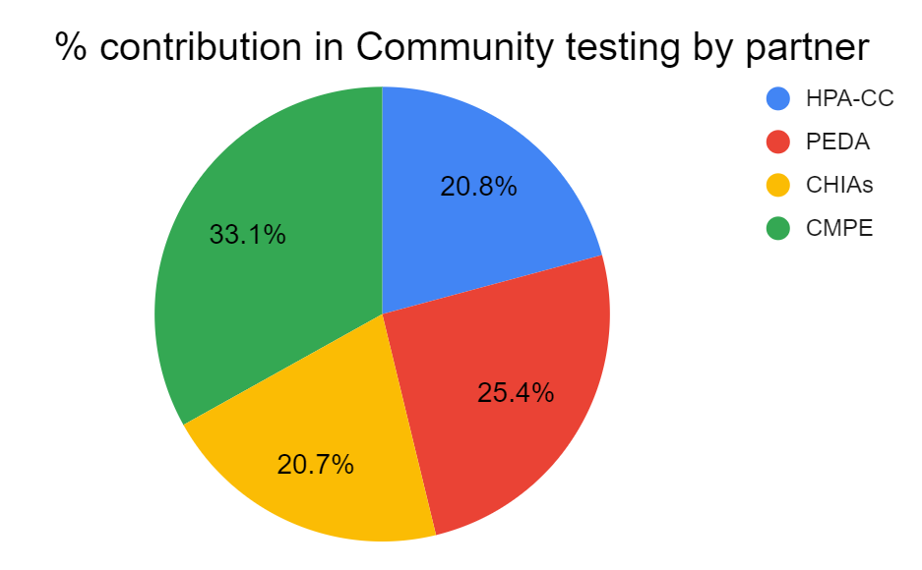
1. Program overall indicators and results
Coverage indicator 2 - Testing in all sectors (Community sectors)
Partner name | # tested | % contribution | # of VMWs | tests/ VMW/ month | % achievement against the target
HPA-CC | 22,748 | 20.8% | 400 | 9 | 155%
PEDA | 27,758 | 25.4% | 400 | 12 | 190%
CHIAs | 22,626 | 20.7% | 400 | 9 | 155%
CMPE | 36,180 | 33.1% | 999 | 6 | 122%
Total | 109,312 | 100% | 2,199 | 8 | 143%

Slide 18
1. Program overall indicators and results
Coverage indicator 2 - Testing in all sectors (Private sectors)
Testing by province | Target | Result | % achievement
02 PHO Phongsaly | 348 | 163 | 47%
03 PHO Luangnamtha | 1,115 | 1,392 | 125%
06 PHO Luangprabang | 418 | 58 | 14%
08 PHO Xayabury | 1,058 | 638 | 60%
13 PHO Savannakhet | 11,643 | 8,811 | 76%
14 PHO Saravane | 6,439 | 6,230 | 97%
15 PHO Sekong | 1,852 | 5,364 | 290%
16 PHO Champasack | 12,525 | 10,847 | 87%
17 PHO Attapeu | 3,528 | 2,610 | 74%
Total | 38,926 | 36,113 | 93%
Total reported PPM: 447

Slide 19
1. Program overall indicators and results
Coverage indicator 3 - Treatment in all sectors
Target (Jul-Dec 2021) | Result (Jul-Dec 2021) | Achievement | Grant rating
100% | 100% | 100% | A2
Area | # of positive cases | % of total positive cases
Southern provinces | 2,432 | 97%
Central and Northern provinces | 73 | 3%
Total | 2,505
 | Result 2020 (Jul-Dec) | Result 2021 (Jul-Dec) | % change
positivity rate | 0.8% | 0.7% | -11.7%
Pf & mixed % | 50.6% | 27.0% | -46.6%
Pv % | 49.4% | 73.0% | 47.8%
3% increase in positive cases compare to Jul-Dec 2020 (#2,432)

Slide 20
1. Program overall indicators and results
Coverage indicator 4 - % case investigation within 3 days
Target (Jul-Dec 2021) | Result (Jul-Dec 2021) | Achievement | Grant rating
75% | 85.71% | 114% | A1
Province | Total Positive | # Case Investigation done within 3 days | % Case Investigation done within 3 days
06 Louangphabang | 1 | 0 | 0.00%
09 Xiangkhouang | 1 | 0 | 0.00%
12 Khammouan | 70 | 68 | 97.00%
13 Savannakhet | 11 | 8 | 73.00%
14 Salavan | 1 | 1 | 100.00%
15 Xekong | 1 | 1 | 100.00%
16 Champasak | 19 | 10 | 53.00%
18 Xaisomboun | 1 | 1 | 100.00%
Total | 105 | 90 | 85.71%

Slide 21
1. Program overall indicators and results
Coverage indicator 5 - % foci investigation within 7 days
Target (Jul-Dec 2021) | Result (Jul-Dec 2021) | Achievement | Grant rating
78% | 72% | 92% | A2
Province | # Indigenous Case | # Foci | # Foci investigated and responded within 7 days | % Foci investigation and responded within 7 days
12 Khammouan | 64 | 22 | 16 | 73%
13 Savannakhet | 3 | 3 | 3 | 100%
15 Xekong | 1 | 1 | - | 0%
16 Champasak | 1 | 1 | - | 0%
18 Xaisomboun | 1 | 1 | 1 | 100%
Total | 71 | 29 | 21 | 72%

Slide 22
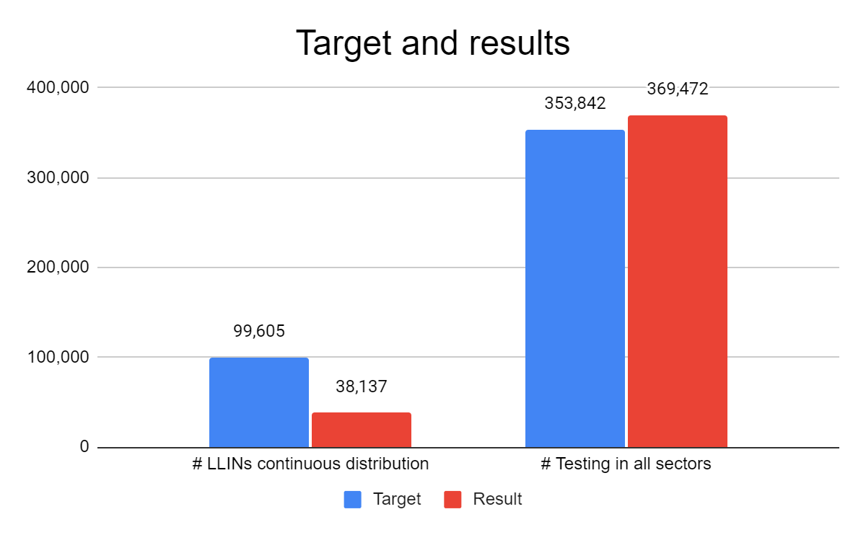
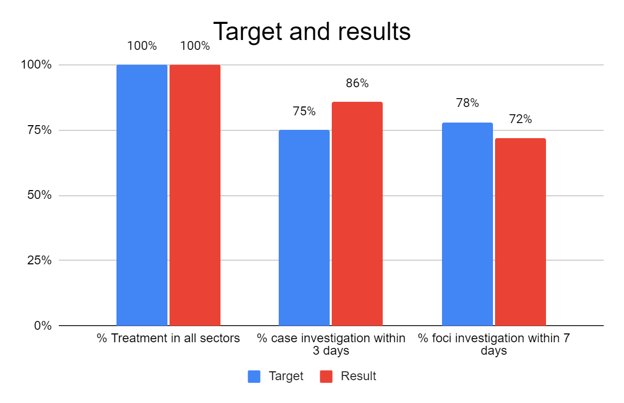
1. Program overall indicators and results
Summary

Slide 23
1. Program overall indicators and results
Grant rating: RAI3E Laos Jul-Dec 2021
Indicator | Grant Rating
# LLINs continuous distribution | B2
# Testing in all sectors | A1
% Treatment in all sectors | A2
% case investigation within 3 days | A1
% foci investigation within 7 days | A2
Jul-Dec 2020 : Overall grant rating: B1
Jan-Jun 2021: Overall grant rating: B1
Reference
Rating | % achievement
A1 | > 100%
A2 | 100 - 90%
B1 | 60 - 89%
B2 | 30 - 59%
C | < 30%
Overall grant rating Jul-Dec 2021 | B1

Slide 24
2. CSOs indicators and results

Slide 25
2. CSOs indicators and results
9 Indicators/CSO
# testing
% treated
% Pv referral
% no RDT stock out
% no ACT 6x4 stock out
# VMW trained on ICCM
% functioning VMW
# supervision
# staff trained on PSEA

Slide 26
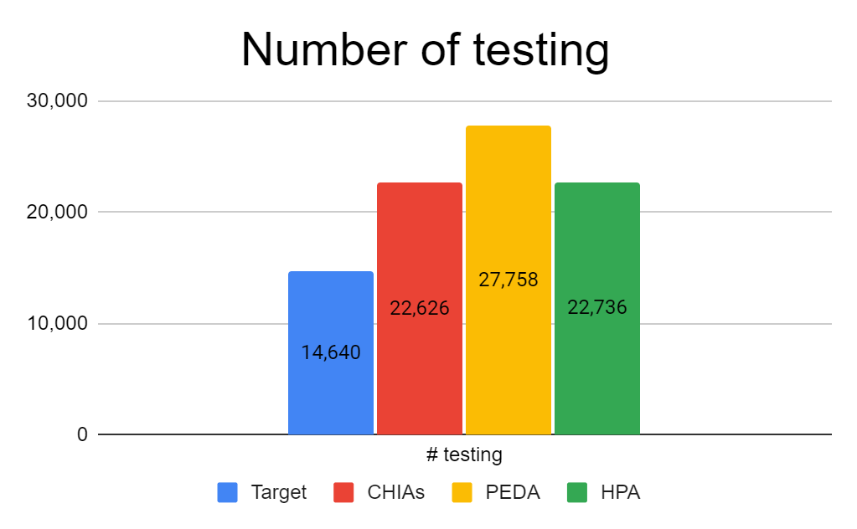
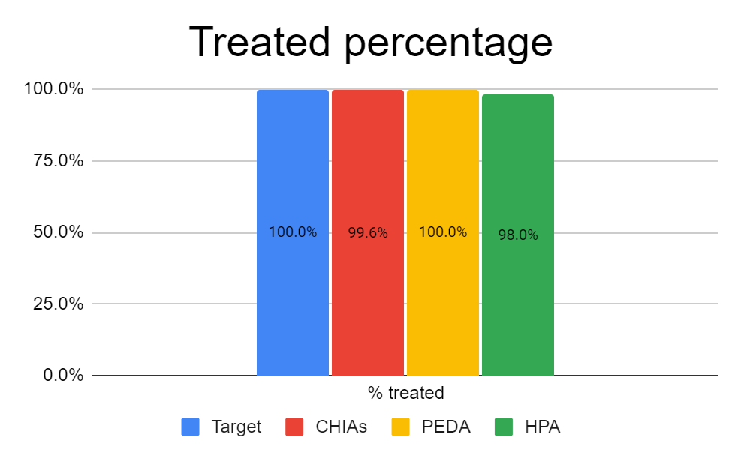
2. CSO indicators and results

Slide 27
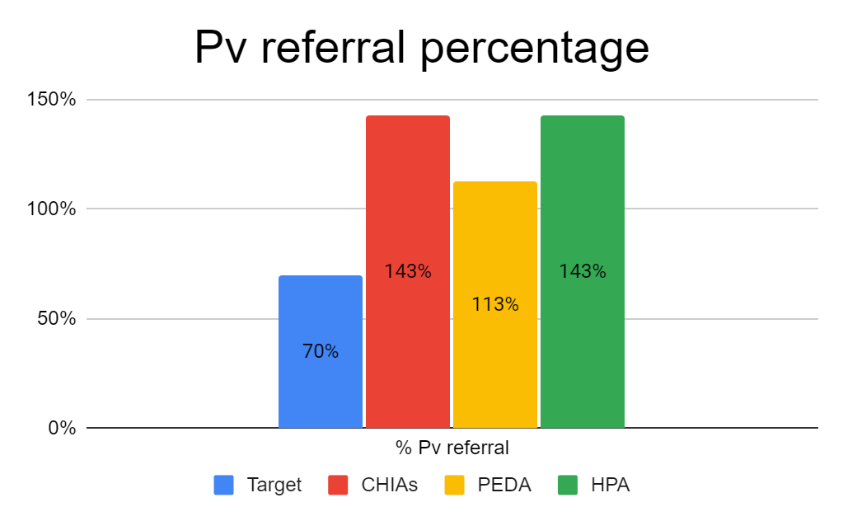
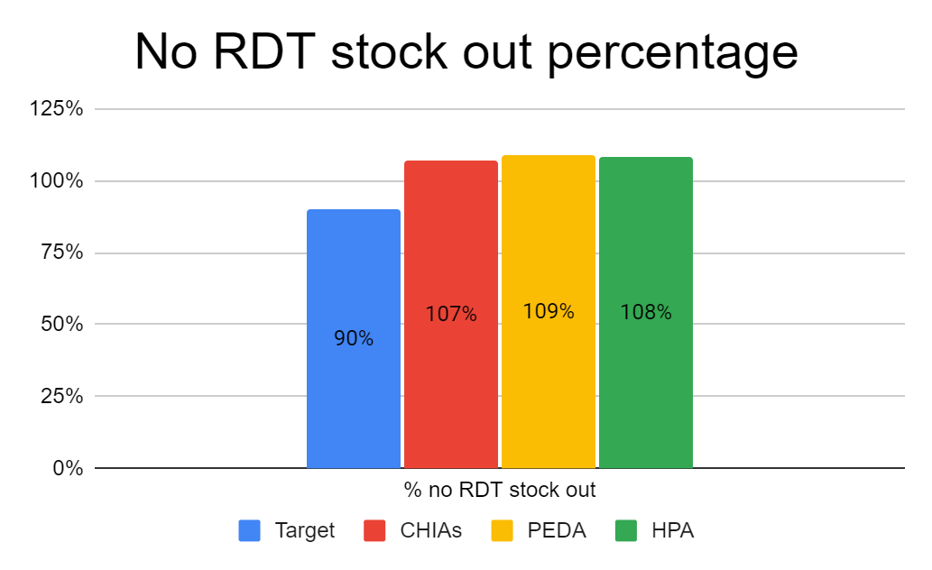
2. CSO indicators and results

Slide 28
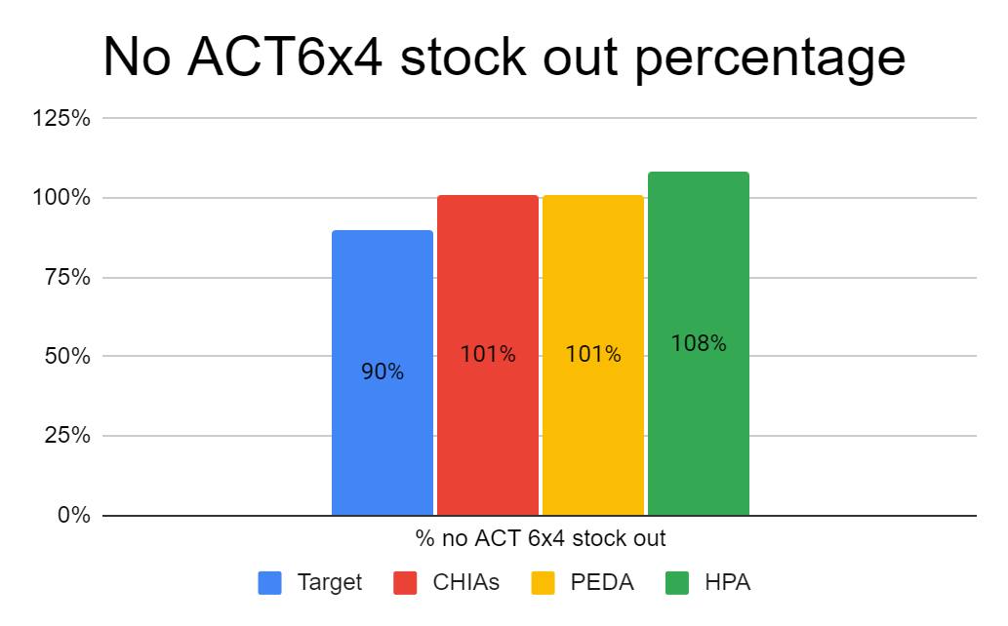
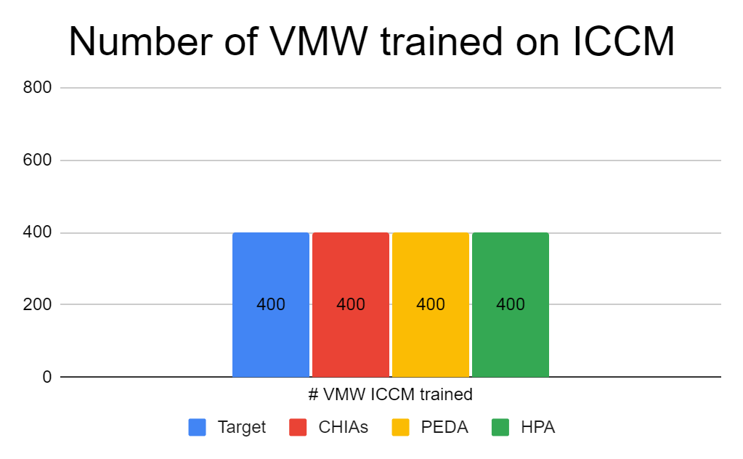
2. CSO indicators and results

Slide 29
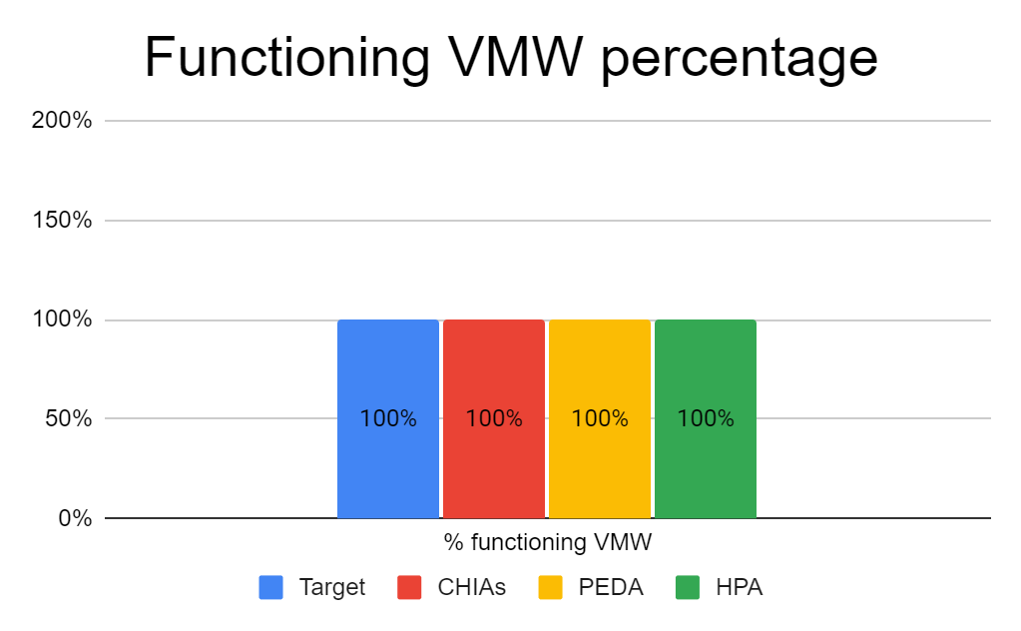
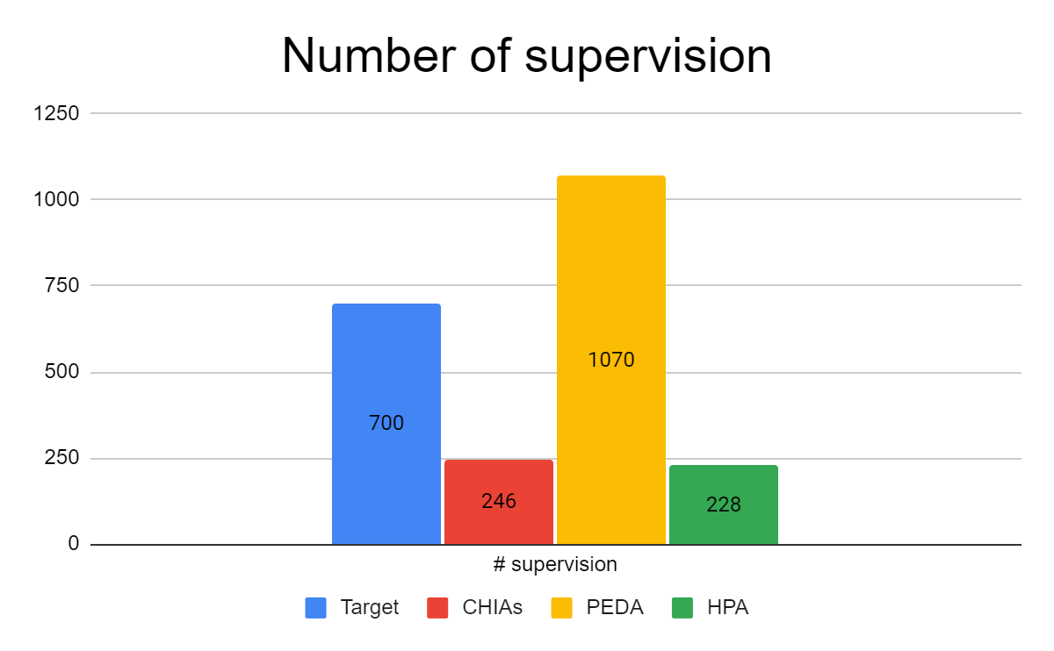
2. CSO indicators and results

Slide 30
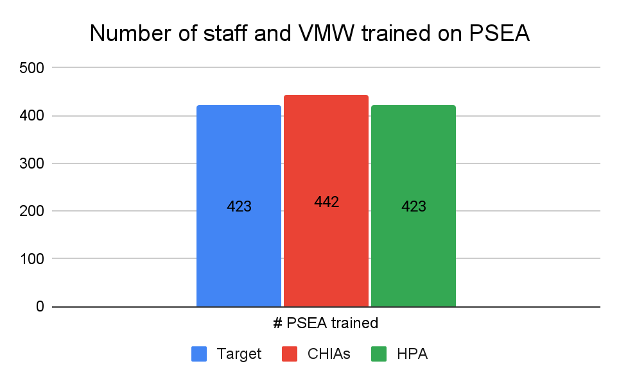
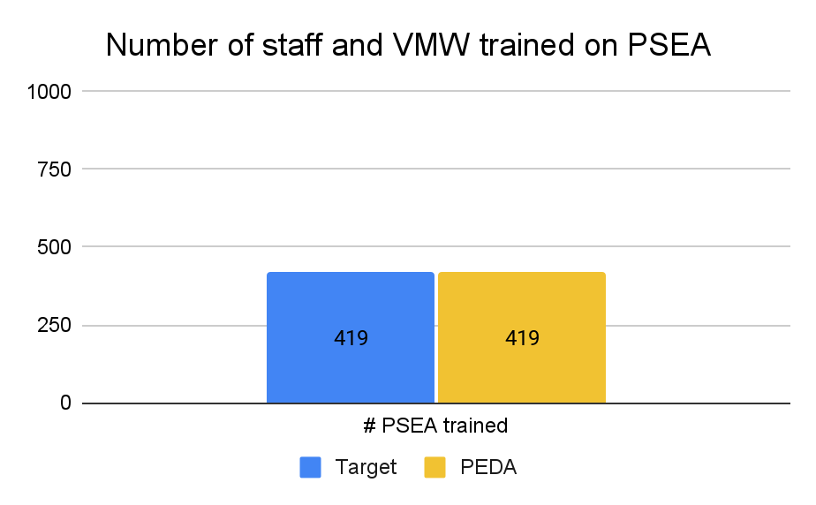
2. CSO indicators and results

Slide 31
3. DPC-HIS, WHO and MPSC indicators and results

Slide 32
3. DPC-HIS, MPSC and WHO indicators and results
DPC-HIS
MPSC
Key Activities |  |  | Milestones/Targets |  |  | Progress |  | Reasons for Programmatic deviation and any other comments
Generate annual health statistic report |  |  | Annual health statistics report for 2020 is finalized and disseminated |  |  | Advancing (2) |  | The draft report is finalized and currently processing the endorsement from the Minister. Finalization was delayed due to Covid 19 and prolonged stakeholder consultation to finalize the analysis of 5 year data (for the HDP VIII 2016-2020) and for increased number of indicators being reported from 34 to 50.
Key Activities |  |  | Milestones/Targets |  |  | Progress |  | Reasons for Programmatic deviation and any other comments
Establish functioning electronic web-based stock recording and reporting system |  |  | 85 % of the health facilities rolled out with integrated PSM program for inventory management is functioning |  |  | Completed (3) |  | 98.3% of the sites (184 out of 187 sites) with mSupply is functioning. Health facilities are using eLMIS properly, but we are facing some issue on using mSupply system such broken computers and Staff transition.
Train health staff on PSM system strengthening |  |  | PSM strengthening training is conducted for staff from Xiengkhoung, Houphan ( 21 health facilities province and district level) |  |  | Started (1) |  | Xiengkhoung province completed, Houphan province COVID-19 outbreak this activites will be implementing in Q1/2022. 9 health facilities in Xiengkhoung province received training. All relevant staff were trained

Slide 33
3. DPC-HIS, MPSC and WHO indicators and results
3. WHO
Indicators | Target | Result | Achievement | Remark
Number of surveillance trainings conducted by CMPE with the support from WHO TAs | 2 | 2 | 100%
Number of ICCM trainings conducted by CMPE with the support from WHO TAs | 2 | 2 | 100%
Malaria restratification completed with the support of WHO TAs | 2 | 2 | 100%
Malaria restratification completed with the support of WHO TAs | 1 | 0 | 0 | The stratification exercise which was planned for Q4 2021 was postponed until Q1 2022. This change was due to both inability for the program and partners to meet face to face which is important for in depth collaborative exercises such as this, and also the decision that a full set of annual data from 2021 would benefit the analysis and restratification work.

Slide 34
4. Budget vs. expenditure

Slide 35
4. Budget vs. expenditure Jan – Dec 2021 – Summary by SR
Implementer | Budget 2021 | Expenditures 2021 | Currency Gain/Loss 2021 | Net Savings 2021 | Burn Rate | Note
CMPE | $2,363,265 | $1,645,897 | $242,553 | $474,815 | 80% | Detail on next slide
CHIas | $288,531 | $255,067 | $31,361 | $2,103 | 99%
HPA | $366,905 | $302,356 | $47,392 | $17,157 | 95%
PEDA | $295,080 | $263,505 | $30,706 | $869 | 100%
DCDC | $39,044 | $32,577 | $3,228 | $3,239 | 92%
DPC | $87,840 | $63,554 | $6,287 | $17,999 | 80% | Production and Dissemination of Annual Statistical Report delayed to 2022
MPSC | $78,646 | $42,808 | $5,588 | $30,250 | 62% | Purchase computers delayed to 2022, trainings and supervision delayed or done online
WHO | $523,699 | $387,645 |  | $136,054 | 74% | HIS TA Carry Over to 2022
TOTAL | $4,043,010 | $2,993,409 | $367,115 | $682,486 | 83%

Slide 36
4. Budget vs. expenditure Jan – Dec 2021 – CMPE Detail
Category | Main Source of Budget Balance (2021) | Note
Procurement | $220,797 | $152K – Savings from nets for continuous distribution (not procured) $68K – Savings from other procurement
PF Accelerator Activities | $48,859 | Activities delayed (carry over to 2022)
Other Activities | $203,619 | $60K – Savings from meetings/trainings done online $128K – Delayed ICCM and Surveillance trainings (Carry Over to 2022) $9K – iDES not done $5K – PV Referral not implemented
TOTAL | $473,275

Slide 37
4. Budget vs. expenditure Jan – Dec 2021 – Carry Over and Net Savings
Implementer | Net Savings 2021 | Carry over to 2022 | Savings after Carry Over | Note
CMPE | $474,815 | $230,401 | $244,414 | Carry Over to 2022 for delayed ICCM and Surveillance trainings, PF Accelerator Activities, Annual Meeting, other outstanding advances
CHIas | $2,103 | $2,103 | $0
HPA | $17,157 | $14,340 | $2,817
PEDA | $869 |  | $869
DCDC | $3,239 |  | $3,239
DPC | $17,999 | $11,079 | $6,920 | Production and Dissemination of Annual Statistical Report delayed to 2022
MPSC | $30,250 | $12,902 | $17,348 | Purchase computers delayed to 2022, trainings and supervision delayed or done online
WHO | $136,054 | $134,164 | $1,890 | HIS TA Carry Over to 2022
TOTAL | $682,486 | $404,989 | $277,497

Slide 38
Thank You!

